Slide 1
Improving Performance & Efficiency of 35011 General Steam Navigation
Dr Steve Rapley
Chief Mechanical Engineer
35011 General Steam Navigation Locomotive Restoration Society
16th October 2022

Slide 2
Contents
Introduction
  Who I am
  Who GSNLRS are, & what our aims are
Issues with the original design & how we’re addressing them
  Crank axle failure
  Drifting exhaust
  Low performance efficiency (including How to perform locomotive exhaust CFD)
Questions?

Slide 3
About me
Chartered Engineer, Member of the Institution of Mechanical Engineers, Professional Aerodynamicist
BSc in Mathematics (with Study in Europe), MSc in Theoretical and Applied Fluid Mechanics, PhD from the School of Mechanical, Materials & Manufacturing Engineering at the University of Nottingham
15 years professional experience working for Rolls-Royce plc. & Bladon Micro Turbine
  6 years at Rolls-Royce Submarines
    CFD of the PWR
    CFD of the Steam Generator
  6 years at Rolls-Royce Fuel Cell Systems
    heavily focused on CFD analysis of ejectors, building up a wealth of knowledge of how to analyse these
    Predominantly single nozzle designs, though some work on multi-nozzle oblong ejectors
  3 years at Bladon Micro Turbine, Principal Aerodynamicist, leading the Aerothermal Team

Slide 4
About me
Life long interest in railways & steam locomotives
  Earliest memory of a steam locomotive 34092 City of Wells on the K&WVR
  Keen railway modeller, interested in the unusual.
Various heritage railway volunteer roles & memberships over the years
  Romsey Signal Box Project
  Great Central Railway (Nottingham)
  General Steam Navigation Locomotive Restoration Society
Member of GSNLRS since 2017
  Society put out an appeal for a CME in 2020
  I applied and was appointed to the role in September 2020

Slide 5
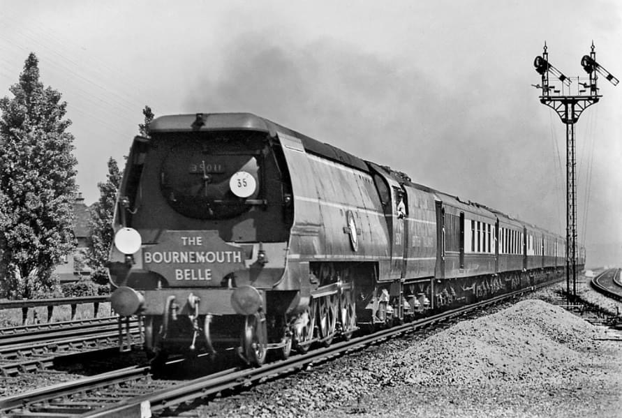
GSNCIC/GSNLRS Introduction
General Steam Navigation CIC
  Custodians of BR(S) Rebuilt Merchant Navy Pacific 35011 General Steam Navigation since 2016
  Supported by General Steam Navigation Locomotive Restoration Society
Aim of the project is to return 35011 to original design condition for mainline running
  Removing the 3 sets of Walschaerts valve gear & the inside-admission middle cylinder
  Refitting Bulleid’s chain driven valve gear & steam reverser
  Manufacturing a new middle cylinder to the original design with outside admission
  Manufacturing a new crank axle (35011 lost its axle before arrival in the scrap yard)
  Refitting the air-smoothed casing

Slide 6
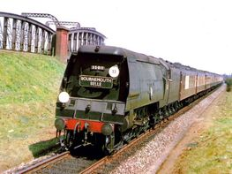
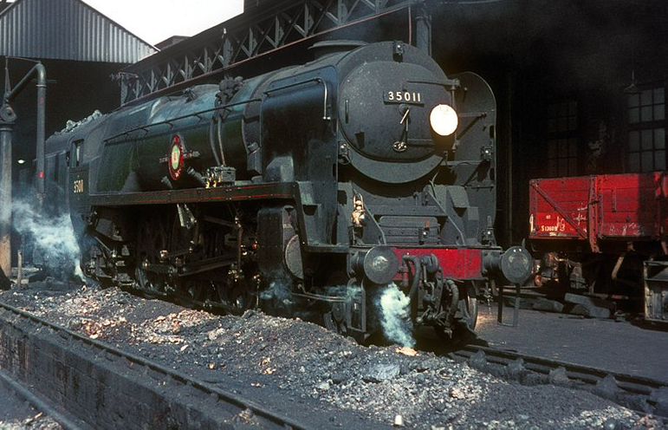
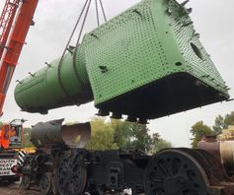
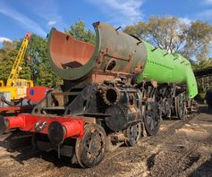
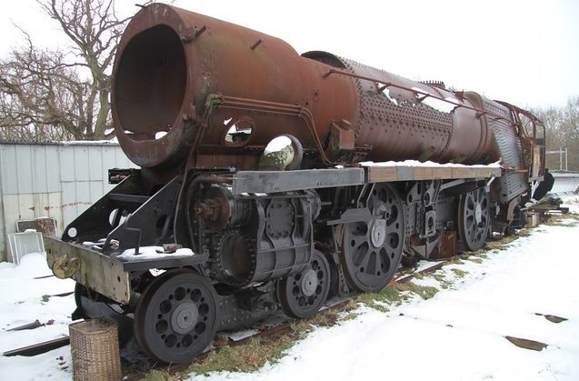
The life (so far) of 21c11…
Photos courtesy of A Cawston, Colour Rail, D Philips, D Beardmore &GSNCIC

Slide 7
Restoration progress
Moved locomotive from Sellindge to Blunsdon (Swindon & Cricklade Railway)
  Provides a base that is on a railway and more centrally located
Boiler lifted from frames and de-tubed
Trailing truck sent to North Norfolk Railway Engineering for restoration
Frames stripped of Walschaerts valve gear and other features added on rebuilding
Building up inventory of parts for boiler backhead
Purchased the vital steam reverser
Completed design work of replacement frame stretchers and new crank axle
Started design of new middle cylinder

Slide 8
Engineering-implementing modern working practises & techniques
Established Engineering Sub-committee to lead engineering efforts
Brought in safer working practices, reflecting the need for competencies within the volunteer workforce
Developing an electronic bill of materials, complete with drawings from the Bulleid Pacific Locomotives Association archive
Using Computer Aided Engineering to resolve issues with the original design
Founding member of Main Line Steam Builders Group

Slide 9
Issues with the 1944 Bulleid Merchant Navy design
Unbalanced Crank axle
  Spectacular failure of crank axle on 35020 Bibby Line at Crewkerne in 1953
Drifting exhaust
Poor fuel economy
  Minimum specific steam consumption 15-20% higher than comparable designs
Myths?
  Casing fires
  Tendency to slip

Slide 10
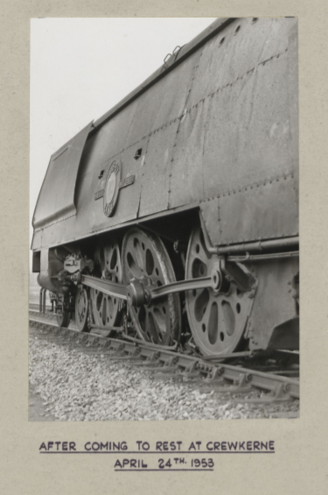
Crank axle failure
Crank axle on 35020 Bibby Line fractured at ~80MPH as the locomotive passed through Crewkerne station
  No derailment, no reported injuries, no fatalities
Entire Merchant Navy Class swiftly withdrawn for investigation
  Subsequent investigations showed failure was likely to occur on 20 out of 30 class members soon
  Light Pacifics showed no issues
Failure due to high stress on axle at speed due to unbalanced design
Axle initially redesigned to a larger diameter, unbalanced design, with onerous inspection regime, to return class to service
Latter balanced arrangement designed, first 6 balanced axles were fitted to original Merchant Navy locomotives, including 35011
  All rebuilt Bulleid pacifics received design on rebuilding.
  No original Light Pacifics ever fitted with design

Slide 11
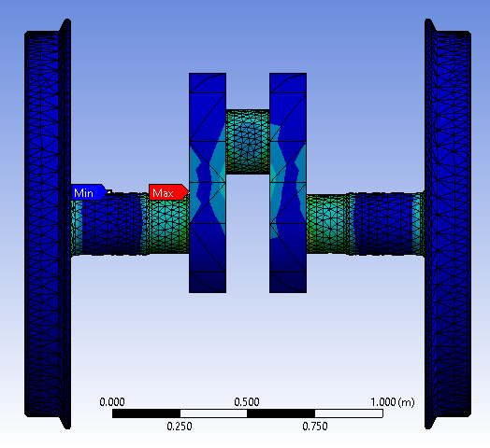
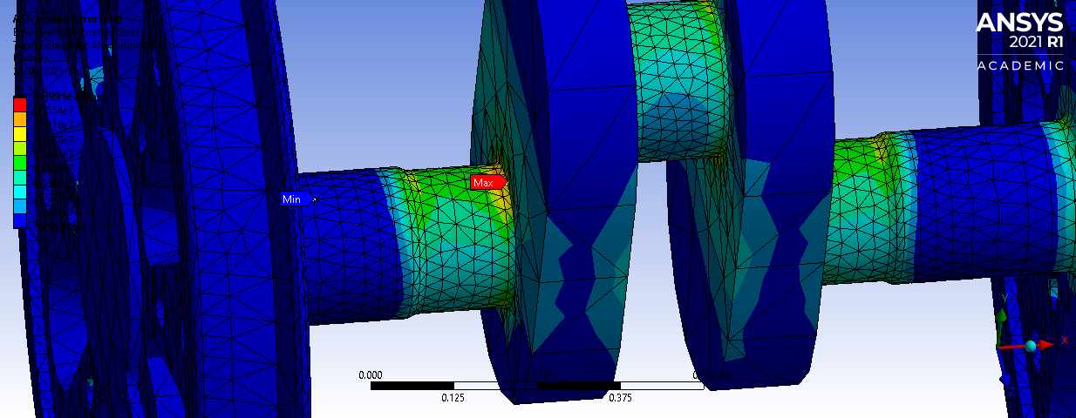
Crank axle Finite Element Analysis (Original Design)
Stress concentrations predictions on the original axle design
localised large stress concentration on the top edge of the boundary between the crank web and the axle piece.
High stress on the surrounding areas of both the axle piece and the crank web.
Stress patterns non-uniform, spreading from the epicentre of the stress on the top of the axle piece, in line with the orientation of the crank web.
Safety factor predictions indicate low safety factor at this location
Very close match with where the failure on 35020 occured

Slide 12
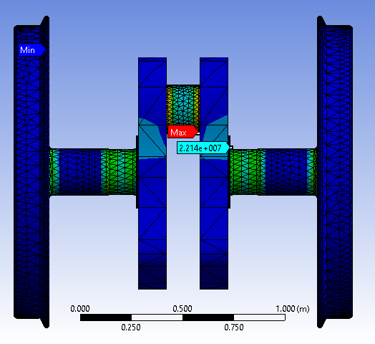
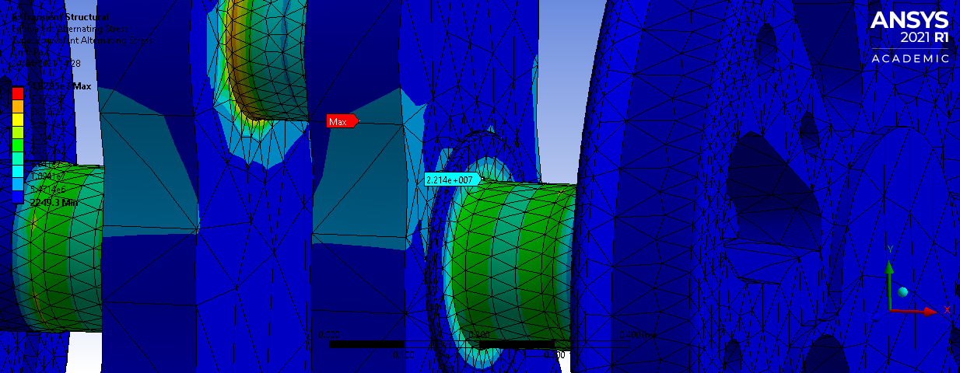
Crank axle Finite Element Analysis (Balanced design)
Stress concentrations predictions on the balanced axle design
Maximum stress is now found on central crank pin, rather than the axle piece.
The area of peak stress from the original design now only feels a stress of 23.5% of the stress felt there in the original design.
stress redistributed more evenly, resulting in consistent contours of stress around the circumference of the axle piece.
Infinite life predicted with both 1956 material (modern equivalent 945m38) A4T

Slide 13
Drifting exhaust: External aerodynamics CFD
Industrial tutor for final year Mechanical Engineering students CFD project at Loughborough University
Known issue with original Bulleid pacfic design regarding drifting exhaust obscuring crew forward visibility
Study conducted to explore options for improving conditions via:
  Extending duct around exhaust further back (10% improvement in visibility)
  Modifications to exhaust design (up to 50% improvement (?!))

Slide 14
Poor fuel economy: Internal Aerodynamics (H2 2020)
Industrial tutor for final year Mechanical Engineering students CFD project at Loughborough University
Projects split in to a group stage to develop methodology, then individual tasks
First attempt at project
  Error in geometry provided to students (smokebox oversized by about a foot)
  Only found one data set for validation prior to starting project (BR Performance & Efficiency Bulletin 10)
  Boundary conditions applied with hindsight not completely appropriate

Slide 15
Poor fuel economy: Internal Aerodynamics (H2 2020)
Flow structures for Bulleid-Lemaitre design.
Vast gap between nozzles and exhaust, compounded by geometrical error
Diffuser not working well
Incorrect boundary conditions make results from individual tasks not relevant for much read across

Slide 16
Poor fuel economy: Internal Aerodynamics (H2 2021)
Second attempt at project
  Attempted validation against bulletin 10 & bulletin 20
  Boundary conditions applied with hindsight not completely appropriate (still)
  Key result is CFD is not far off in prediction of performance variation between designs
  Results from individual tasks again not easy to read across due to incorrect boundary conditions

Slide 17
Poor fuel economy: Ejector simulation & design experience from RRFCS
At RRFCS most of our ejectors were single nozzle designs, based on the work of Kentfield & Barnes
Lots of CFD performed upon them
Two key takeaways:
  Very good resolution of the boundary layer vital for accurate simulations-targeting single digit wall y+ values, ideally with a surface average below 3.
  Vital to have good grid resolution along the primary flow path, using a separate domain/zone within the mesh to ensure this
    Prevents artificial numerical mixing of the primary and secondary flows
As our flow rates increased, we started looking at multiple ejectors in parallel, and then multi-nozzle ejector designs, inspired by steam locomotive exhaust designs (Giesl & Kylchap)
  Oblong ejectors with multiple parallel nozzles work if the flow area per primary nozzle is maintained the same as the ideal single-nozzle ejector (squaring the circle)

Slide 18
Locomotive Exhaust CFD
How should we do CFD analysis of a locomotive exhaust? Lessons learnt from Loughborough students & my experience

Slide 19
Validation before design
Validate your CFD methodology against a comparable design with some good test data
  BR Performance & Efficiency reports are a goldmine for this purpose
    Bulletin 8 gives good data for a single nozzle design
    Bulletins 10 & 20 give good data for multi-nozzle designs
    Bulletin 18 gives good data for a Giesl ejector
  Need good drawings of the components in question though-the less you know, the more errors you’re potentially introducing
Consider the impact of different turbulence models & approaches
A methodology that is consistent is a useful one. If it always underpredicts boiler airflow by 10%, for example, across multiple designs, you can have confidence that for any new design, the predicted airflow will be within 10% of reality. Or you can use it to rank designs

Slide 20
CFD Domain
Model air flow from exit of tubes to beyond the locomotive boundary
  Important to allow exhaust to function “properly”, terminating domain too soon will at best cause convergence issues, at worse artificially it will impact the predicted performance as the top of the exhaust won’t function normally.
Model steam flow from well upstream of nozzles
  Helps with numerical convergence, especially if flow is choking
Can you employ symmetry?
If you’re replicating a test, consider what parts of the test environment need including in your model

Slide 21

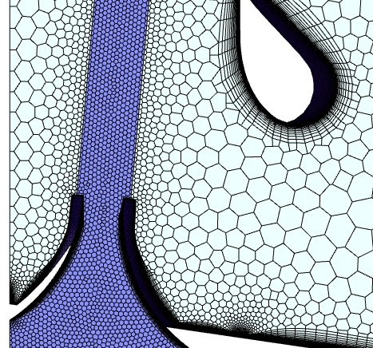
Mesh design
Prism layers (and lots of them)
  Vital for good resolution of near wall behaviours
  Targeting single digit wall y⁺ values
    Enhanced wall treatment area-weighted average <1 with maximum below 3
    ^{SST k-ω target average of <5}
Divide/refine mesh by projecting cylinder from tip of blast nozzles to the top of the exhaust
  Prevents growing mesh causing artificial mixing of steam and air too early
  Beware of mesh collapse on corners/interfaces

Slide 22
Boundary conditions
All flow boundaries should be pressure boundaries
  Helps with convergence, especially as steam flow will likely be choked.
  Steam pressures from top right quadrant of graph
  Gas inlet pressure (smokebox draught) should be negative, and should be adjusted until, when gas inlet pressure vs mass flow is plotted, it sits on the curve in lower left quadrant
  Result you then compare against test data is in top left quadrant of graph
  Apply turbulent boundary conditions instead of default
    Turbulence intensity commonly defined as 0.16Re^{-0.125}
    Re used in intensity calculation should be based on local hydraulic diameter

Slide 23
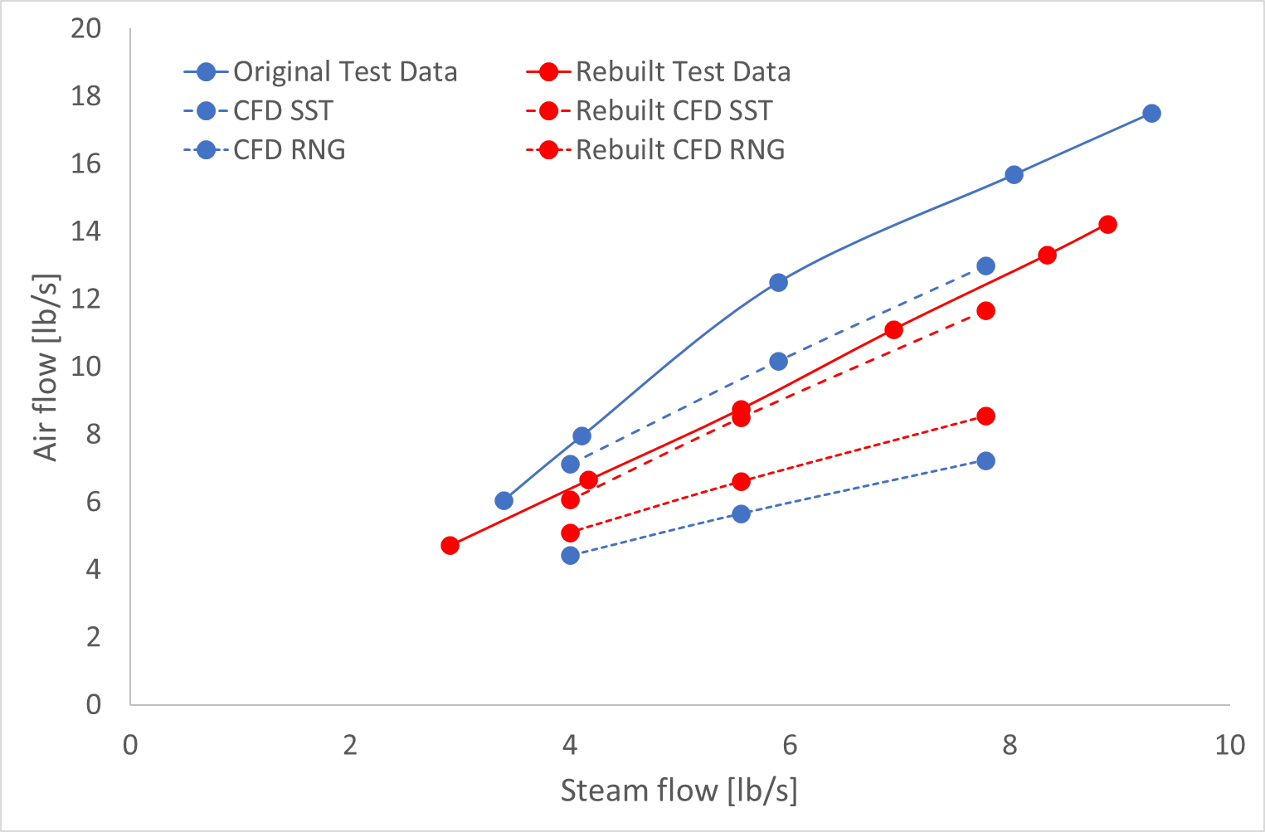
MN Exhaust: Turbulence model/Validation
Simulations of original and rebuilt exhaust designs, using methodology of previous few slides
Comparison between RNG k-ε and SST k-ω turbulence models
  SST both closer to test data & predicting relative behaviour of two designs
  SST used in design study presented later on
  Depending on the solver you use & the data set you model, you may not get this result (CFD can be fickle)

Slide 24
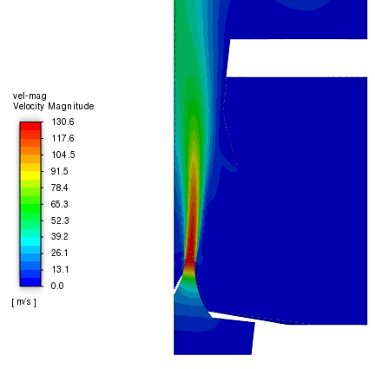
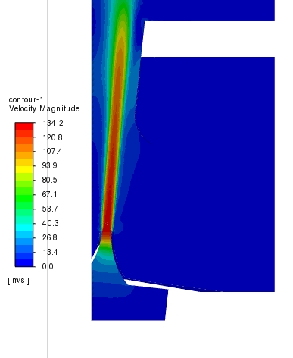
Steam jet dissipates sooner in original design
Simulation of 1/10th of smokebox, assuming rotational periodicity can be applied
Contours of velocity magnitude on symmetry plane
Steam jet dissipating sooner in original design, hence reduced performance
  Jet moving out of mesh refinement region, leading potentially to underprediction of entrainment, especially at higher flows
Original design
Rebuilt design

Slide 25
Preparing for H2 2022 Projects
Read some good books:
  The Red Devil and Other Tales from the Age of Steam by David Wardale
  "The fire burns much better ...", the Ph. D. thesis by J.J.G. Koopmans
  Fundamental Design Calculations for the 5AT Locomotive, as prepared by David Wardale
  La Locomotive a Vapeur, by A Chapelon
  …and numerous technical articles
Had a good think about what we’re trying to achieve with improving 21c11 (and what the rebuilt locomotives achieved)

Slide 26
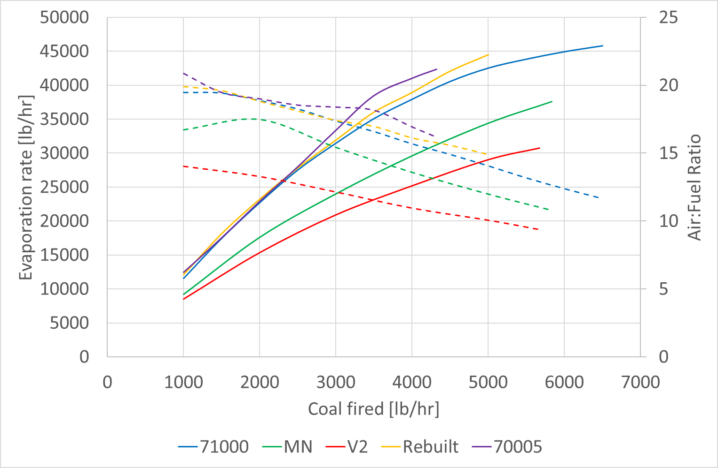
Merchant Navy Fuel economy poor
Original Merchant Navy produces ~25% less steam per pound of coal than rebuilt MN or BR standard pacifics
  AFR ~14% less on original design
Rebuilt MN performance similar to 71000 prior to modifications to latter in preservation
Data from BR test bulletins 5 (Std 7), 8 (Single chimney V2), 10 (Merchant Navy), 15 (Std 8), 20 (Rebuilt MN)

Slide 27
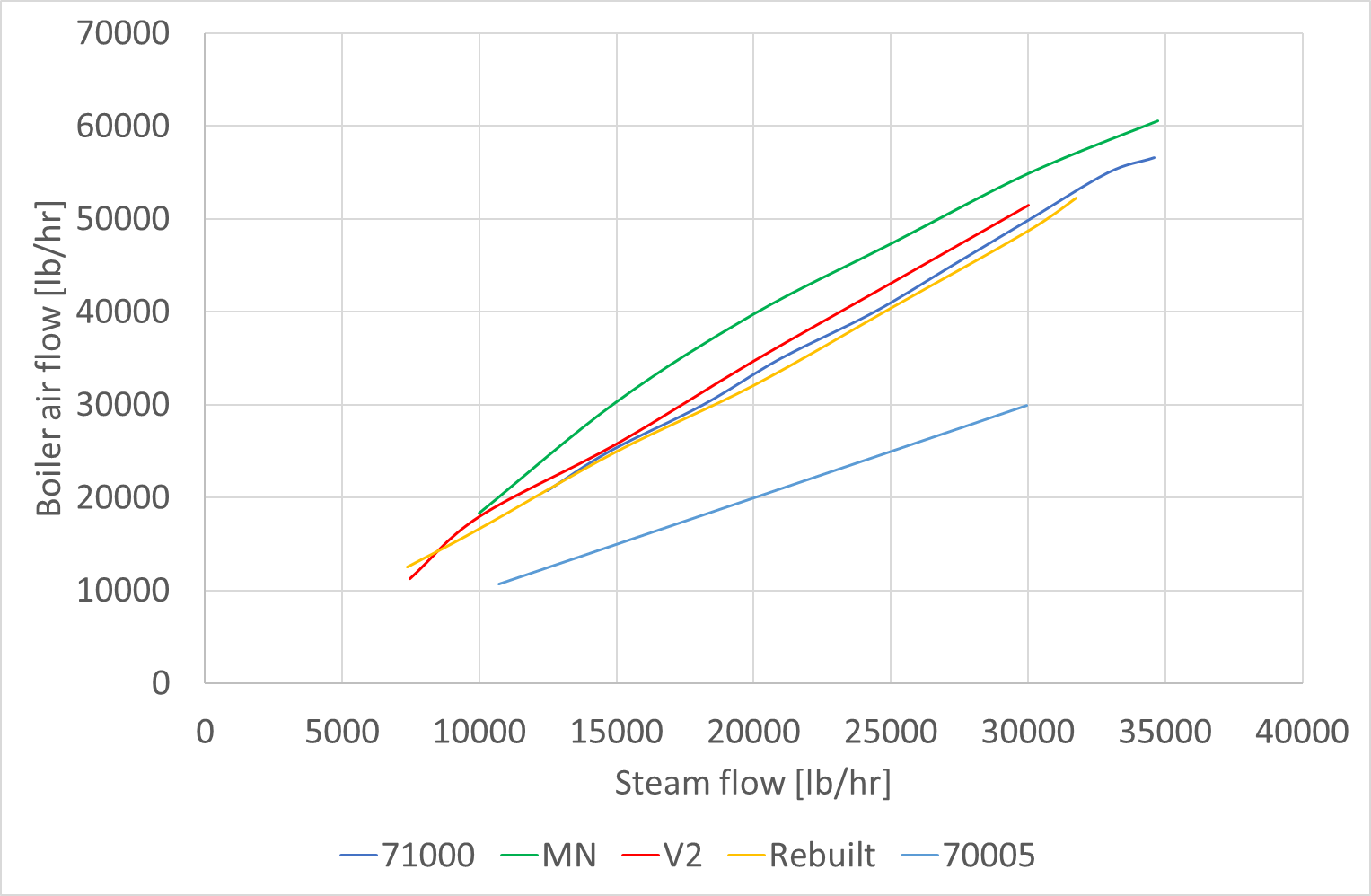
Merchant Navy Boiler air flow high
Original Merchant Navy has ~20% higher air flow than rebuilt design
  …but AFR is low, suggesting poorer combustion conditions
Rebuilt MN has very similar air flow as 71000 prior to modifications to latter in preservation
Data from BR test bulletins 5 (Std 7), 8 (Single chimney V2), 10 (Merchant Navy), 15 (Std 8), 20 (Rebuilt MN)

Slide 28
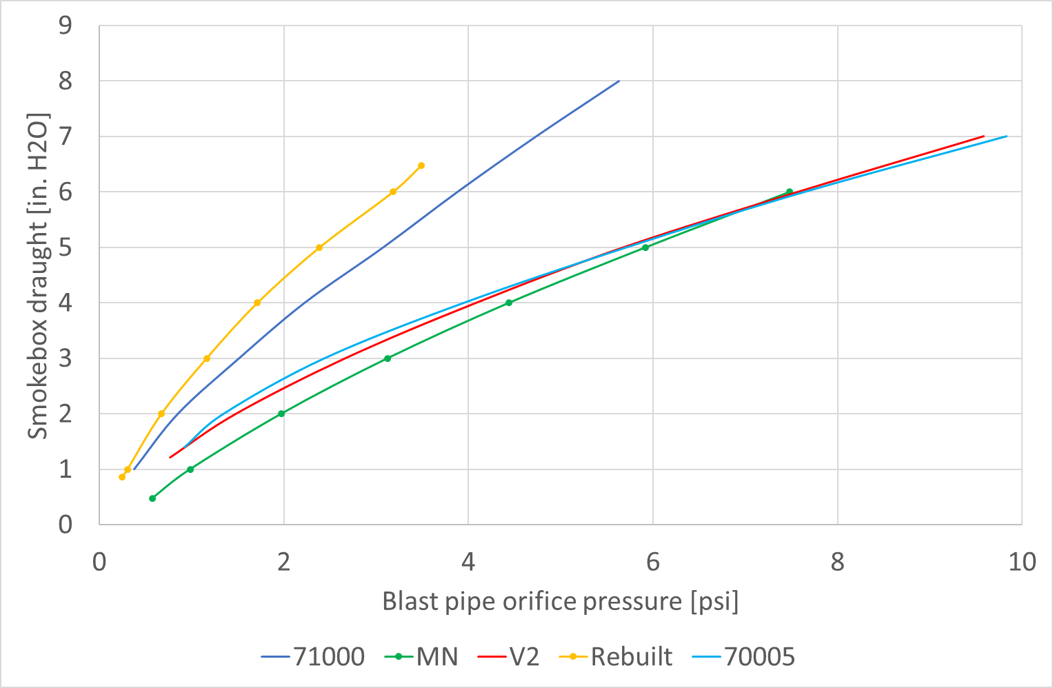
Smokebox draught on Original design low
OVS Bulleid fitted Lemaître style exhausts to all his new locomotive designs
Problems with original design
  Same exhaust design fitted to the MN & Light Pacific designs, despite the different power levels of the two designs
  Comparing Lemaitre’s original drawing with those of the Bulleid design show the steam nozzles may be too far away from the chimney
  Blast nozzle area roughly half that of contemporaneous designs
    Low area will increase cylinder back pressure
Original Merchant Navy smokebox draught relatively low
Rebuilt MN has more than double the draught of original
Data from BR test bulletins 5 (Std 7), 8 (Single chimney V2), 10 (Merchant Navy), 15 (Std 8), 20 (Rebuilt MN)

Slide 29
Changes in gas circuit on rebuilding (MN class)
Damper doors were fitted to original & rebuilt MN design
  Flow area halved from 12.2 ft² to 6.1 ft² upon rebuilding
Primary flow area reduced from 50% to 37.3% of grate upon rebuilding
  Compare with LNER V2 36.6%, BR Std 7 37%, BR Std 8 43%
Superheater surface area reduced 8% due to lack of space in new smokebox
Exhaust modified from Bulleid-Lemaître to new design
  5 nozzle blast pipe retained, unaltered
  Replacement exhaust with slightly lower diffuser angle (12.7 (original) vs. 12 (rebuilt)) & longer diffuser (18 ½ vs. 26 inch)
  Exhaust length comparable
  Geometric choke lower on rebuilt design

Slide 30
Improvement goals
Reduce cylinder back pressure by increasing effective blast nozzle area
Improve performance & efficiency by increasing AFR (via increased boiler air flow)
  Target is better air/steam ratio than rebuilt design; in simulations this is 1.513
Stretch goal: to improve performance & efficiency further by adding tube-in-shell feedwater heater

Slide 31
Options
Keep the original exhaust design
  Known design
  Fuel economy is poor, costing us money
Refit the rebuilt design
  Some improvement on the original design, still poor
Fit a modern exhaust
  New design, possibly unproven
  Potential for performance improvements
  Any exhaust changes shouldn’t change the aesthetic of the locomotive

Slide 32
Alternative exhaust option
British “best-practise” suggests fitting either double Kylchap or a Giesl
  Doesn’t fit with requirement that any exhaust changes shouldn’t change the aesthetic of the locomotive
  Giesl performance can be temperamental
Double or triple Lempor
  High levels of performance possible
  Doesn’t fit with requirement that any exhaust changes shouldn’t change the aesthetic of the locomotive
Single squat Lempor (or even Kylpor)
  Possible compromise on performance
  Fits with requirement that any exhaust changes shouldn’t change the aesthetic of the locomotive

Slide 33
New exhaust designs for original & rebuilt Bulleid locomotives
 | Lempor | Bulleid-Lemaître
Blast nozzle area (cm²) | 205.7 | 174.6
Blast nozzle diameter (mm) | 58 | 66.675
Number of nozzles | 9 | 5
Distance from nozzle tip to exhaust (mm) | -103 | 600
Mixing chamber area (m²) | 0.276 | 0.317
Mixing chamber diameter (mm) | 593 | 635
Mixing chamber length (m) | 0.9413 | 0
Exhaust area (m²) | 0.426 | 0.426
Sized using D. Wardale’s 5AT FDCs as a primer
  Equations converted into excel spreadsheet
Drawing on experience from RRFCS, assumed that a multi-nozzle ejector can be thought of as multiple triangular ejectors blended into one another
Extrapolated sizing of 4 nozzle Lempor to a 9 nozzle design, compromising on diffuser length in order to fit aesthetic requirement of one single exhaust
  Sized by designing for 2¼ exhausts on blast nozzle flow area, then combining mixing duct flow areas, maintaining duct length, and setting total diffuser outlet area to be the same as the original design (2’5” diameter)
Differences between calculated design and model
  Nozzle distance adjusted to give higher & more robust performance
  Mixing chamber length increased to take up available height
Numerous simulations conducted varying nozzle angle, position, length and diameter, to study impact on performance

Slide 34
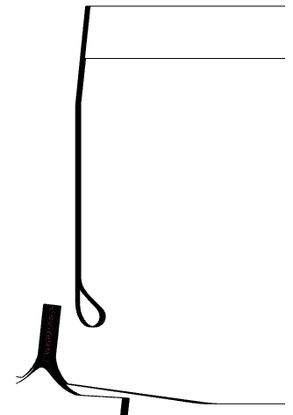
Lempor geometry variation
Parameters varied (and meaning of some values):
Nozzle angle: image shows 6.16 degrees, matching diffuser angle. At radial location 0mm, angle 4.33 orients jet towards the centre of area of the 1/9th sector each nozzle feeds
Radial location: at nozzle angle 6.16degrees, location 0mm has the nozzle axis and diffuser wall intersecting. Distances beyond this are towards the axis
Nozzle diameters: 58mm, 54mm (& starting to work on 48mm)
Nozzle length: 203mm (shown here) has nozzle tip in line with base of the mixing duct. Other lengths bring the nozzle tip towards the base of the smokebox (103mm is in line with the base of the bell mouth)

Slide 35
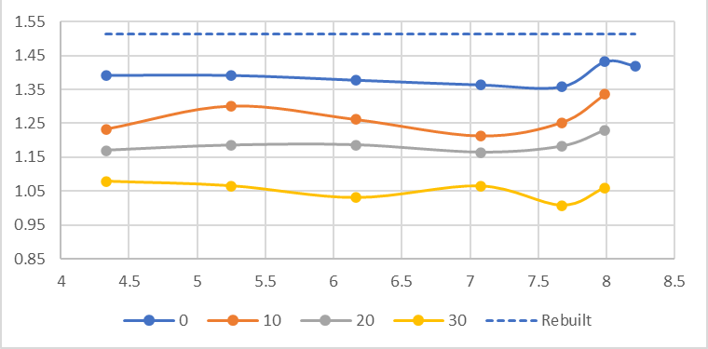
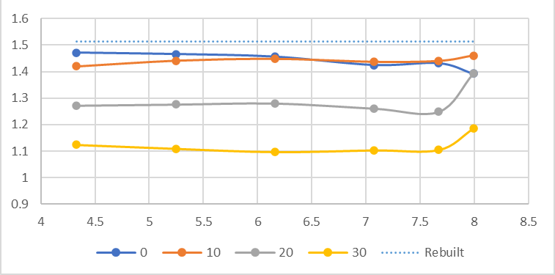
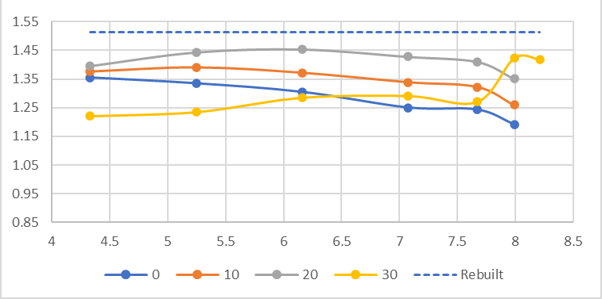
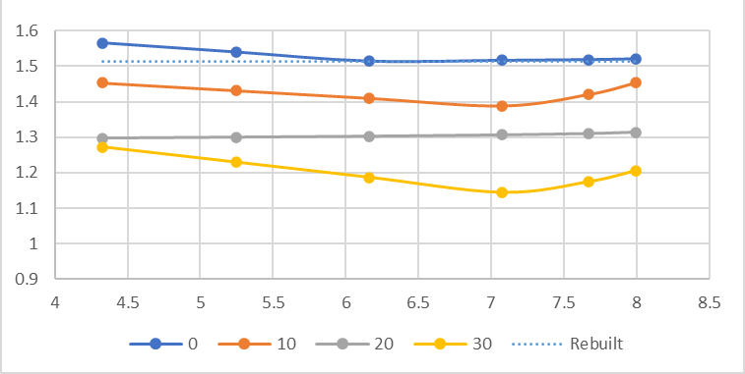
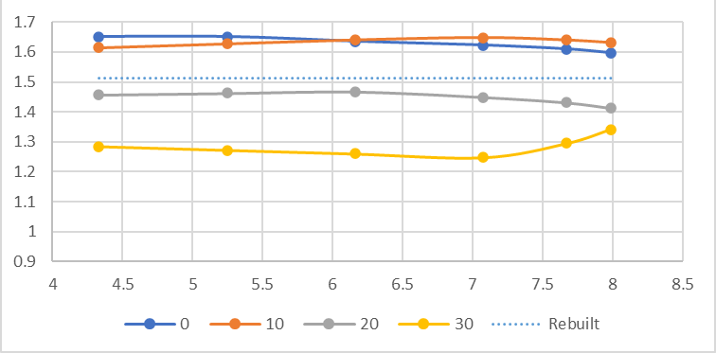
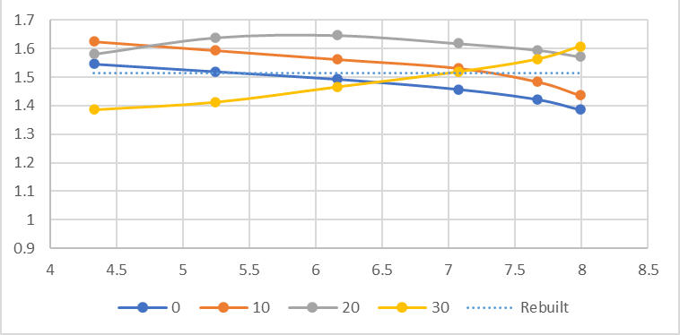
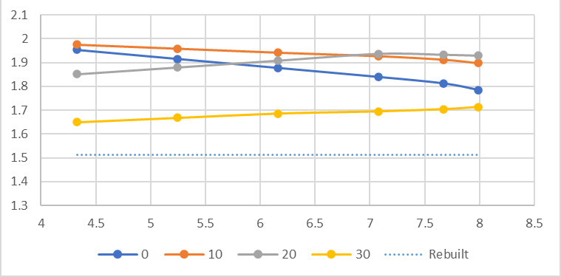
Effect of nozzle variables on performance
58mm diameter, 3mm
58mm diameter, 103mm
58mm diameter, 203mm
54mm diameter, 3mm
54mm diameter, 103mm
54mm diameter, 203mm
48mm diameter, 103mm

Slide 36
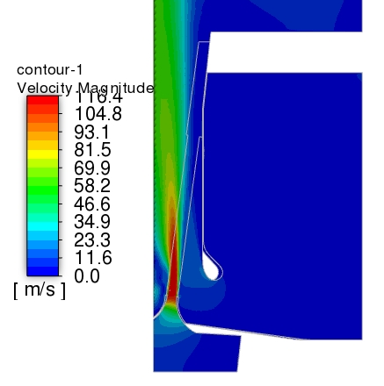
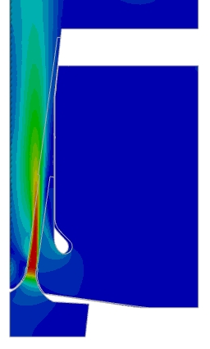
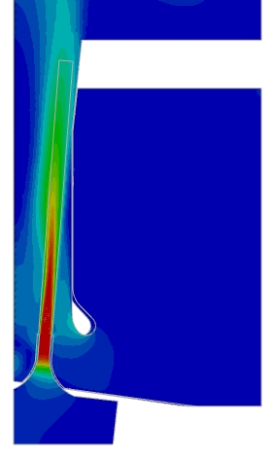
Flow visualization (58mm diameter)
Simulation of 1/18th of smokebox, assuming rotational periodicity
Contours of velocity magnitude on symmetry plane
Steam jet being pulled towards axis in 30mm design, hence reduced performance (A/S ratio 1.01 vs 1.43)
  Flow moving out of mesh refinement so A/S may be underpredicted
More acceleration of secondary flow at exhaust entrance
Flow staying attached to diffuser in 103/30/4.33 design, hence strong performance (A/S 1.47)
3mm Nozzle at 30mm, 7.67 deg
A/S 1.01
3mm Nozzle at 0mm, 7.99 deg
A/S 1.43
103mm Nozzle at 30mm, 4.33 deg
A/S 1.47

Slide 37
Summary/Next steps with exhaust
Best design, compared to rebuilt exhaust design, currently offers:
  31% increase in airflow
  30% decrease in steam pressure upstream of blast nozzle if running conjunction with FWH
Confirm “spare-time” analysis with Loughborough analysis
Finalise design for rebuilt MN
Finalise design that has margin for supplying up to 20% steam to feedwater heater
  48mm diameter nozzle showing potential for much higher A/S ratio (~2)
  If 20% steam flow passed to FWH, steam pressure in line with 54mm diameter designs

Slide 38
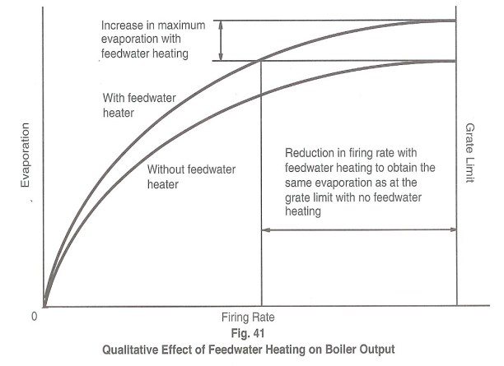
Improve fuel efficiency through feedwater heating
Most “modern” steam locomotives used steam injectors to transfer water into boiler
  Raise pressure from atmospheric to 250psi
  Raise temperature to ~70degC
Using tube-in-shell feedwater heater (& pumps) increases feed temperature to ~110-140C
  Increase in maximum power available, & fuel savings available (15% water, 30% coal)
Graph Fig.41 from The Red Devil and Other Tales from the Age of Steam 2nd edition by Wardale, David )

Slide 39
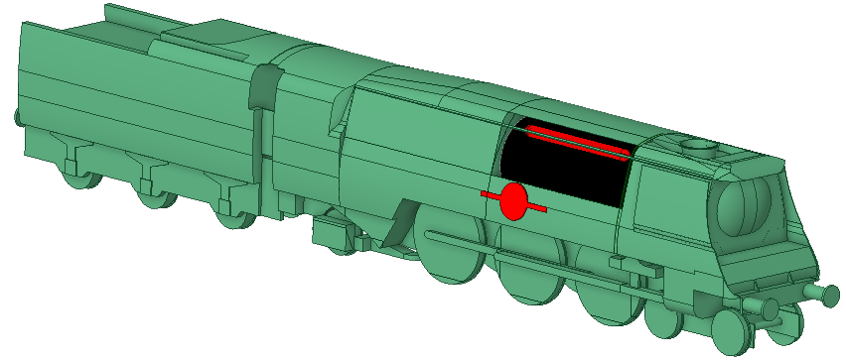
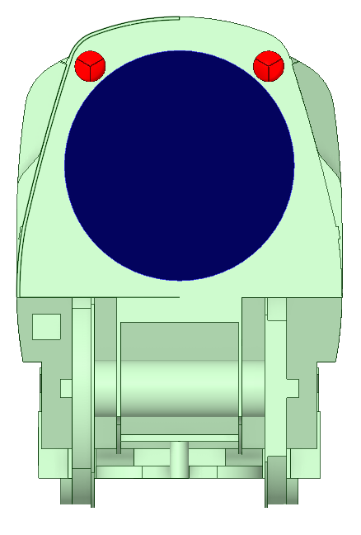
Fitting a feedwater heater to an original Bulleid
Unusual for many British locomotives to have any apparatus on the boiler shell
FWH can be hidden under Bulleid air smoothed casing
  (Image shows where it would go)
  Comprise on outer diameter, but significant length available
Concept design
  Two heaters
  2.7m long, 250mm OD
  Single pass steam, 6-pass water
  15mm OD Copper Tubes
  15-21 tubes per pass (TBD)
  HT area 16.7-23.4m² (5AT 18.3m², SAR26 13.3m²)

Slide 40
Improve fuel efficiency through feedwater heating
Focus: improve utilization of fuel by pre-heating feedwater
Internal aerodynamics/heat-transfer: tube in shell heat exchanger
Group tasks
Study empirical design methods for heat exchangers (ESDU data items, heat transfer literature)
Develop geometry models and simplifications to study different geometric arrangements of feedwater heater
Develop boundary conditions for feedwater heater running at different engine power.
Develop a CFD model of the feedwater heating and steam cooling.
Decide validation strategy to build up the scientific credibility of your simulations.
Develop post-processing tools for high-quality result visualisations.
Suggested individual tasks:
Study the effect of mesh on predicted flows.
Study the effect of turbulence model on predicted flows.
Design explorations to improve heat transfer performance and/or reduce pressure drops across a range of operating conditions

Slide 41
Put the steam back in General Steam Navigation
Visit our website (www.35011gsn.co.uk)
Become a member (https://35011gsn.co.uk/membership.html)
Become a volunteer (restoration, fundraising, engineering leadership (https://35011gsn.co.uk/about-us-1/working-weekends.html))
Sponsor a component (https://35011gsn.co.uk/supporting-us/component-sponsorship.html)
Become a shareholder-benefits can include seats on the first train hauled by 35011, footplate rides, and the chance to drive 35011, depending on the level of your shareholding (https://35011gsn.co.uk/shares.html)

Slide 42
Any questions?

