Slide 1

CPR Aylth Roundhouse and Diesel Depot
John Duncan

Slide 2
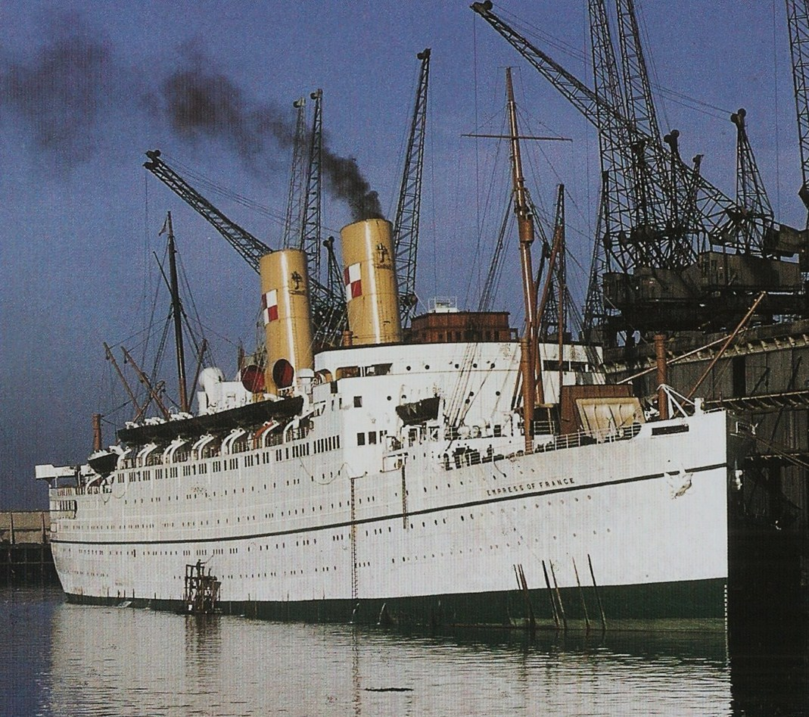
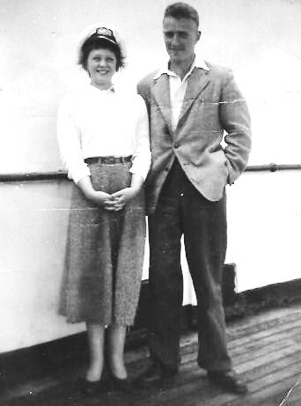
CPS “Empress of France” – Gladstone Dock June 1956

Slide 3

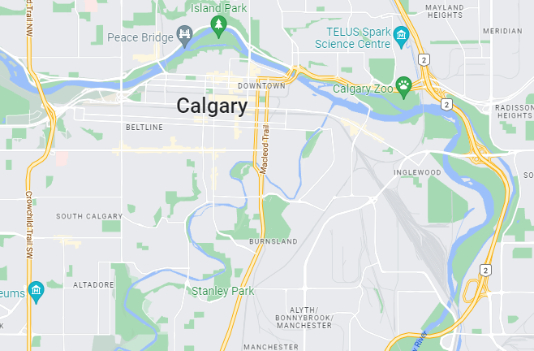

Slide 4
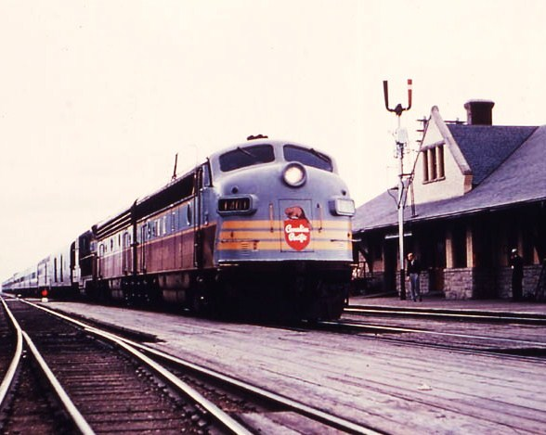
Train No 7 ‘The Dominion Montreal to Vancouver
F A& B unit plus GP9 with 4625 steam Generator
Potage de Prairie

Slide 5
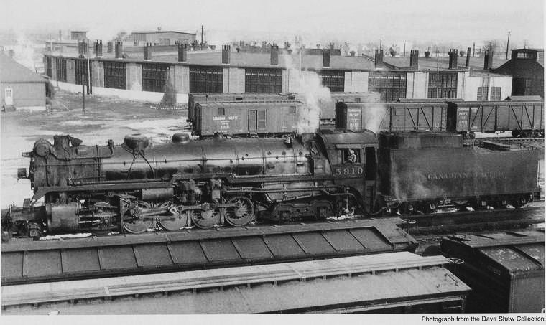
First view of Alyth Roundhouse
From the wood bridge to the stockyard
Locomotive 5910 Selkirk, T1a 2-10-4

Slide 6
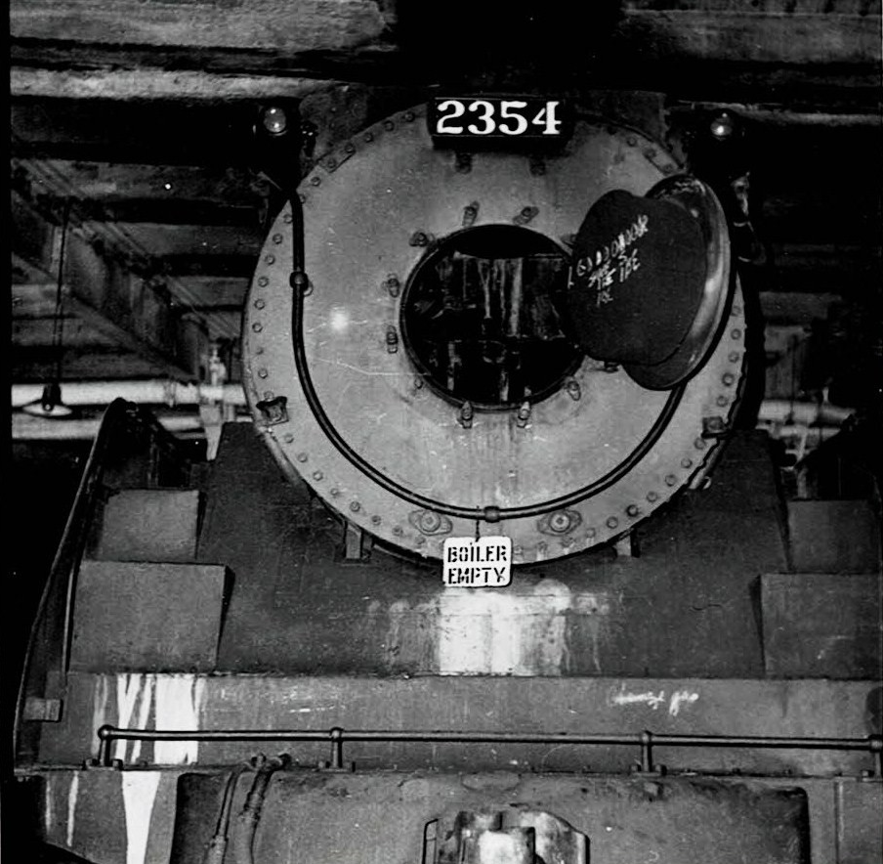
First close up of a G3g Pacific
Big in height and width
In for yearly exam

Slide 7
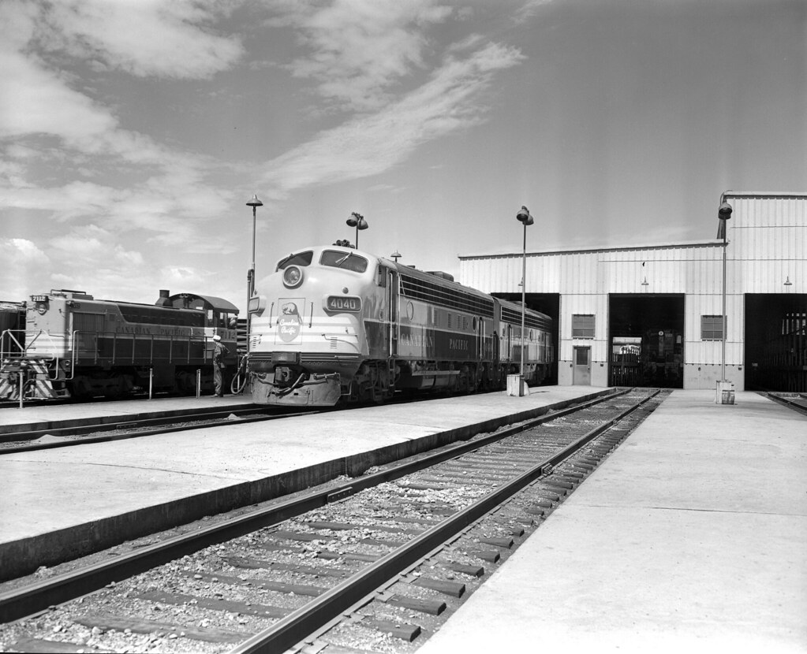
East end of Alyth diesel shop fuelling points

Slide 8
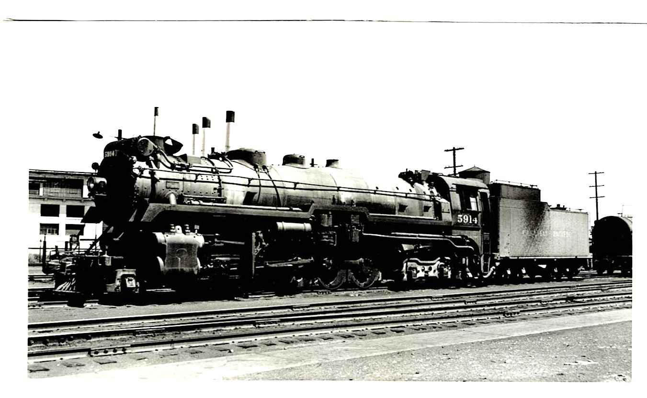
1929 built T1a 5914 at oil fuel road Alyth
Private brass foundry behind

Slide 9
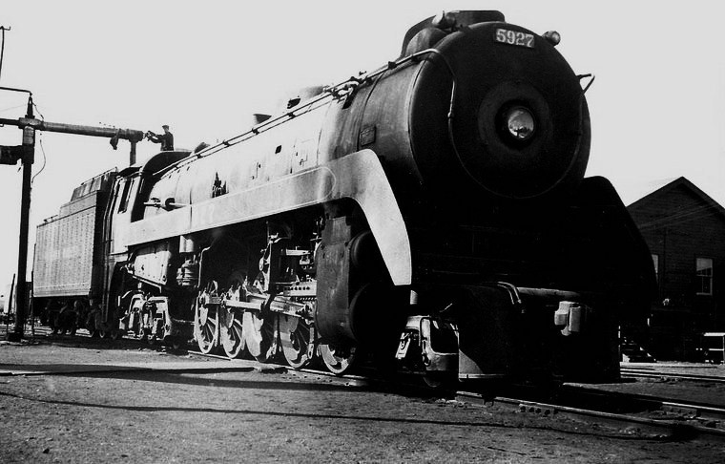
5927 the last T1b before scrapping
Filling up with 4100 gallons of Bunker C Oil

Slide 10
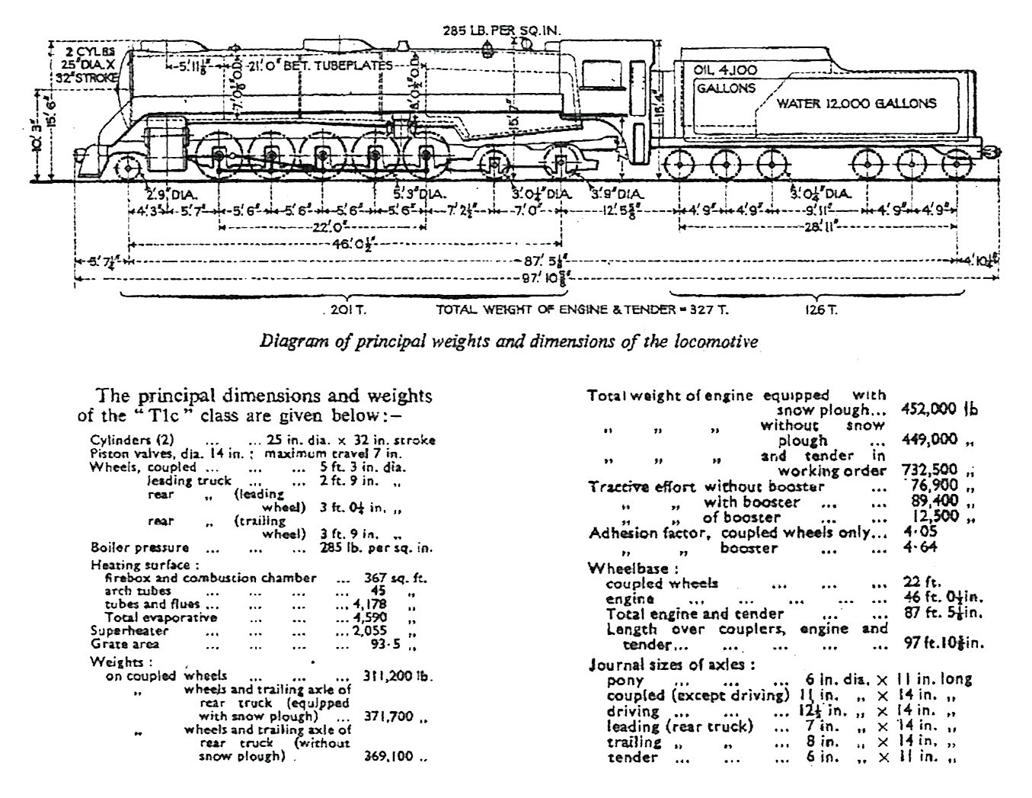
Dimensions of Selkirk T1b 1938 build

Slide 11
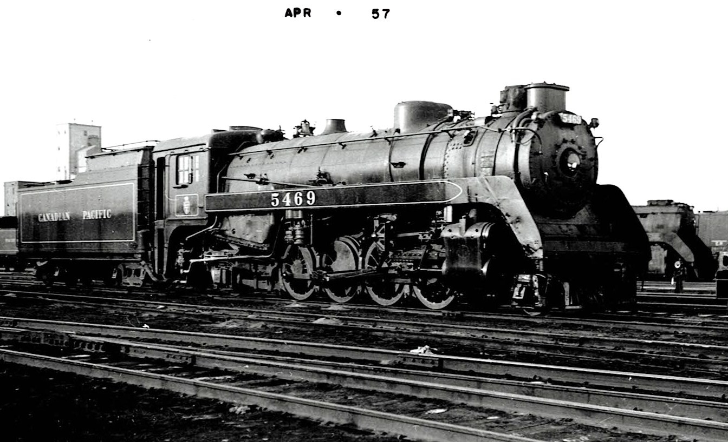
P2k 5469 2-8-2 1948 build at Alyth

Slide 12
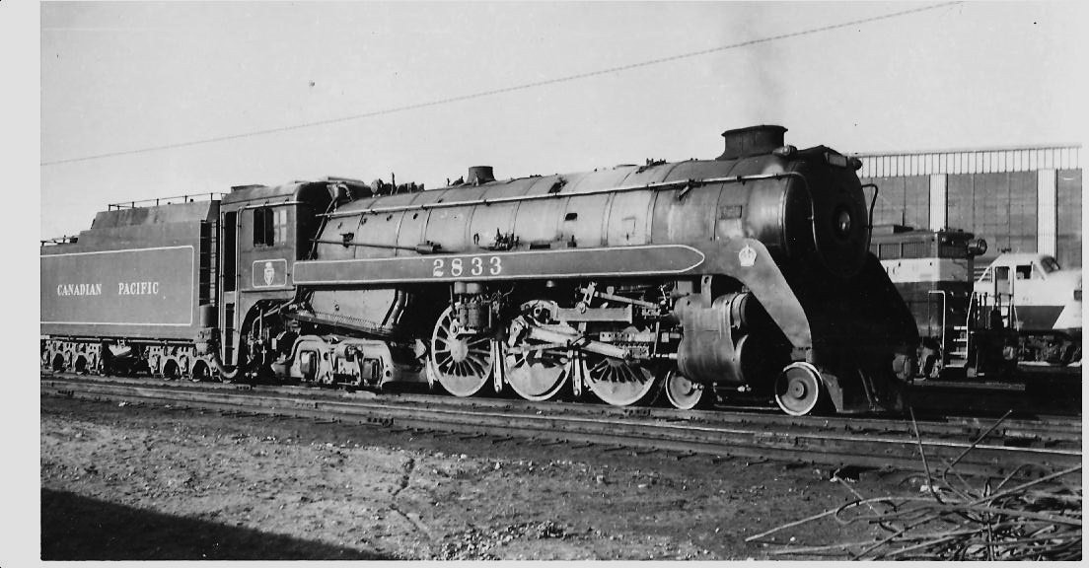
H1c 2833 4-6-4 Royal Hudson
Just off Edmonton mail, night shift , initial exam

Slide 13
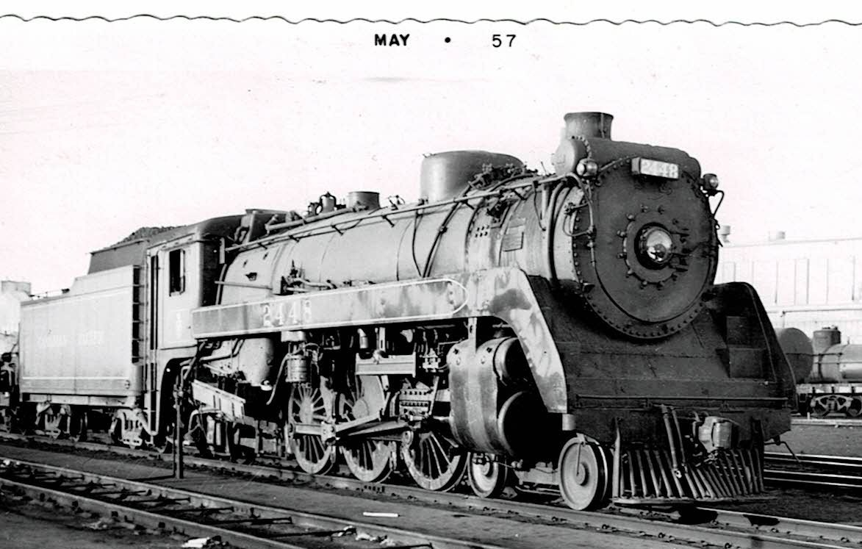
G3g 2448 4-6-2 at Alyth incoming road
Worked Calgary to Lethbridge road

Slide 14
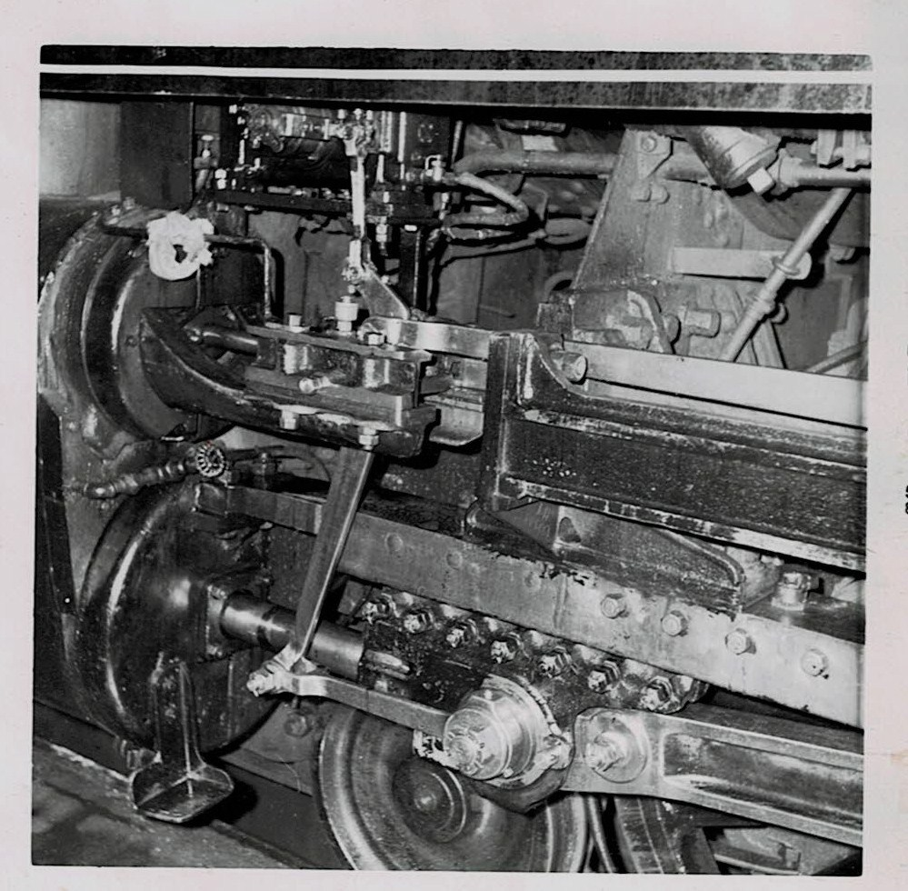
Overhaul of No4 Nathan LH lubricator
Setting Nathan DA valve 25 psi above max boiler pressure at 300 psi

Slide 15
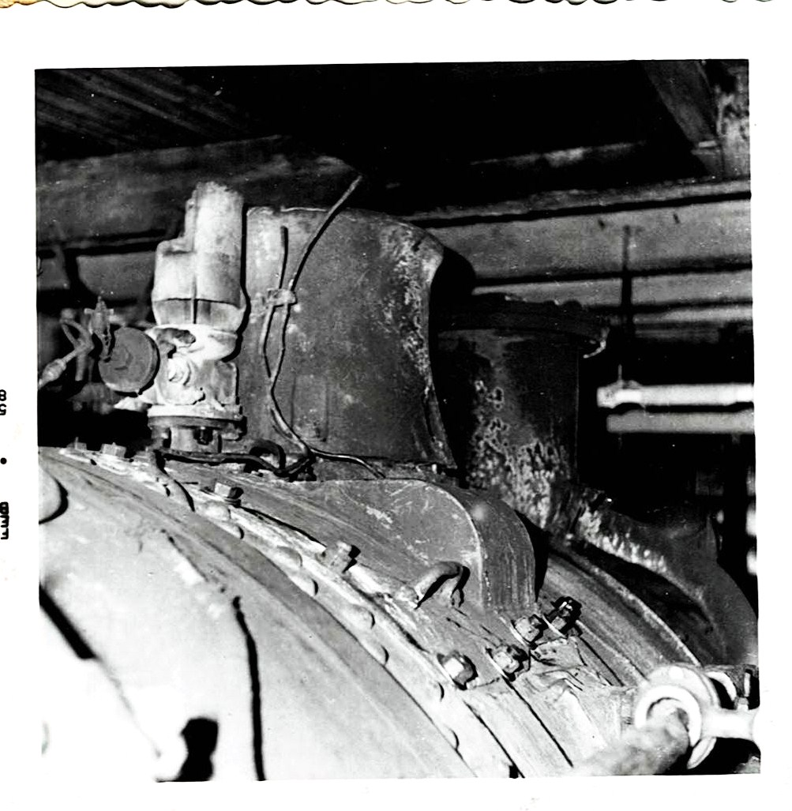
5465 P2K 2-8-2
Top of superheater element and throttle valves, whistle. Smoke stack and coil type feedwater heater

Slide 16
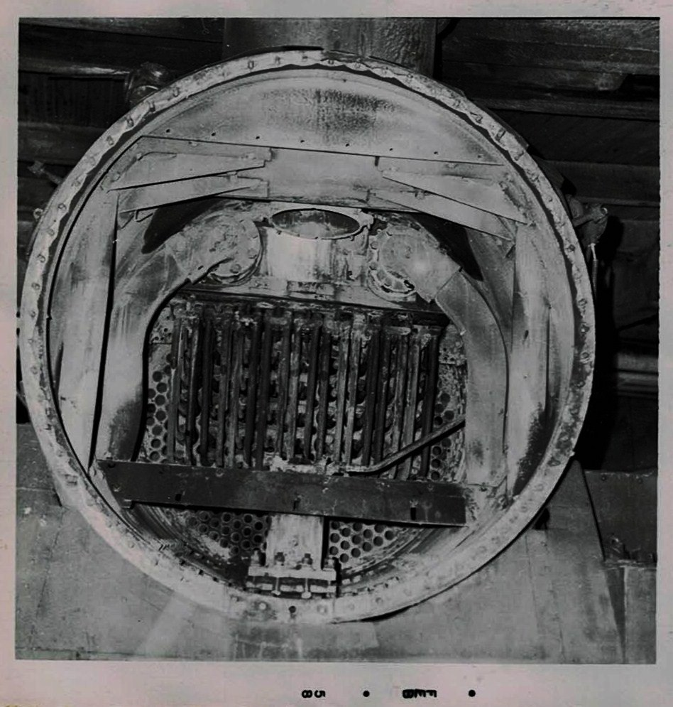
5465 P2K,2-8-2
Smoke box front and cowl after 12 monthly examination and test of elements and examination of throttle valves (nuts on top of element bolts)

Slide 17
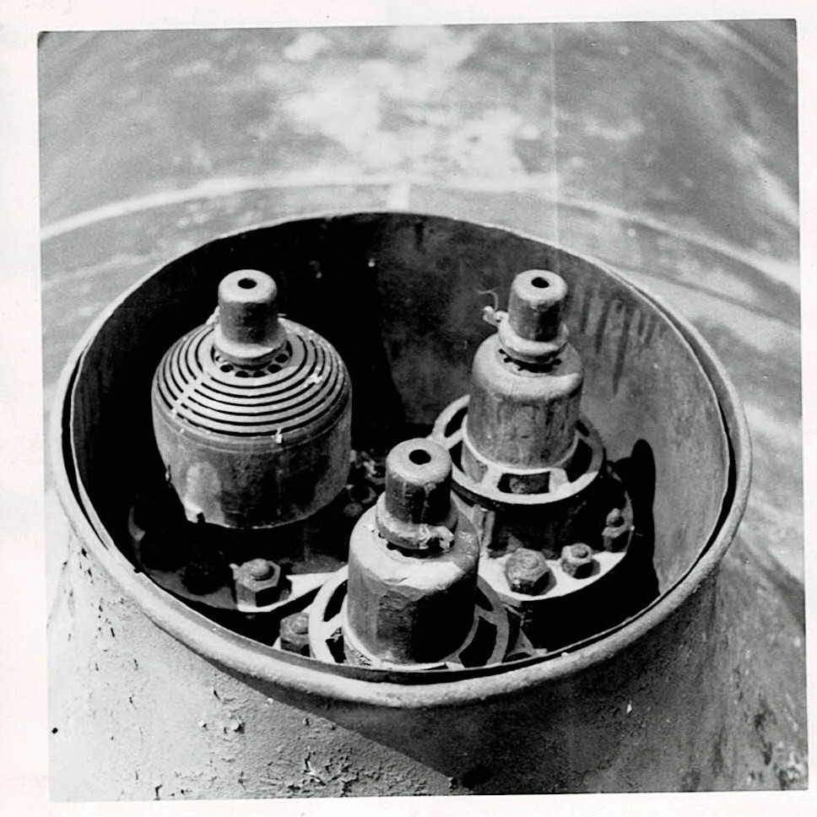
Safety valves on 5933 set at 285 psi

Slide 18
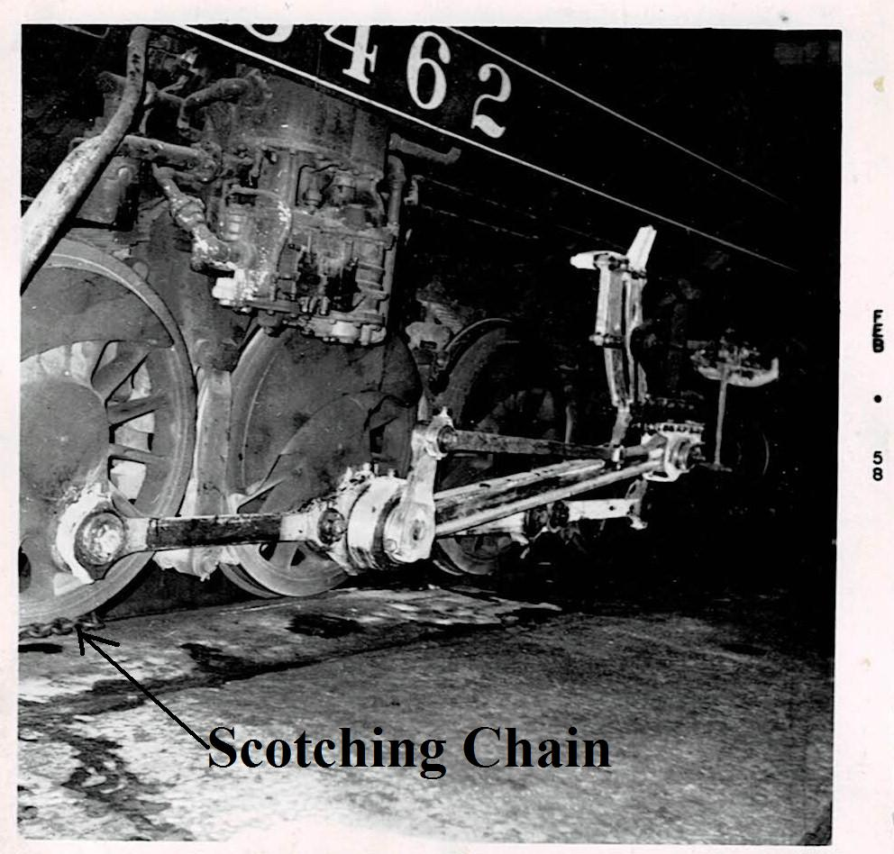
Yearly exam and inspection, moving parts on motion
Whitewashed for cracks – scotching chains

Slide 19
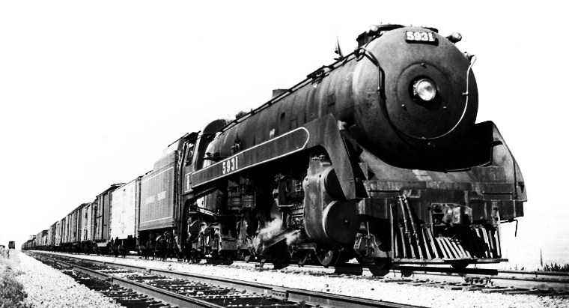
T1c 5931 on heavy freight on Brooks Division
East of Calgary up to 1500 tons

Slide 20
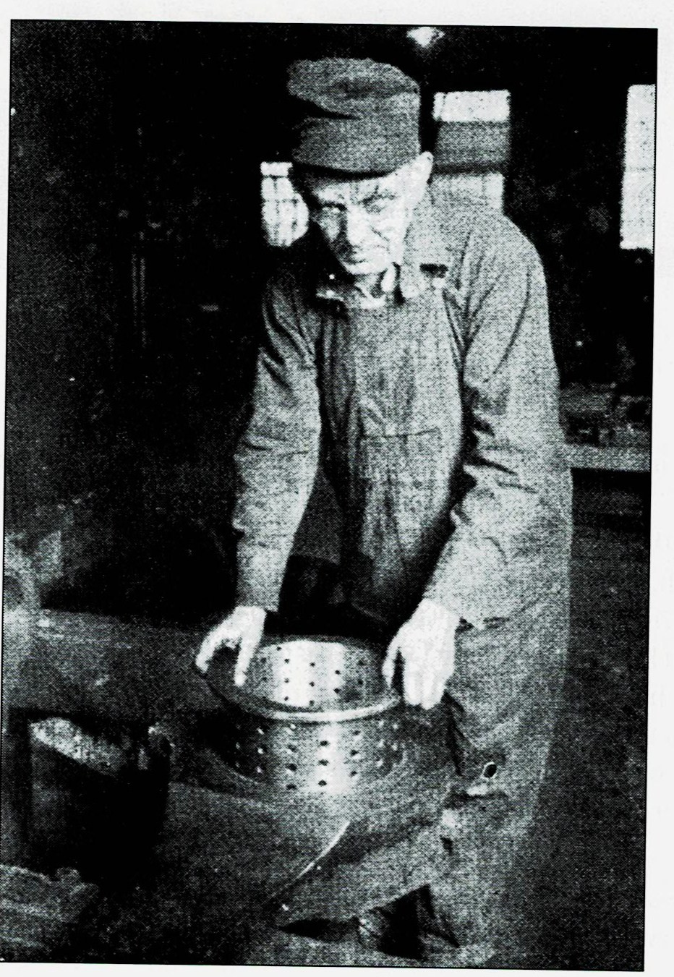
A floating bearing
9 ½” inside dia 12”outside dia
On T1 big end bearings.
Fitted at Medicine Hat

Slide 21
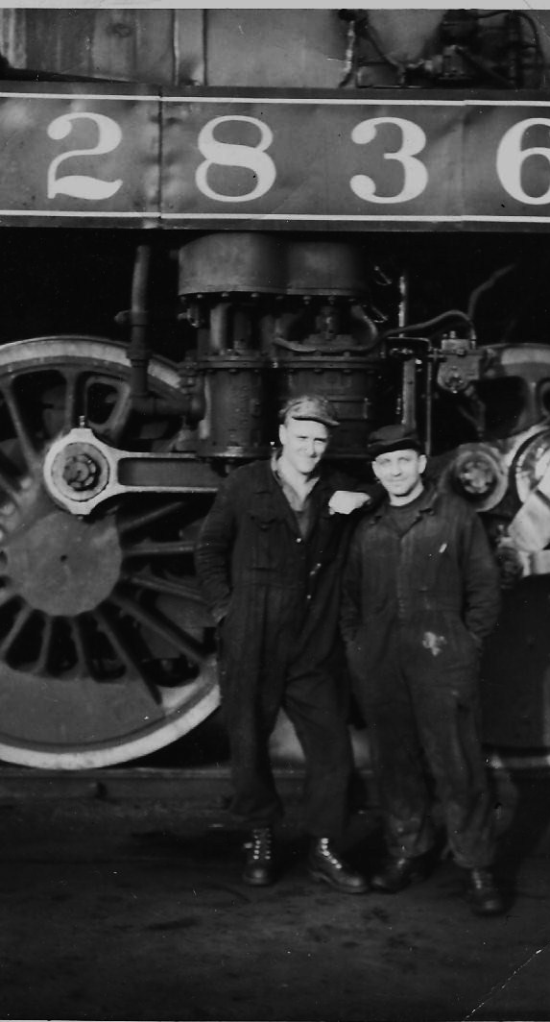
September 1956 on nights 12 – 8 am.
Switcher Machinist
My helper Michael Wislovich (Polish-Canadian).
I was called a limey

Slide 22
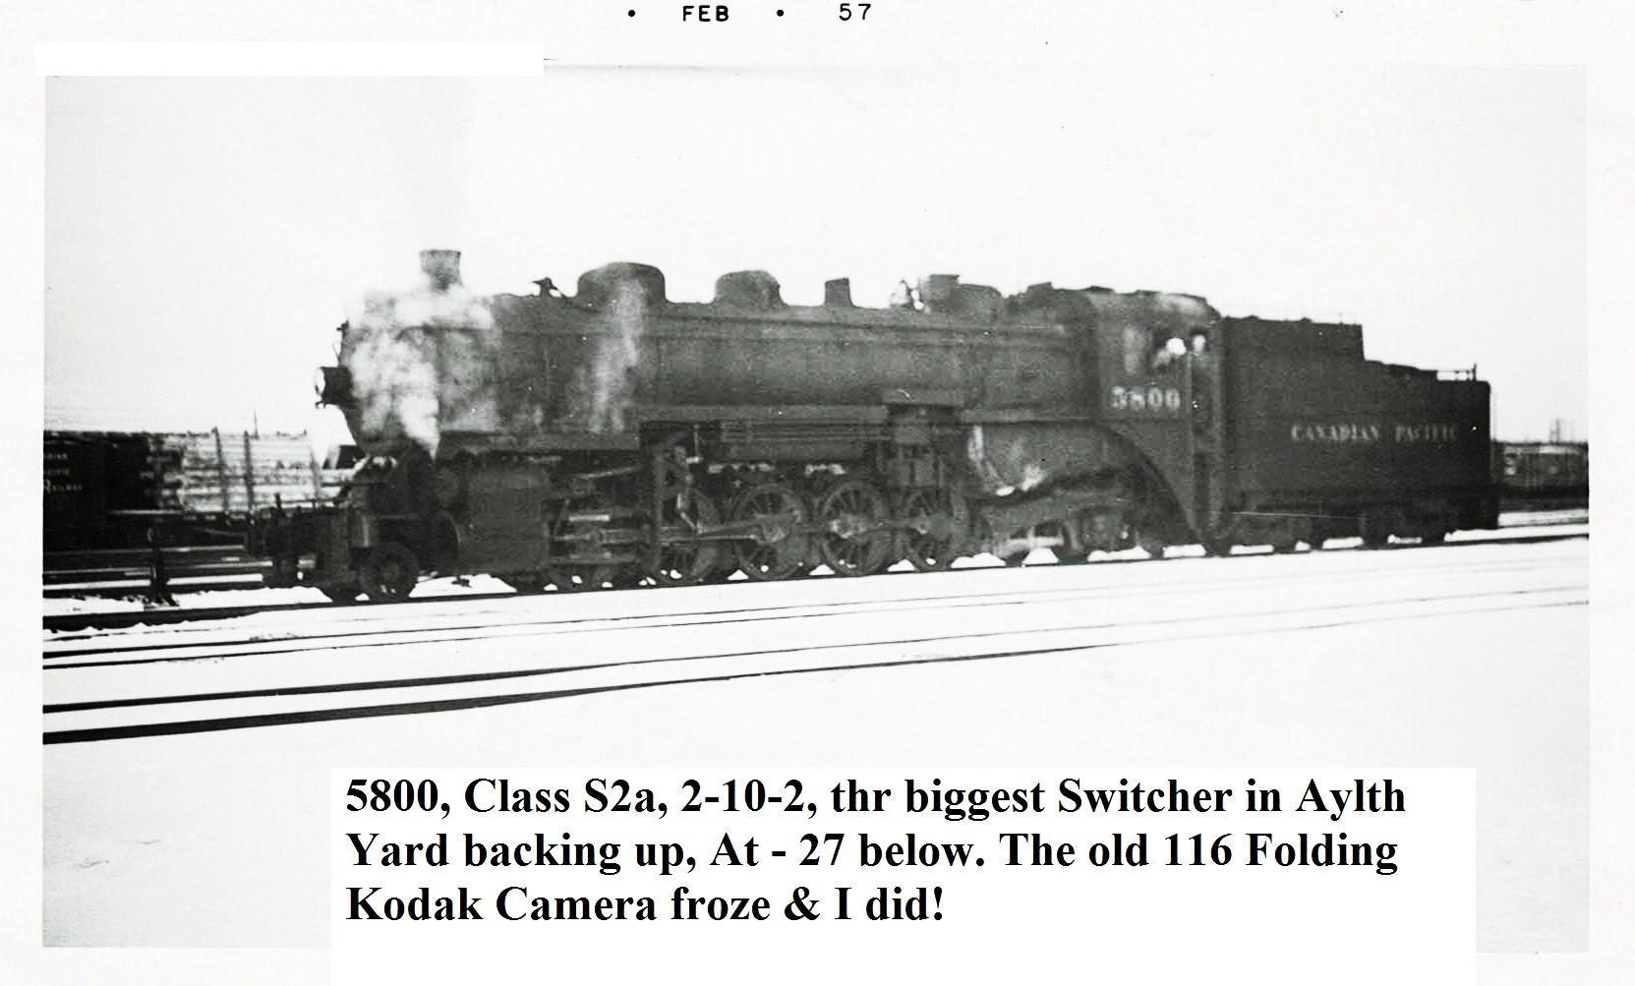
5800 at 27degree F
With Eddie Keener, fireman and Walter Dempsey switchman

Slide 23
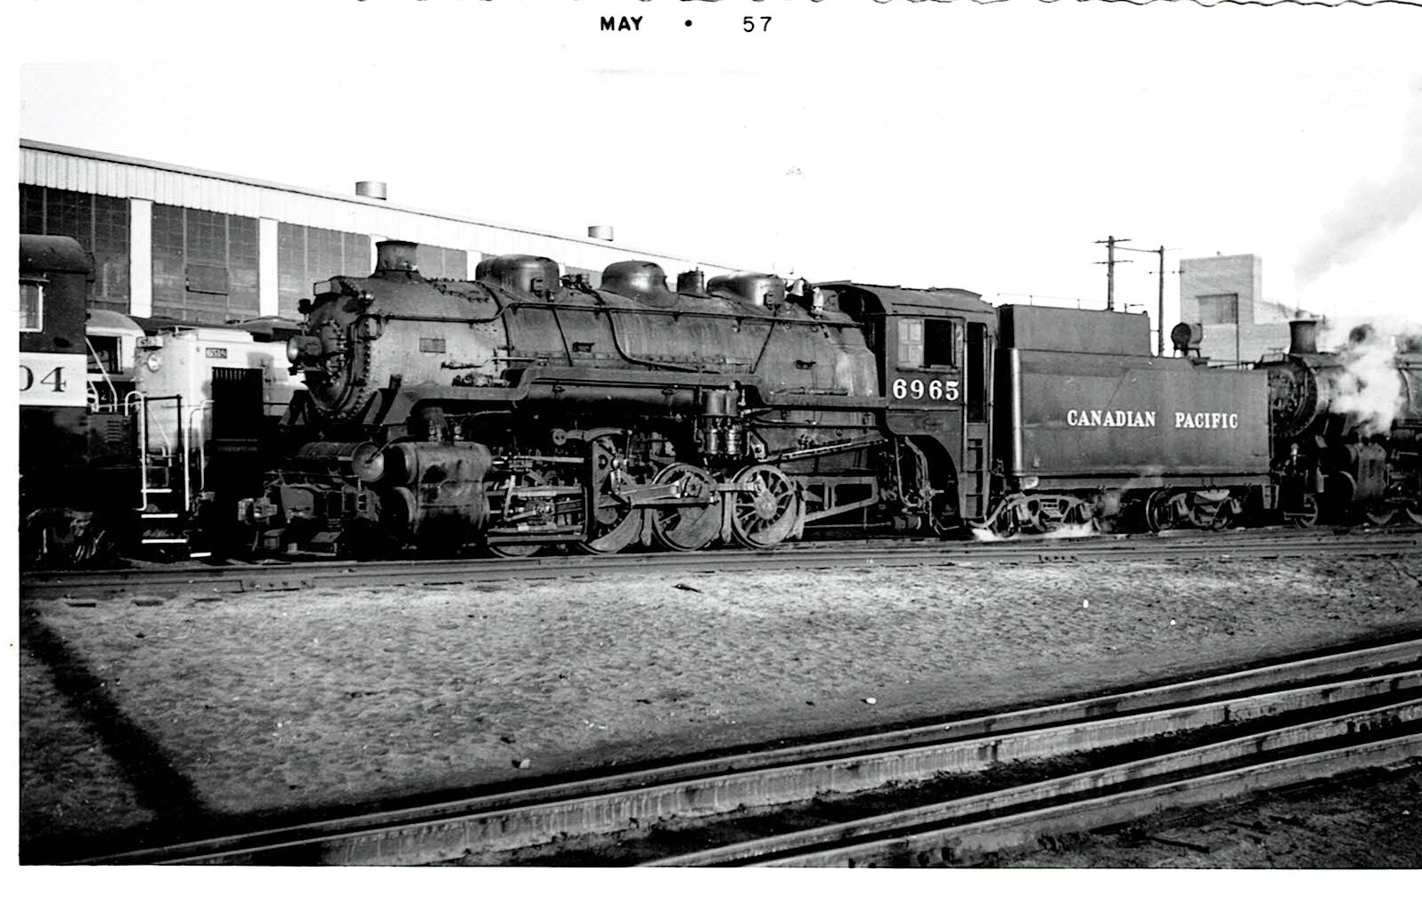
6269 V5a hump engine
Engineer Carl Wilson (Mr Leak only at 8 am)

Slide 24
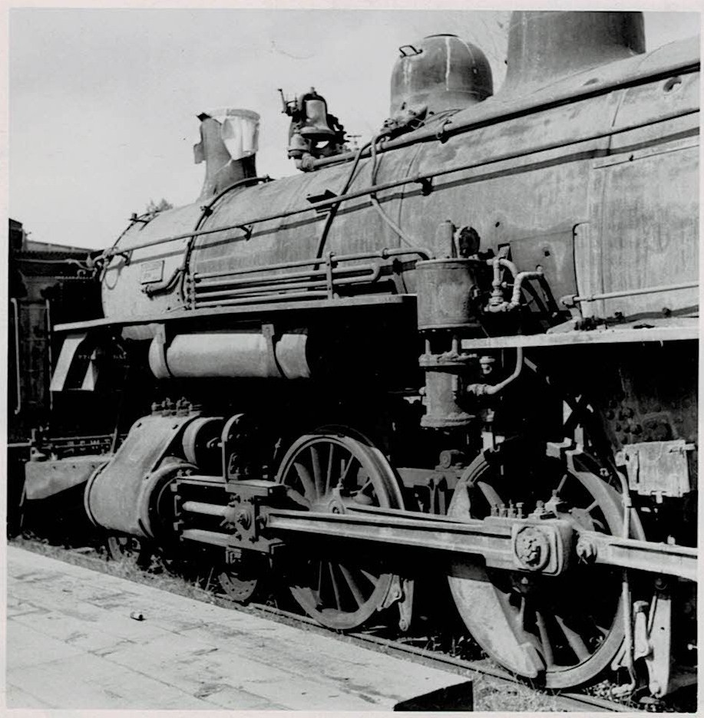
597 Dpc 4-6-0 the oldest switcher
Alco 1903

Slide 25
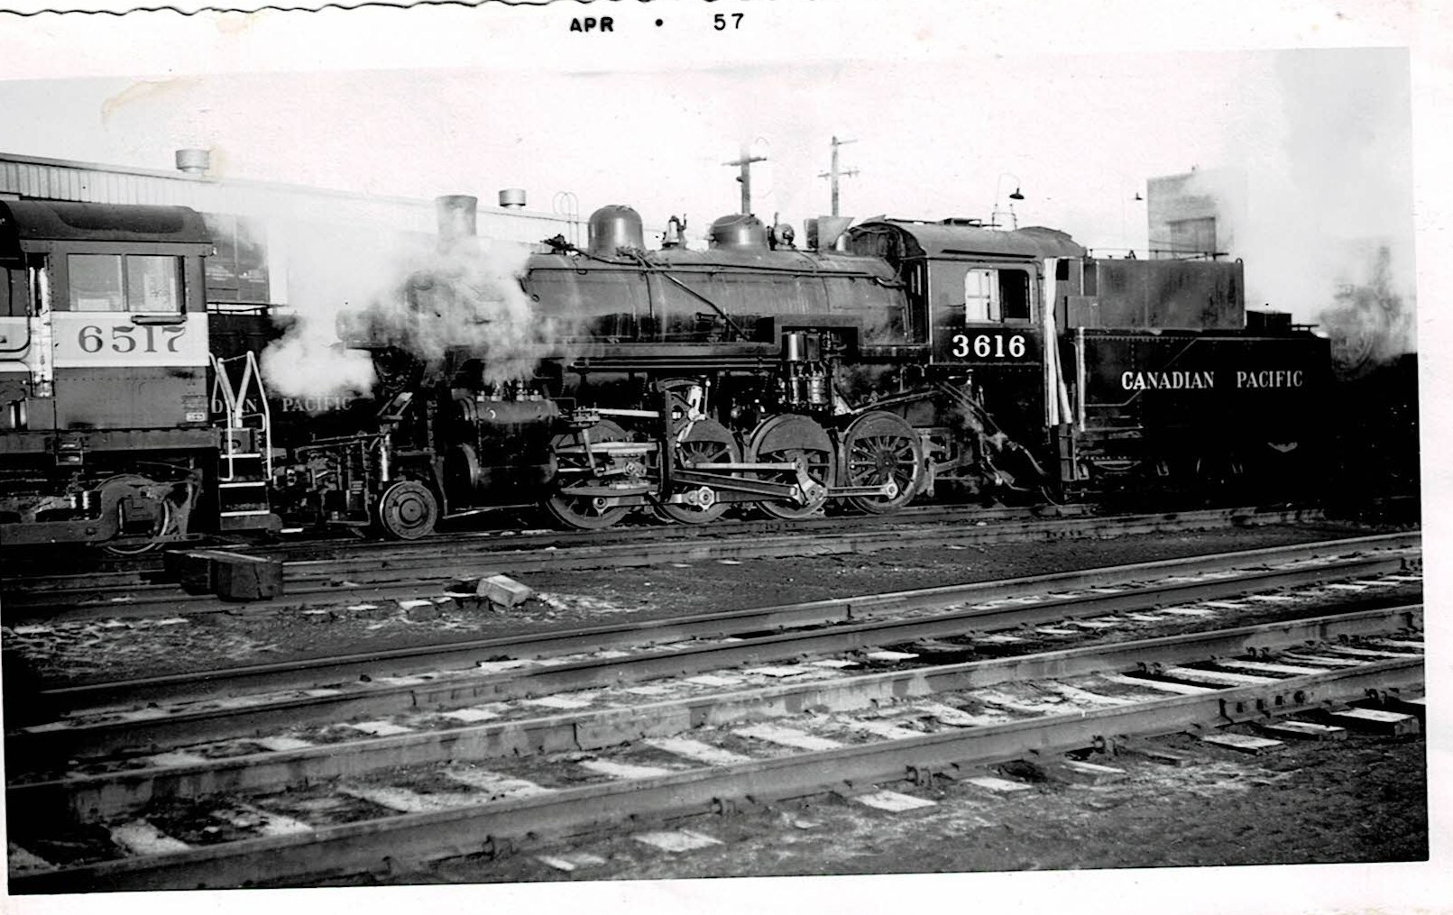
3616 N2a 2-8-0 switcher ex Ogden shops.
The cylinder blow crack seat in upper throttle valve removed and sent to shops

Slide 26
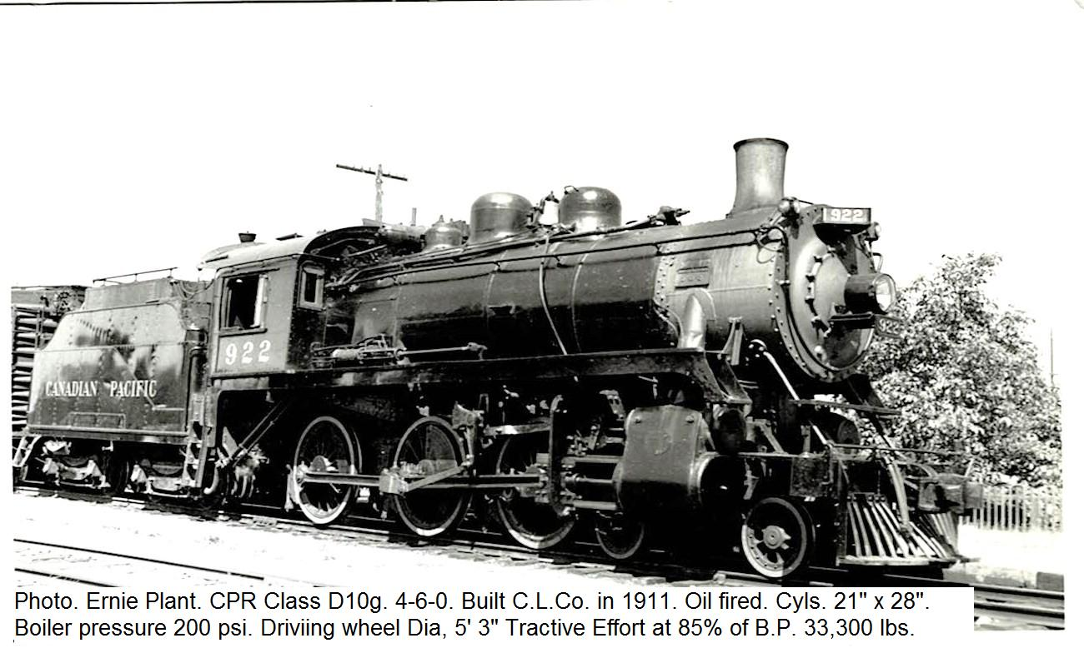
922 D10g 4-6-0 became a switcher
Converted to Walchaerts valve gear

Slide 27
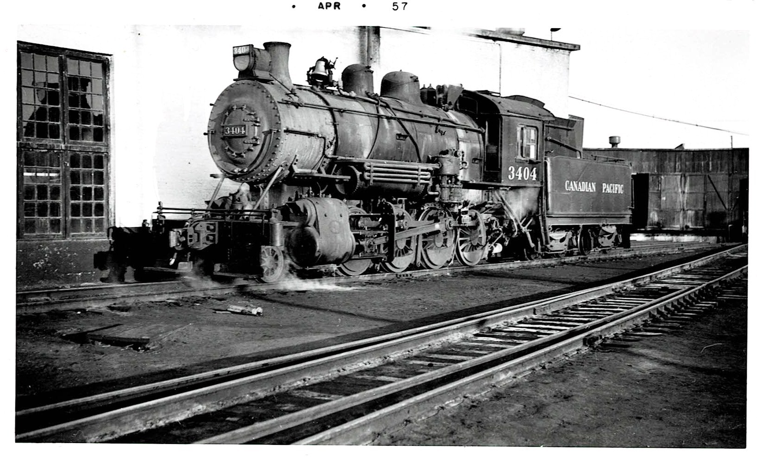
3404 M4a 2-8-0
Best switcher, went east to Windsor Ontario in 1958

Slide 28
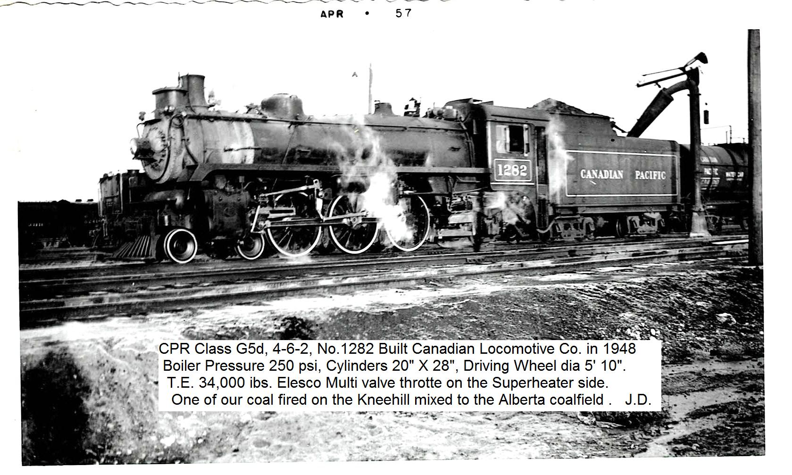
1282 G5d CLC 1948
Coal fired on Kneehill mixed.
9 years old at Alyth taking on water during firemens strike

Slide 29
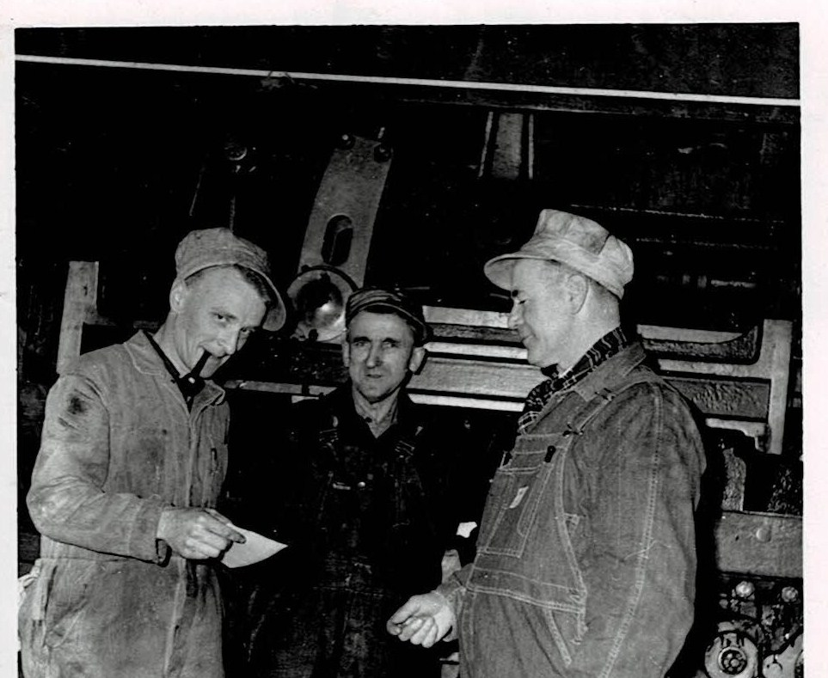
First inspection job after passing air brake exam
On 2864 for the Edmonton mail.
On the afternoon shift from 1600 to midnight

Slide 30
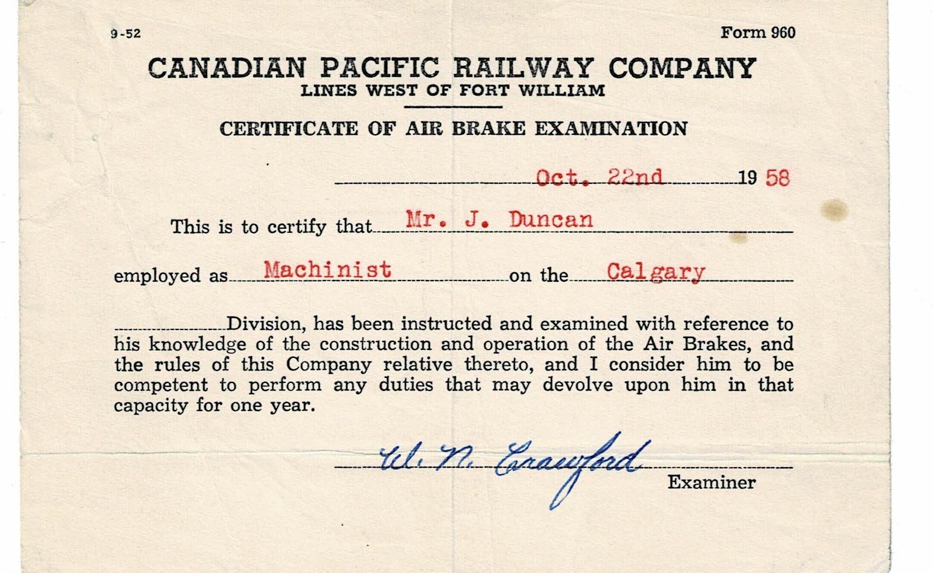
Brake examination in October 1958 for steam & diesel locos certification

Slide 31
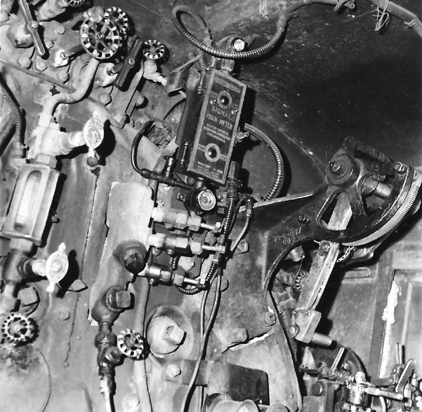
2863 RH side of the cab, showing foam meter
Indicating foam forming at the top of the boiler water level

Slide 32
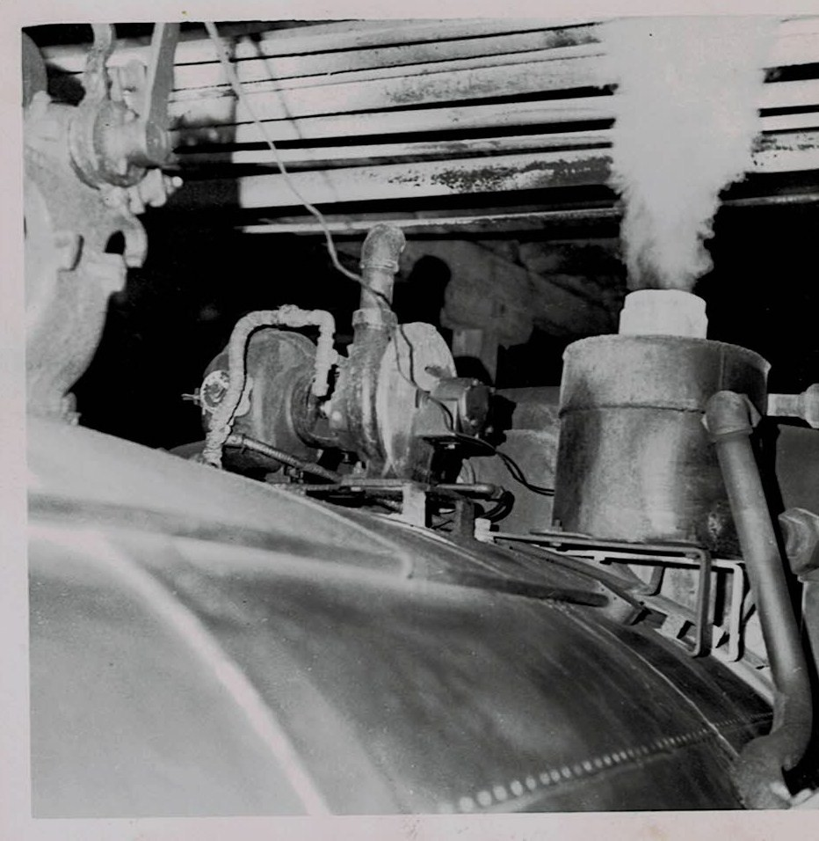
2863 showing foam blow off and dynamo

Slide 33
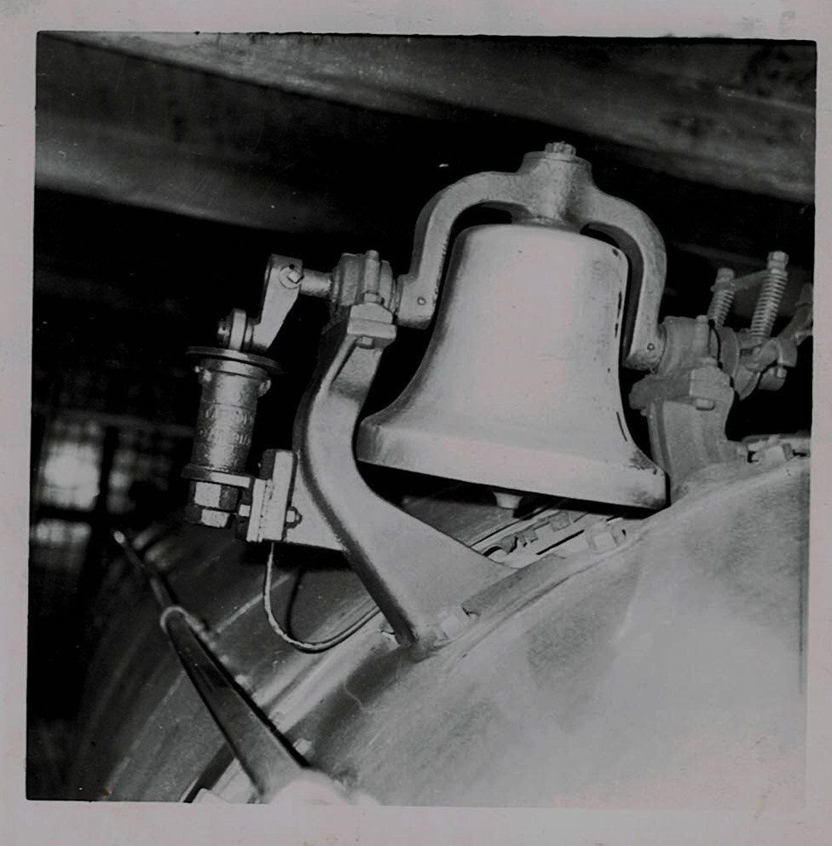
2863 Crosby bell and ringer

Slide 34
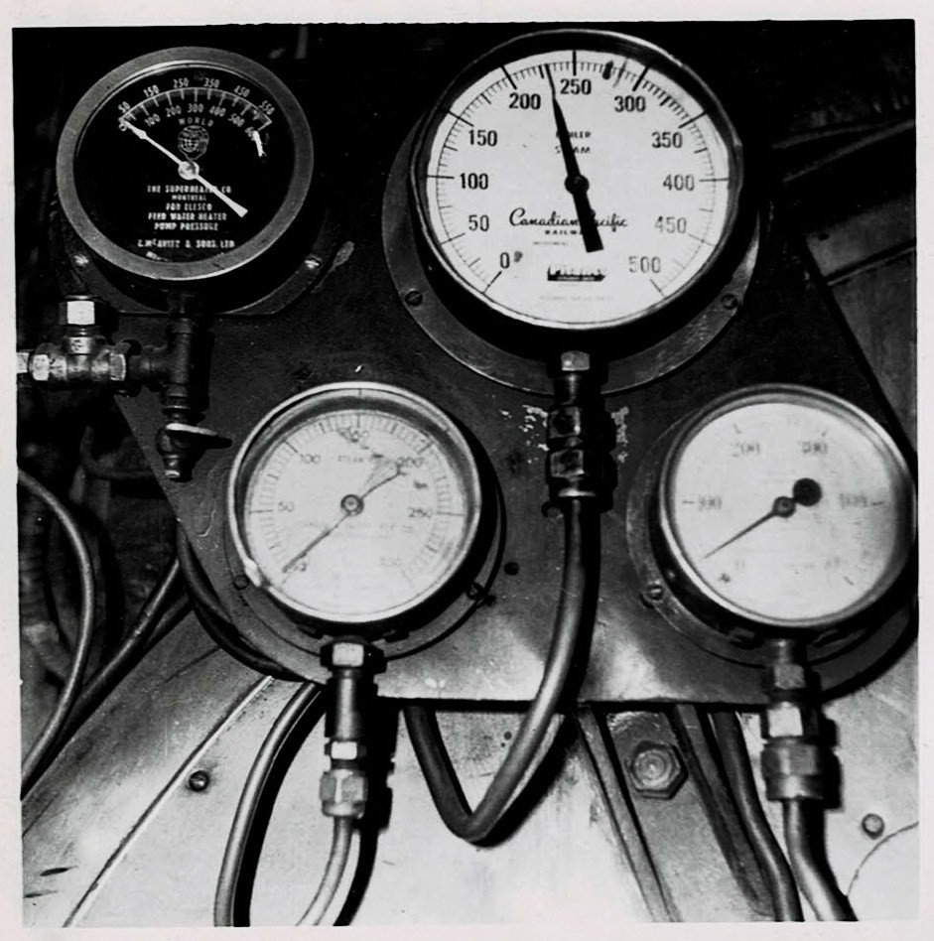
2863 Fireman’s gauges
Boiler pressure
Steam heat
Water pump pressure
Booster engine pressure

Slide 35
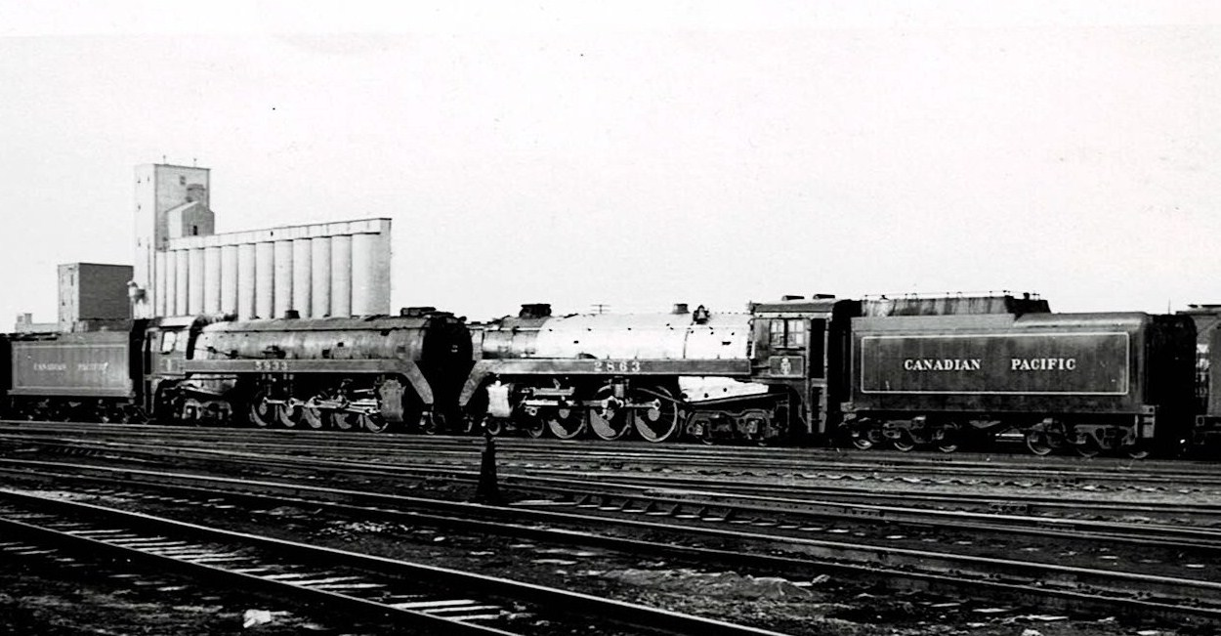
5933 for scrap
2863 East for traffic and special job in 1959
Queen Elizabeth and Duke of Edinburgh visit?

Slide 36
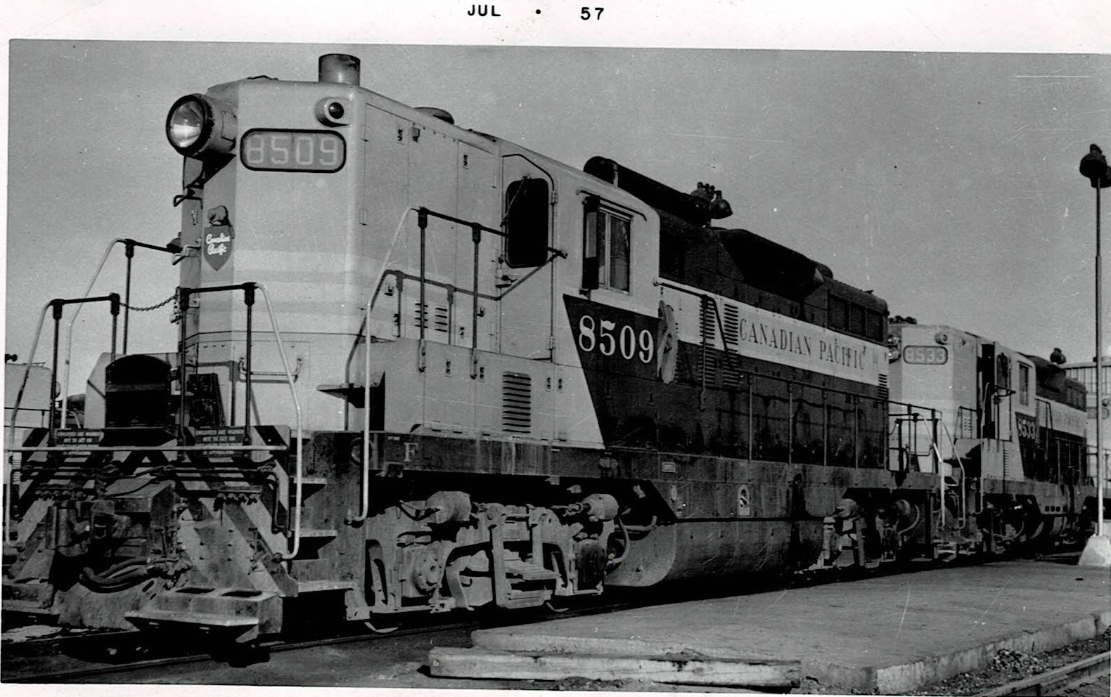
GM Gp9 with OK 4625 steam generator & 2nd Gp9
8509 & 8533

Slide 37
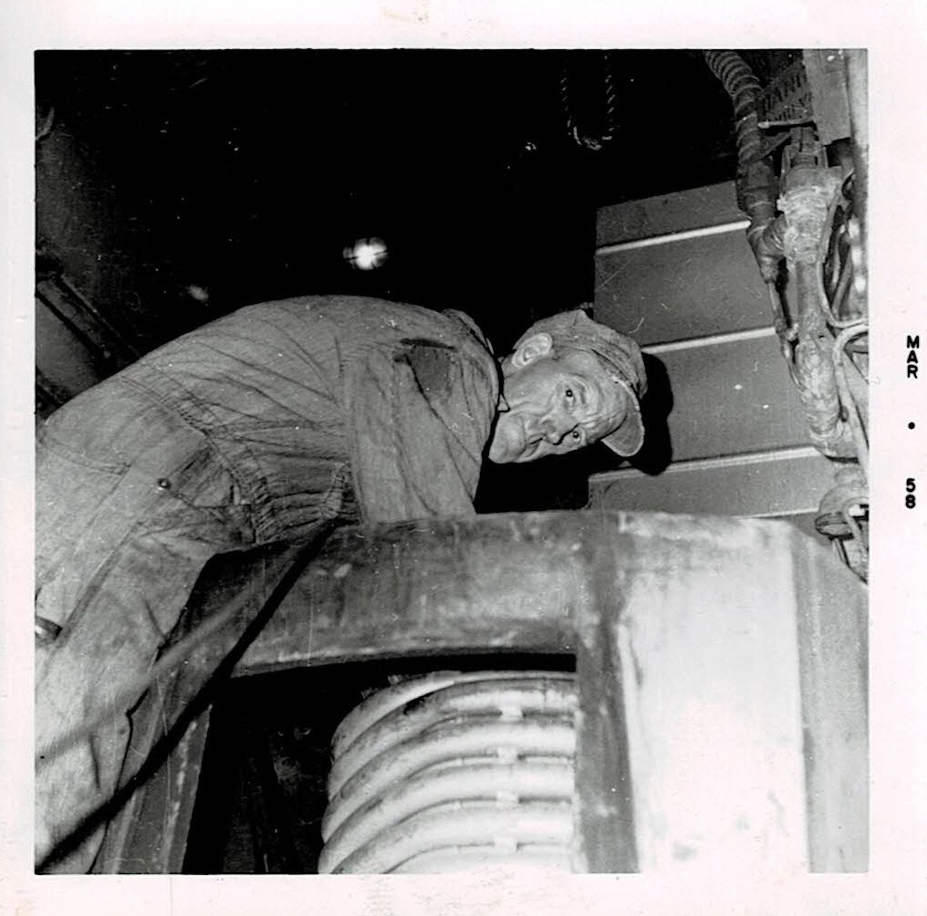
Boilermaker fitting Vapor Clarkson OK4760 steam generator coils in an F unit

Slide 38
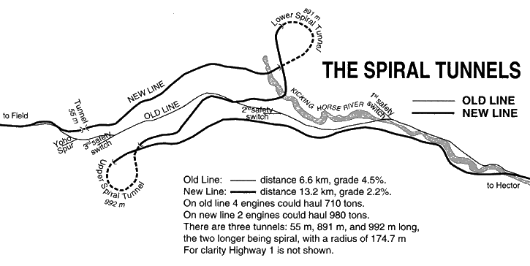
Kicking Horse Pass spirals

Slide 39
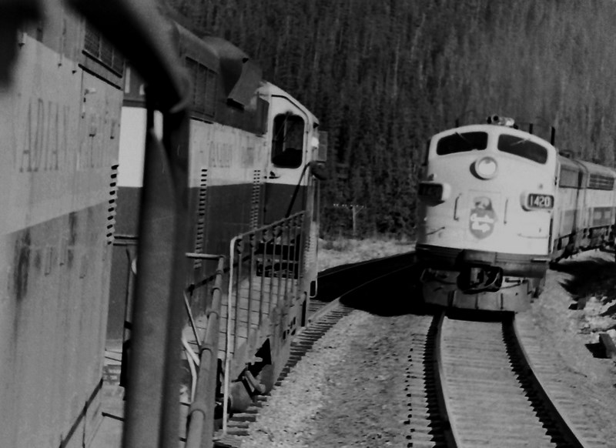
Call out on G9p dynamic brake fault 2nd unit Gp9.
Stopped at Yoho loop between the the Mount Stephen spiral and Cathedral Mountain spiralto let train No8 through

Slide 40
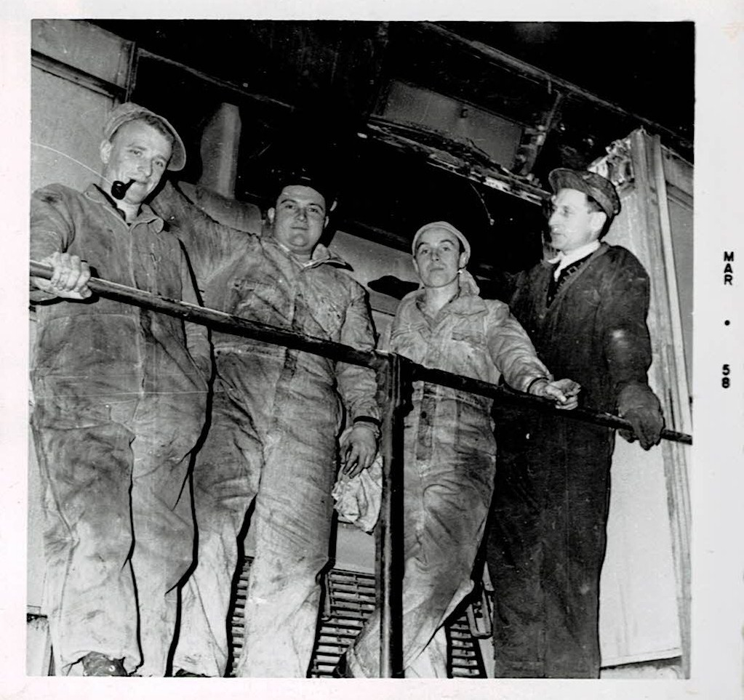
Gp9 dynamic brake grid out
Left to right
John - machinist
Joe – electrician
Bill – electrician
Fritz - machinist

Slide 41
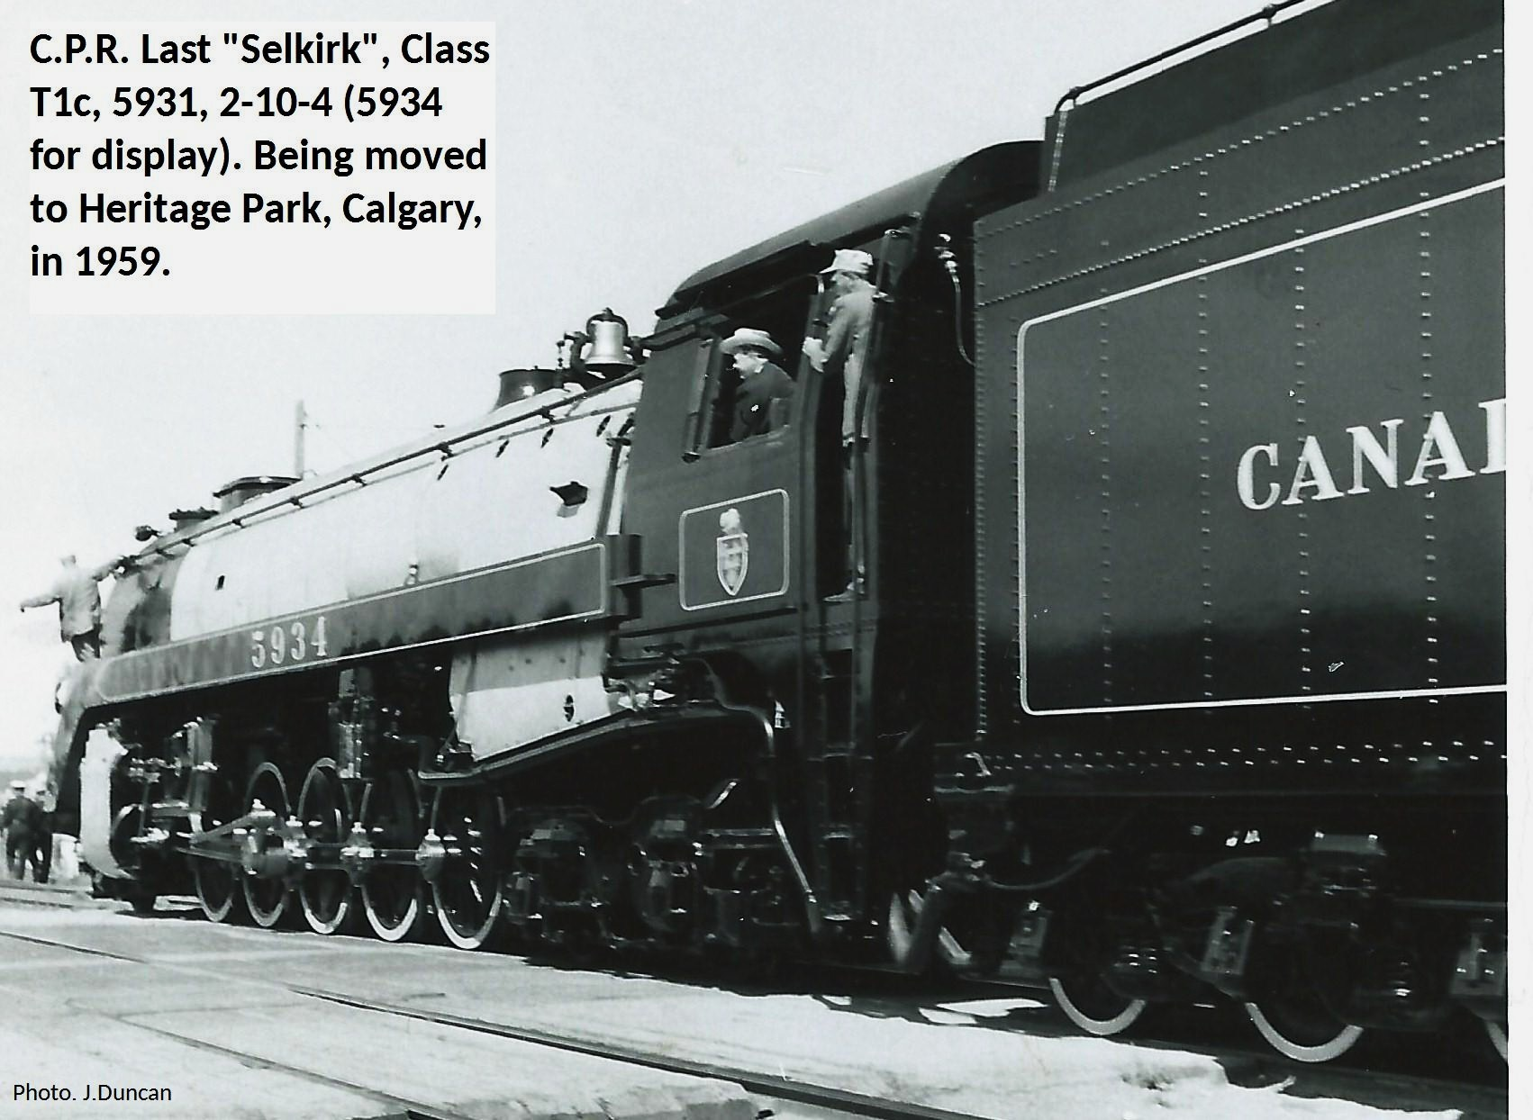
5931 – 1959 going to Heritage Park, Calgary

Slide 42
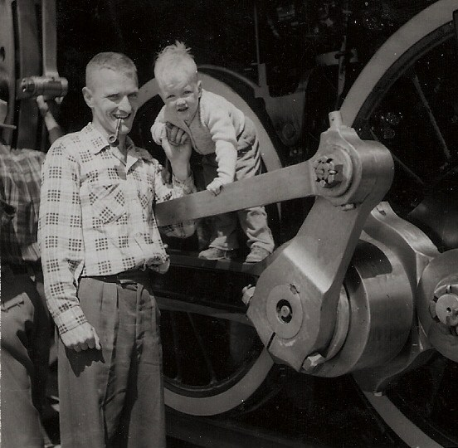
Dad and son Bill 2 ½ with 5931 in 1959

Slide 43
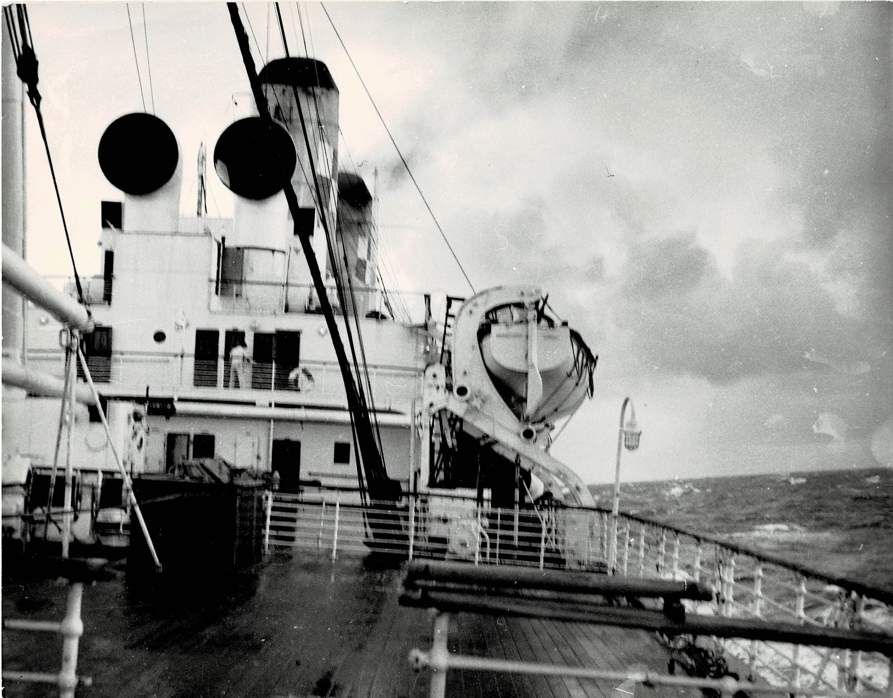
SS Empress of France homeward bound for Liverpool Pier Head, December 1959

Slide 44
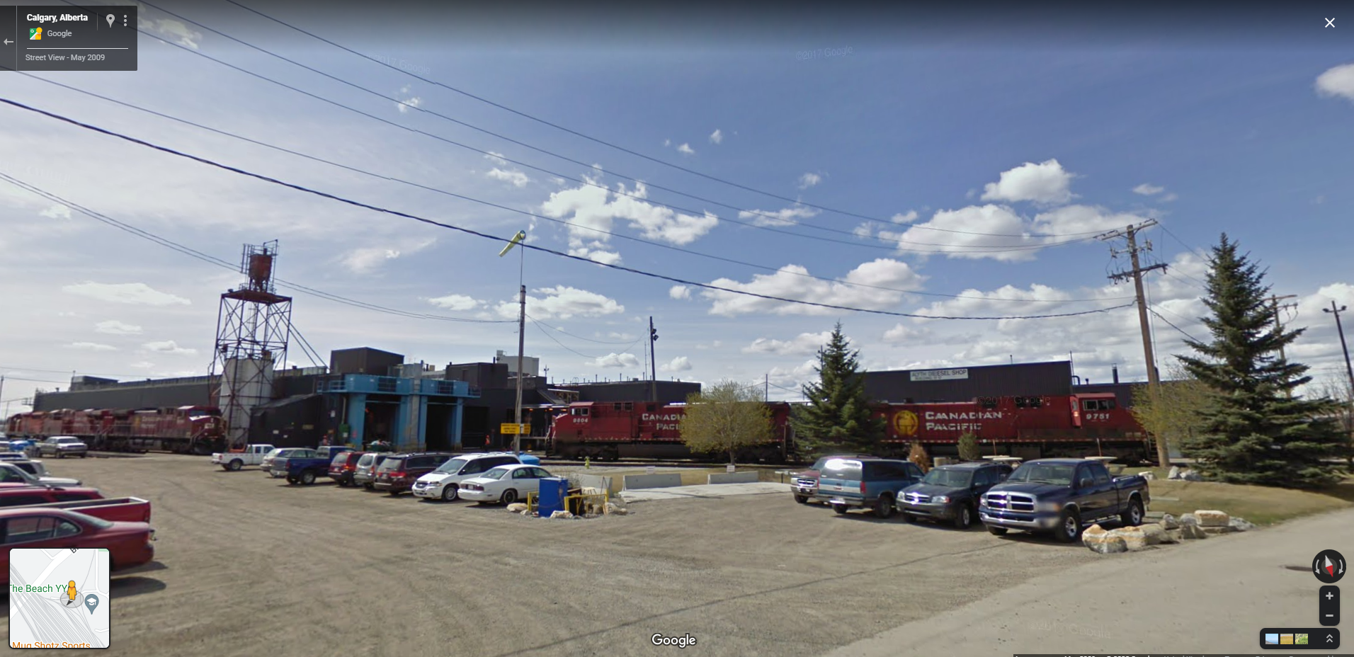
Aylth Diesel Shop

