Slide 1
LNER P2 2007 Prince of Wales:
Traditional Technology; Modern Methods
Advanced Steam Traction Trust Conference 9th October 2016
David Elliott – Director of Engineering

Slide 2
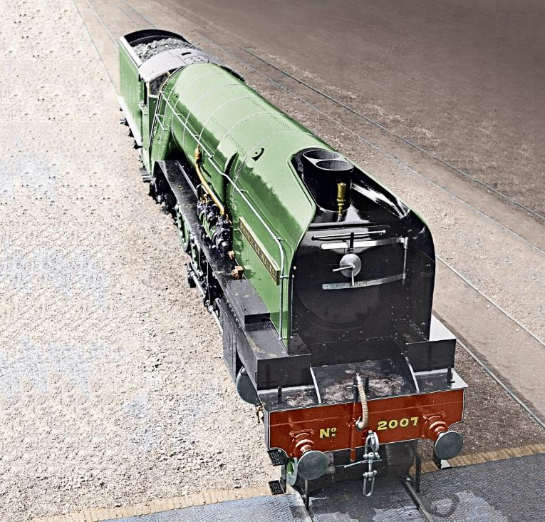
Our mission
Introduction
“To develop, build and operate an improved
Gresley class P2 Mikado steam locomotive
for main line and preserved railway use”

Slide 3
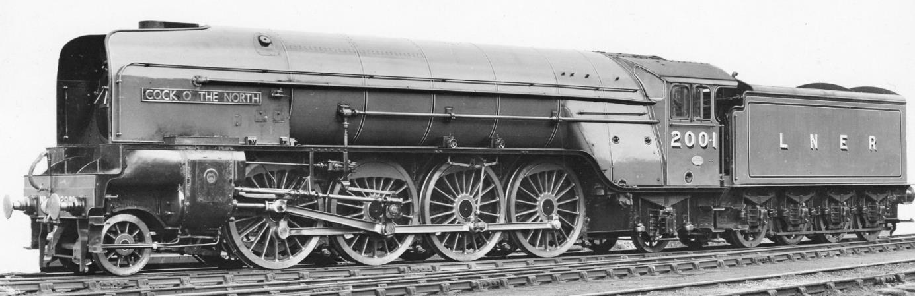
The finished article, May 1934
The original P2s
2-8-2 Mikado wheel arrangement
50 sq ft firebox grate
Kylchap chimney/blastpipe arrangement
ACFI feed water heater
Chime whistle
Lentz rotary cam poppet valve gear
Semi-streamlined and a V-shaped cab front
All-welded tender with spoked wheels
Gill Sans nameplate

Slide 4
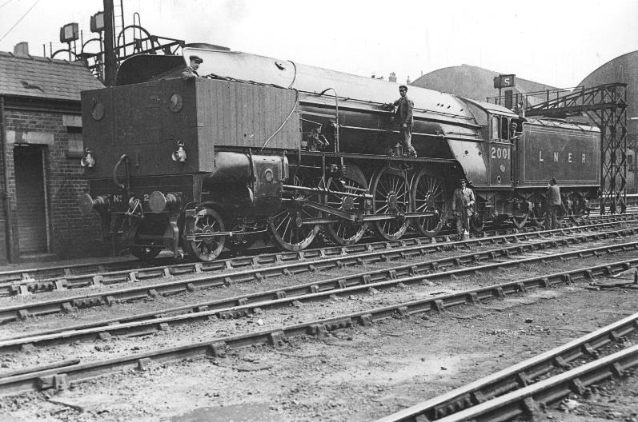
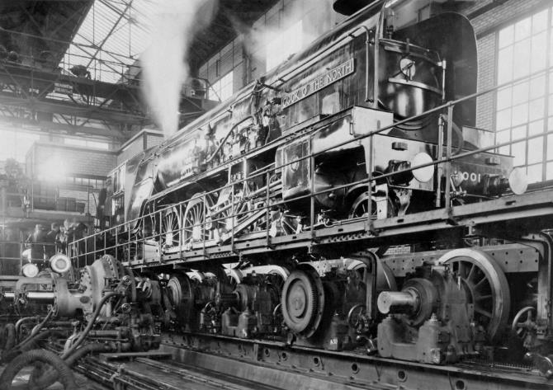
No. 2001 on test
The original P2s
At Vitry-sur-Seine near Paris, France

Slide 5
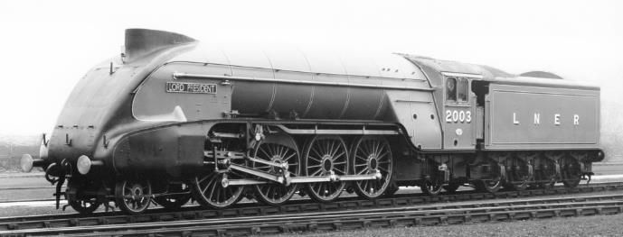
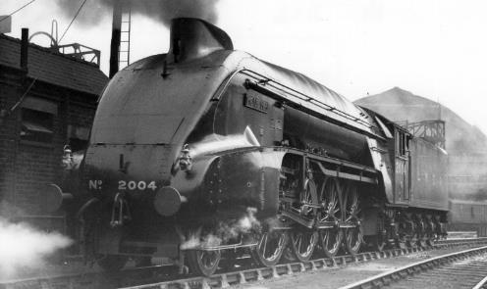
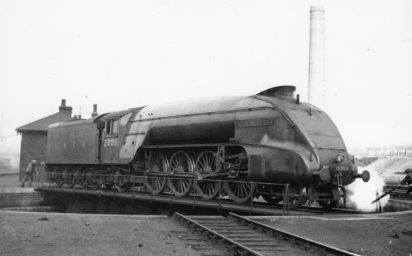
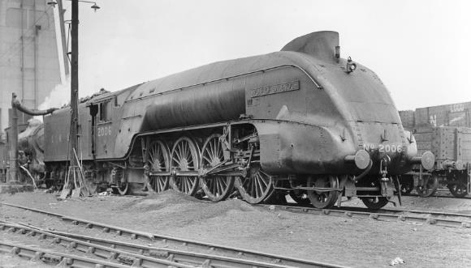
Six locomotives built in total – class complete September 1936
The original P2s
No. 2004 Mons Meg - bypass valve to divert exhaust from the blastpipe
No. 2003 Lord President - first of the streamliners
No. 2005 Thane of Fife - single
(non-Kylchap) chimney
No. 2006 Wolf of Badenoch - longer combustion chamber in firebox to aid combustion
prototype for Tornado’s boiler

Slide 6
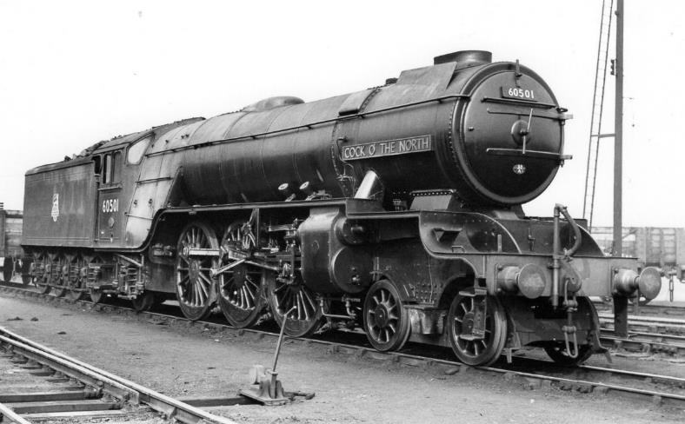
Ignominious end
The original P2s
  Not an outstanding success in service.
  Poor utilisation
  Reputation for track spread and derailment
  Gresley’s death and war time exigencies sealed their fate
  By 1943, all had been rebuilt by Thompson (Gresley’s successor) into ungainly pacifics

Slide 7
Key design principles
Creating No. 2007
Whole locomotive to be drawn in 3D CAD
Existing design to be used except:
  Alterations to alleviate known problems with original design
  Changes required to meet modern operating requirements
  Equivalent Tornado design can be used
  Improvements to assist maintenance and life-cycle costs
Materials at least equal to and preferably better than original
Achievement of compliance with rail industry standards

Slide 8
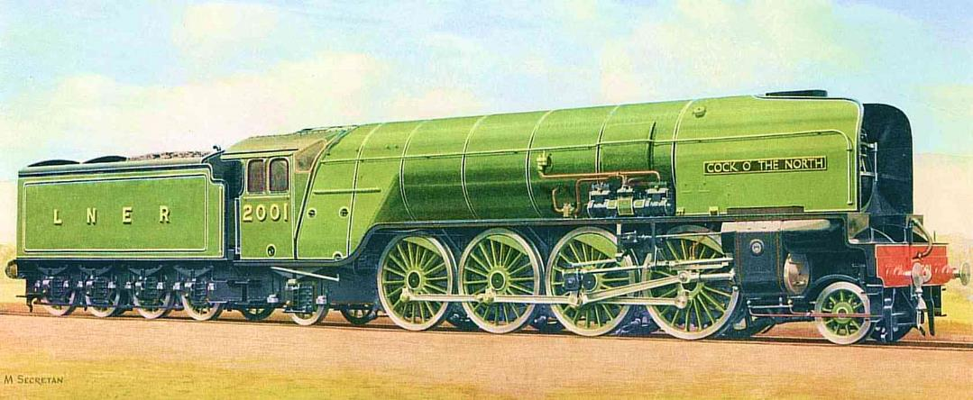
Feasibility Study
P2 project – facing up to the issues
Magnificent and impressive though they were, the original P2s gained an adverse reputation and history records that they were rebuilt into 4-6-2s
A very different starting point compared to the A1 in terms of getting acceptance on the modern railway
Track spread – in modern parlance “poor curving performance” – is of particular concern in terms of gaining acceptance in the modern era
8

Slide 9
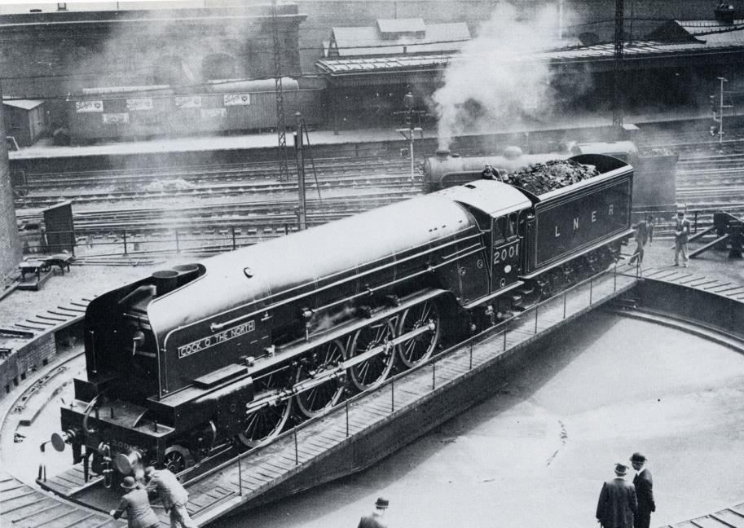
Feasibility Study
Aim of Feasibility Study
To demonstrate that it is technically possible to build a new P2 that will gain acceptance for running on the national railway network
9

Slide 10
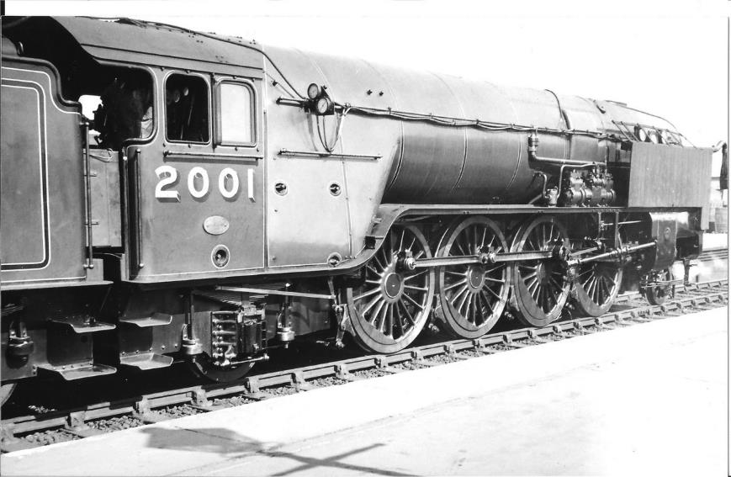
Vampire Study into vehicle ride
Feasibility Study
Phase 1 – create a validated computer model of Tornado
Phase 2 – develop a model of Gresley P2 as built
Phase 3 – optimise the model to prove acceptable performance
10

Slide 11
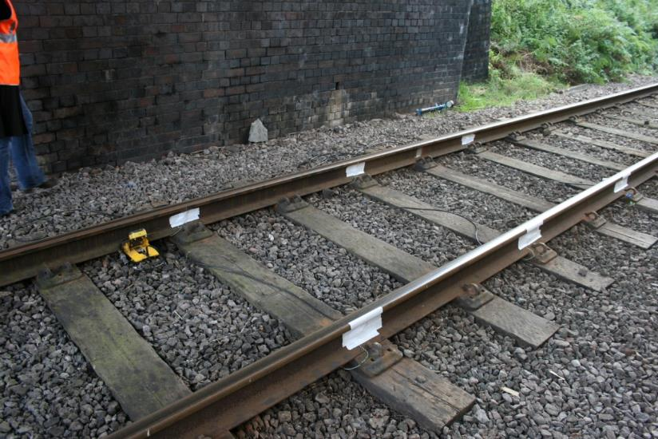
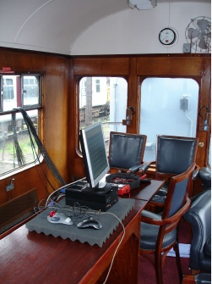
It started with Tornado in 2008 - Track force testing at GCR
Ride Study using Vampire

Slide 12
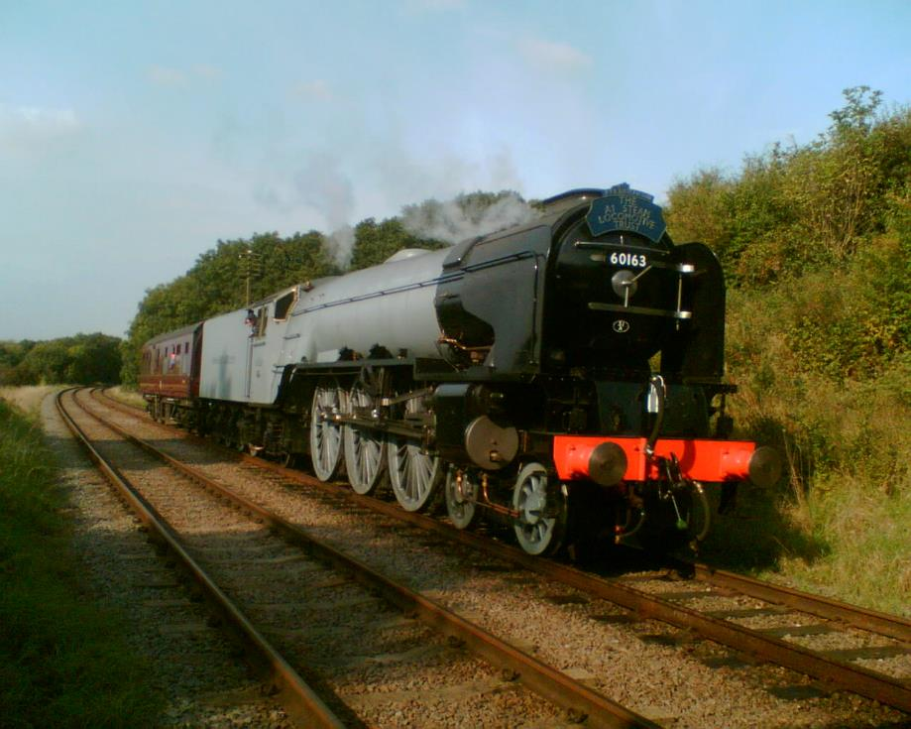
All instrumented up – 60mph max
Ride Study using Vampire

Slide 13
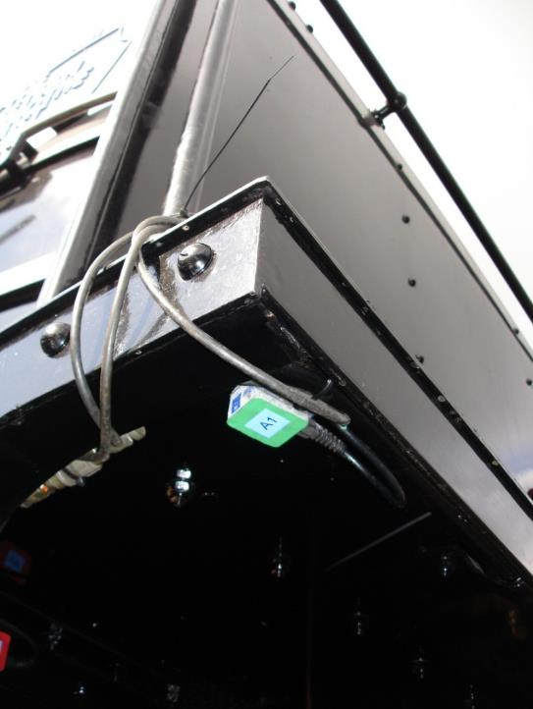
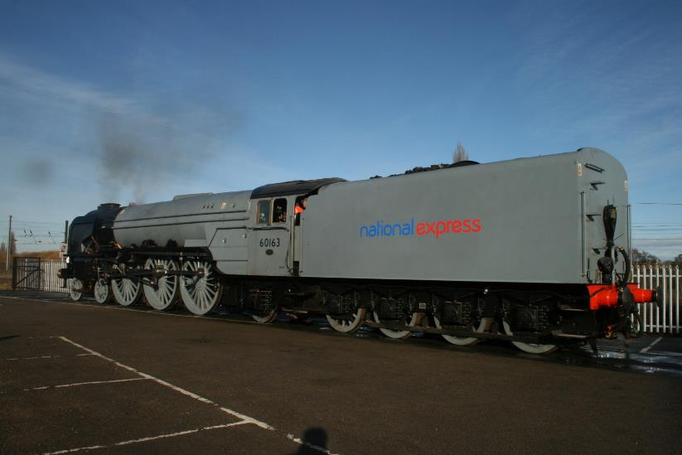
Re-instrumented up for ECML high speed test run – 75mph (plus…)
Ride Study using Vampire

Slide 14
Flying through Durham - 18th November 2008 – amassing validation data
Video omitted to reduce file size – instead see https://www.youtube.com/watch?v=jeFDvKH5rqQ

Slide 15
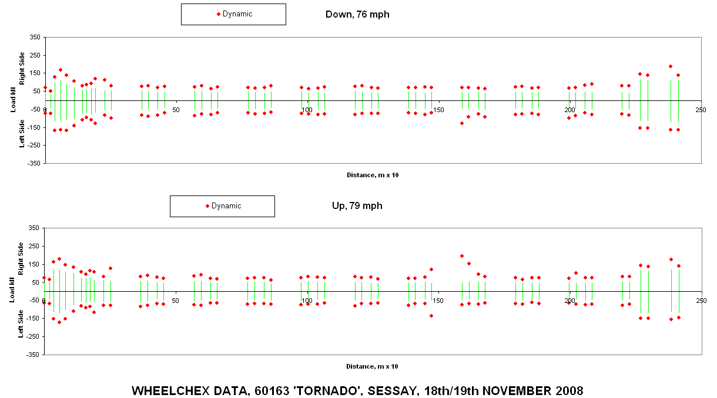
Instantaneous track force measurements – Sessay wheelchex
Ride Study using Vampire

Slide 16
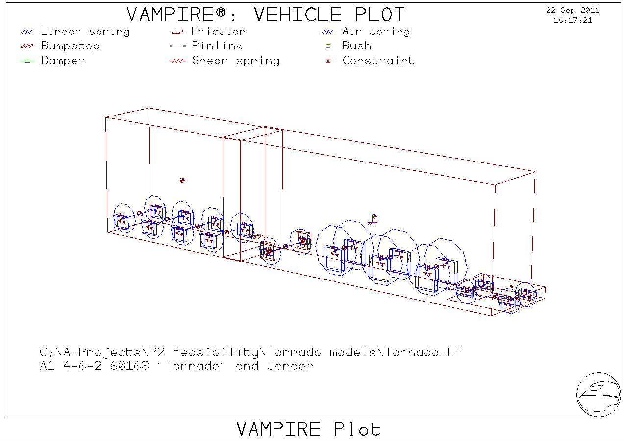
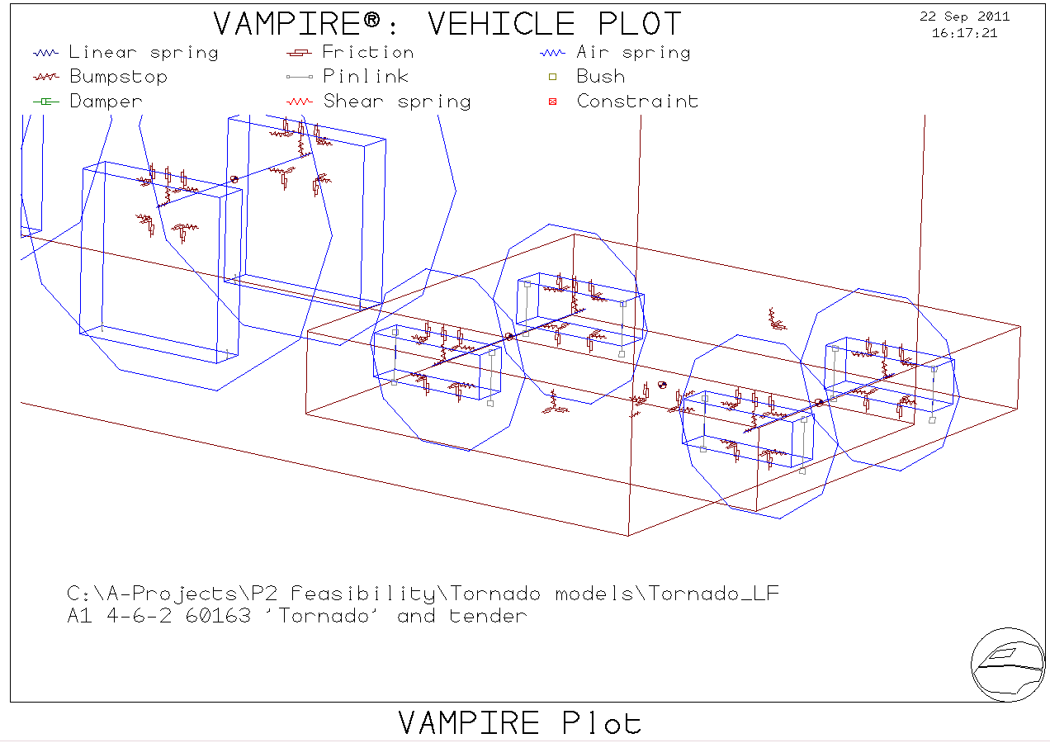
Ride Study using Vampire
P2 feasibility study phase 1 – validated model of Tornado

Slide 17
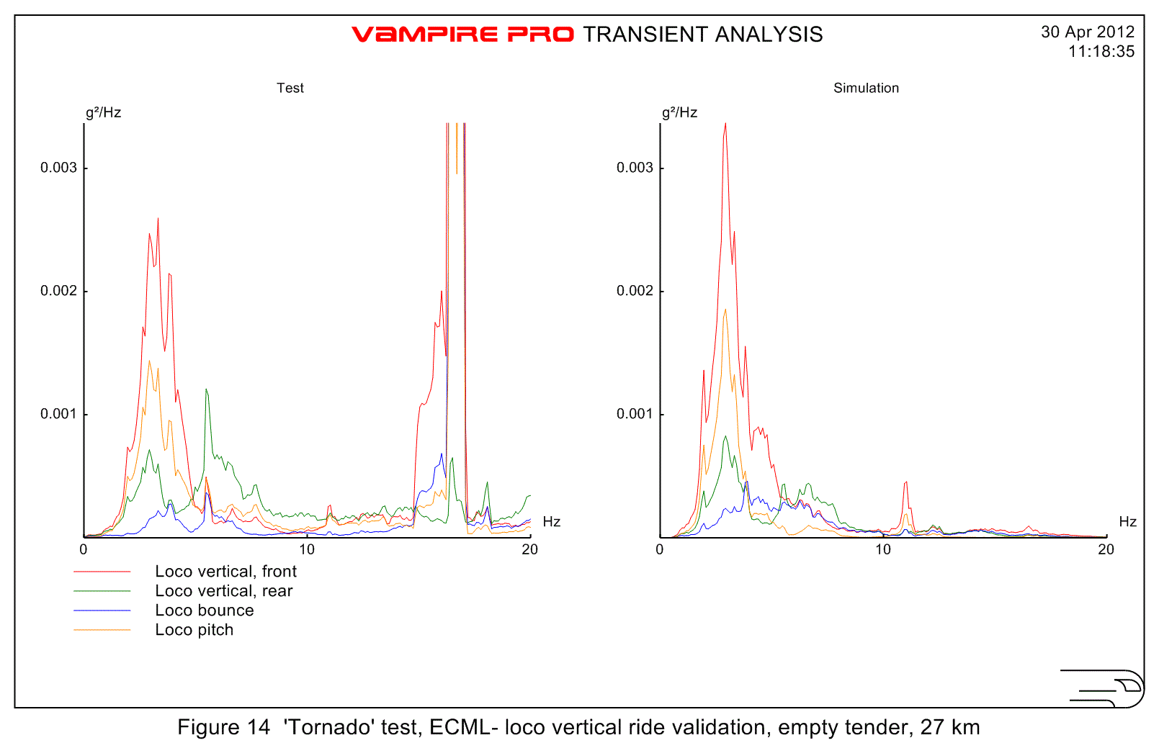
Ride Study using Vampire
The validation process
17

Slide 18
Phase 2 – P2 as the LNER originally built it
Ride Study using Vampire
Key original P2 drawings obtained from NRM
Research
into P2
(and V2)
incidents
Technical
details
extracted
and sent
to Deltarail

Slide 19
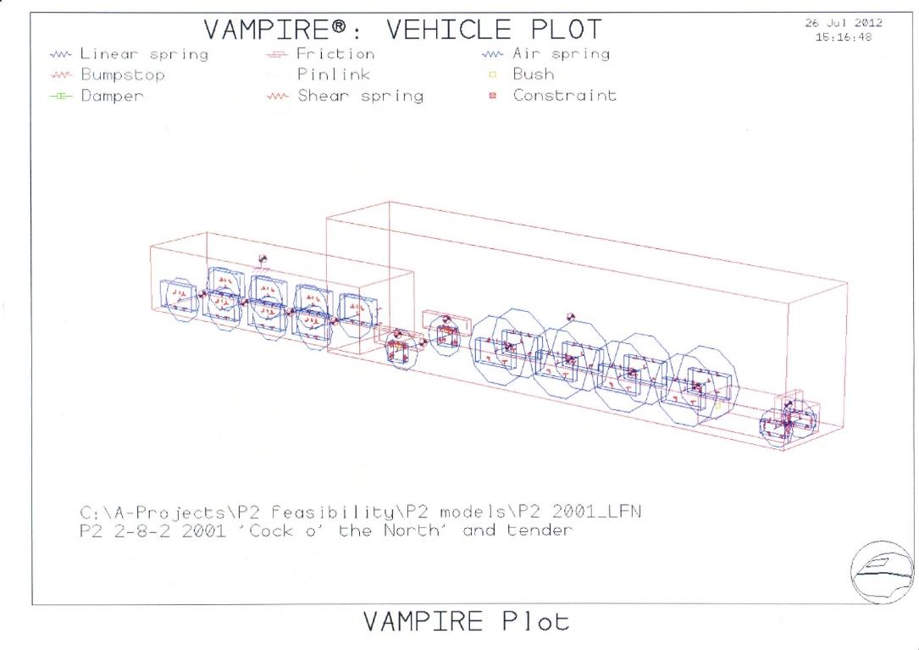
Ride Study using Vampire
P2 Vampire model as built
19

Slide 20
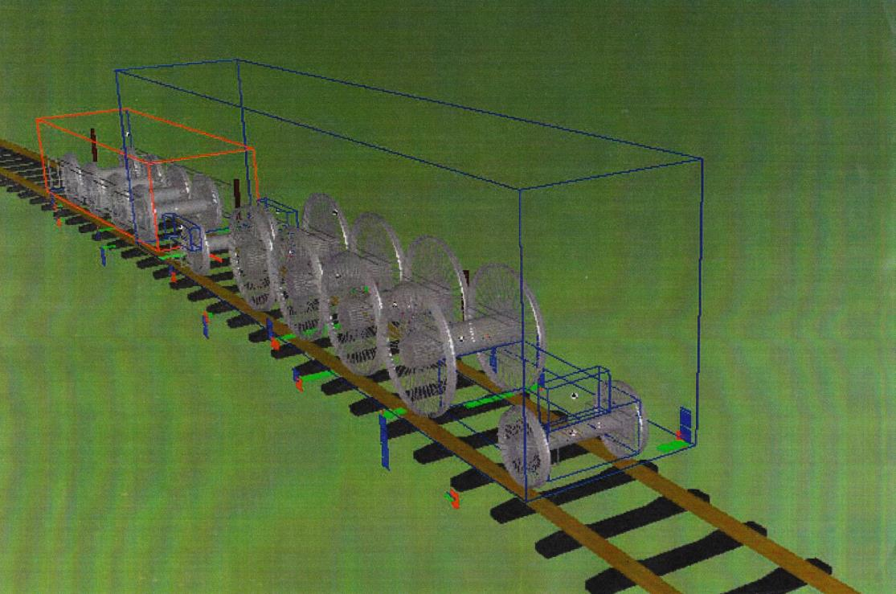
Ride Study using Vampire
Dynamic model of loco showed derailment mode
20

Slide 21
Ride Study using Vampire
Phase 3 – P2 with side control pony truck
21

Slide 22
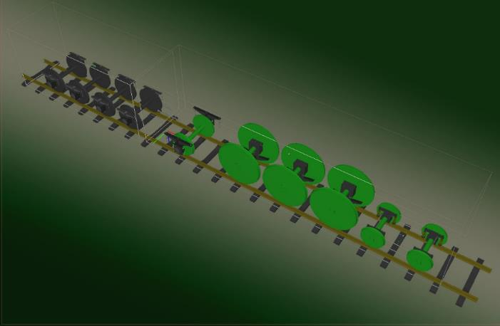
Four computer models created for comparison
Ride Study using Vampire
  A1 4-6-2 no. 60163 ‘Tornado’ – validated using 2008 test data
  P2 2-8-2 no. 2001
  ‘Cock o’ the North’ as built
  P2 2-8-2 no. 2007 vers.1
  as 2001 but with spring
  control pony truck
  P2 2-8-2 no. 2007 vers.2
  as 2007 vers.1 but with refined lateral clearances and vertical hydraulic dampers on pony truck

Slide 23
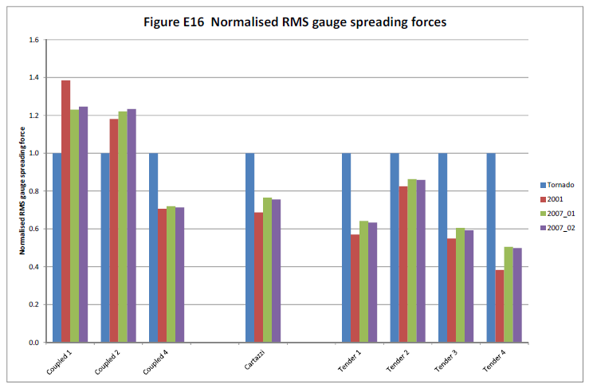
Ride Study using Vampire
Sample results – track shifting forces
23

Slide 24
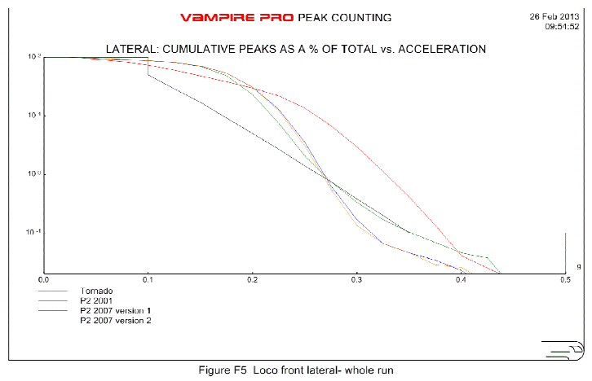
Ride Study using Vampire
Sample results – peak counting
24

Slide 25
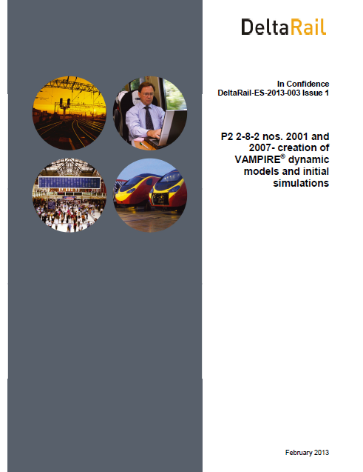
Ride Study using Vampire
P2 feasibility study – summary
  The study was completed and reported in 2013
  All models run on ‘assault course’ track consisting of 6 chain and 4.5 chain curves
  All models run from Tyne Yard (Newcastle) to Tollerton (York) at 83mph using 2008 track data
25

Slide 26
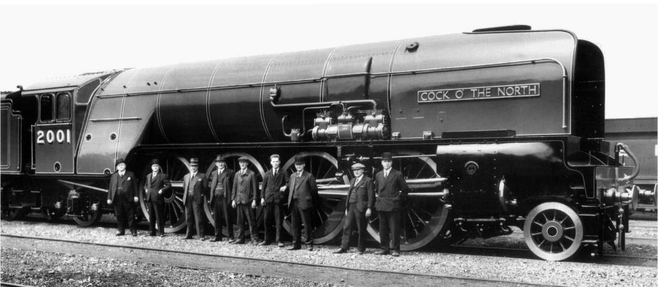
Conclusion
Ride Study using Vampire
  Whilst the design is still at a very early stage, it seems that a Class P2 with a spring-controlled pony truck (possibly with vertical hydraulic dampers) and slightly increased lateral play on the first and third coupled wheelsets could deliver dynamic performance comparable to or better than that of ‘Tornado’ [2013]

Slide 27
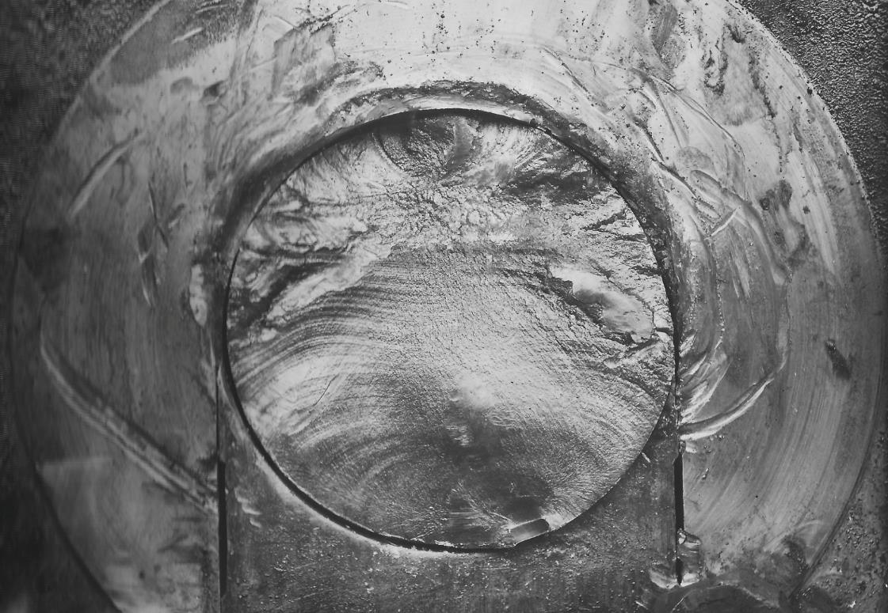
Crank axle
Another problem…..
27

Slide 28
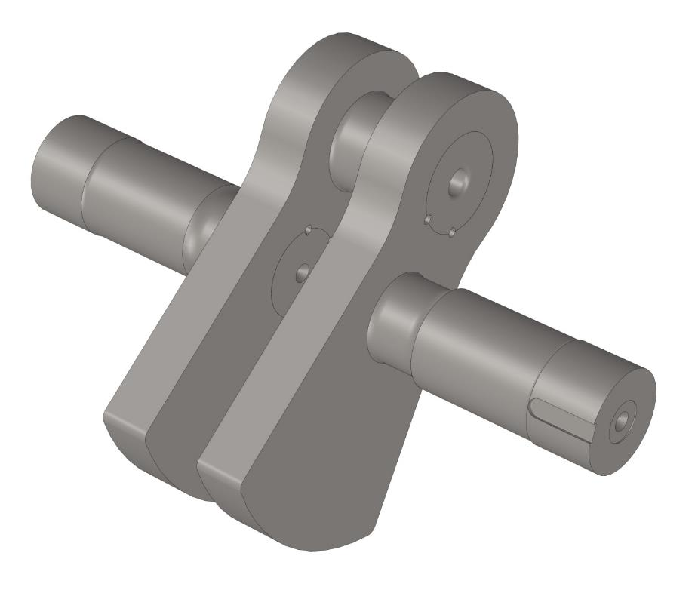
Crank axle
Original crank axle design
28

Slide 29
Crank axle
Crank axle failures
At least 5 crank axle failures in a class of 6 locomotives over a period of less than 10 years
The shortest life is believed to have been 93,000 miles
The example in the previous slide took place at 133,000 miles (2005 Thane of Fife at Stonehaven, 19th July 1938)
Crank axles did not have infinite fatigue life – LNER routinely renewed crank axles on large locomotives at 250,000 miles
Predominant failure mode in crank axles was loosening of crank pins in crank sweeps.
29

Slide 30
Crank axle
Crank axle failures
All failures took place as locomotives were accelerating hard at low speed away from station stops, ie with maximum torque applied to crank axle.
Likely causes:
P2 maximum piston force 34 tons (compared with 28 tons for Gresley A1 class, 31 tons for A4 class with similar crank axles)
8 coupled wheels result in significantly less susceptibility to slipping (which rapidly dissipates peak torques)
30

Slide 31
Crank axle
The solution
Mott Macdonald, Derby contracted to investigate proposed improvements to design.
Stresses in the crank axle arise from several inputs including:
Axle bending stresses from mass of locomotive, traction forces, and braking forces – BASS 504 assumptions used
Torsional stresses from piston forces, inertia forces and torque transmitted from one wheel to the other – calculations from first principles provided for 10 combinations of cut-off and speed
After 2 iterations of axle design, an acceptable result has been achieved
Stronger materials used
31

Slide 32
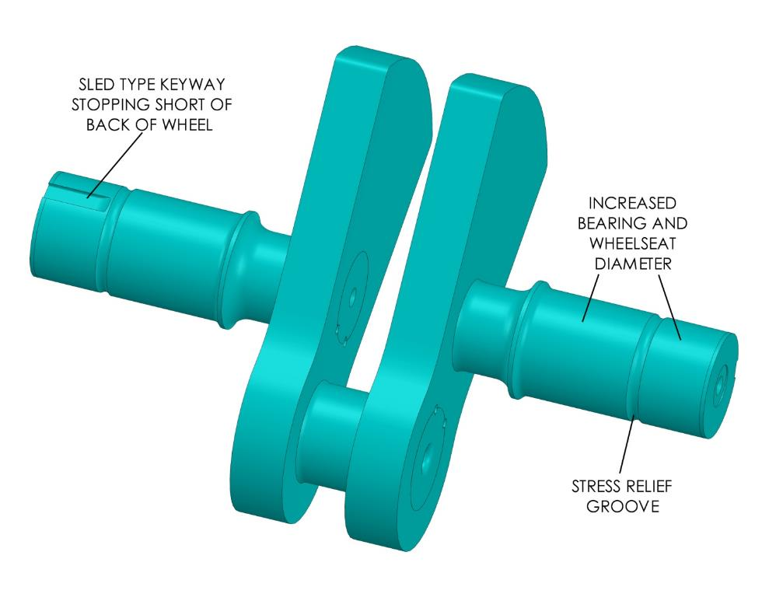
Crank axle
The solution – improved axle design
32

Slide 33
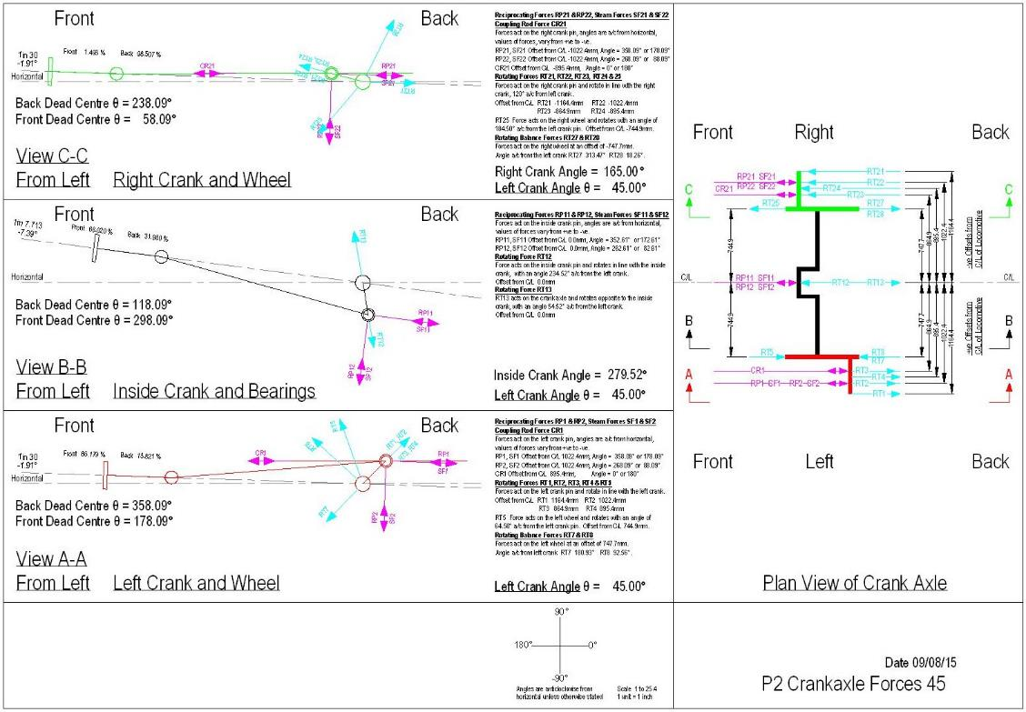
Crank axle
Input to FEA study – geometry and force diagram
33

Slide 34
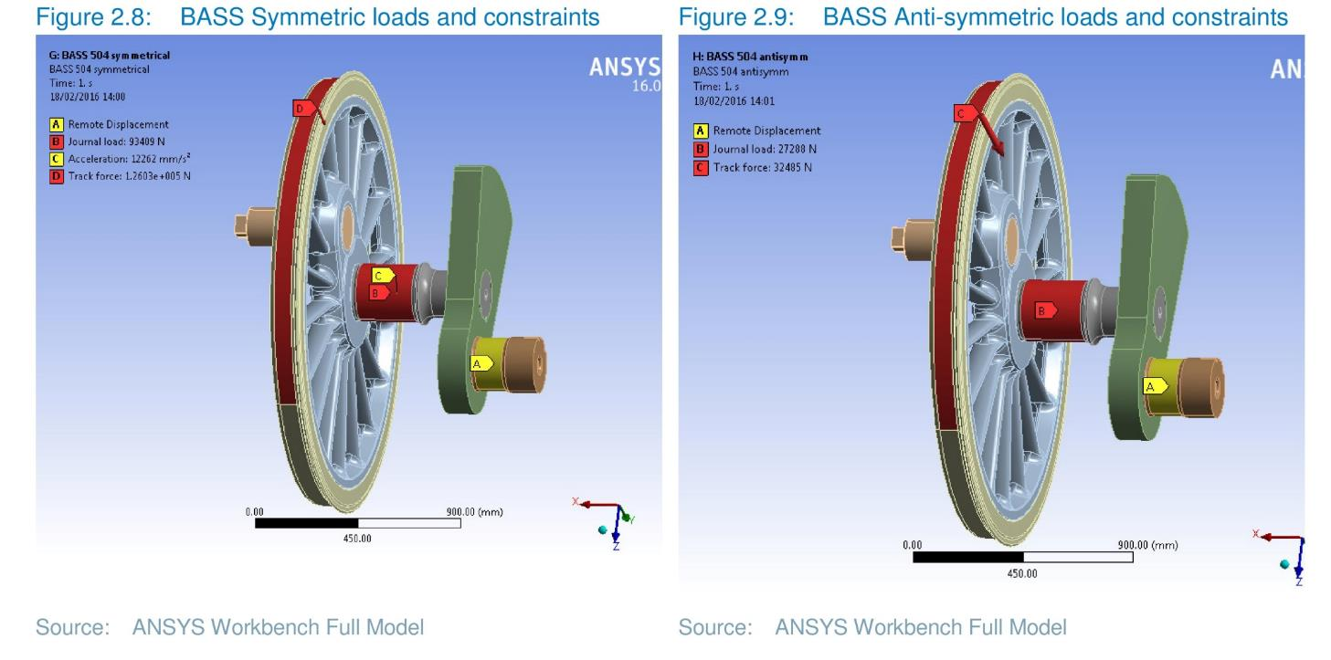
Crank axle
BASS 504 force modelling
34

Slide 35
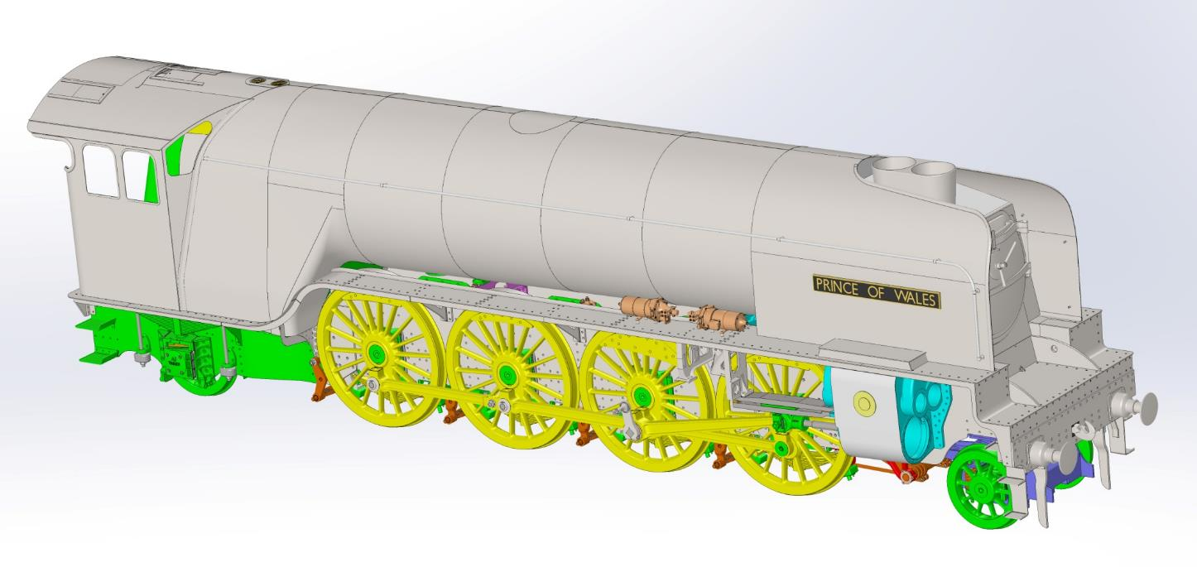
Commonality with Tornado and new design
Detailed design
Green: Tornado design
Yellow : minor redesign
Red: major redesign
Purple: modified V2 pony truck design
Blue: cylinders and valves

Slide 36
Design
P2 design – making use of 3D CAD
INTERMEDIATE FRAME STAY
36

Slide 37
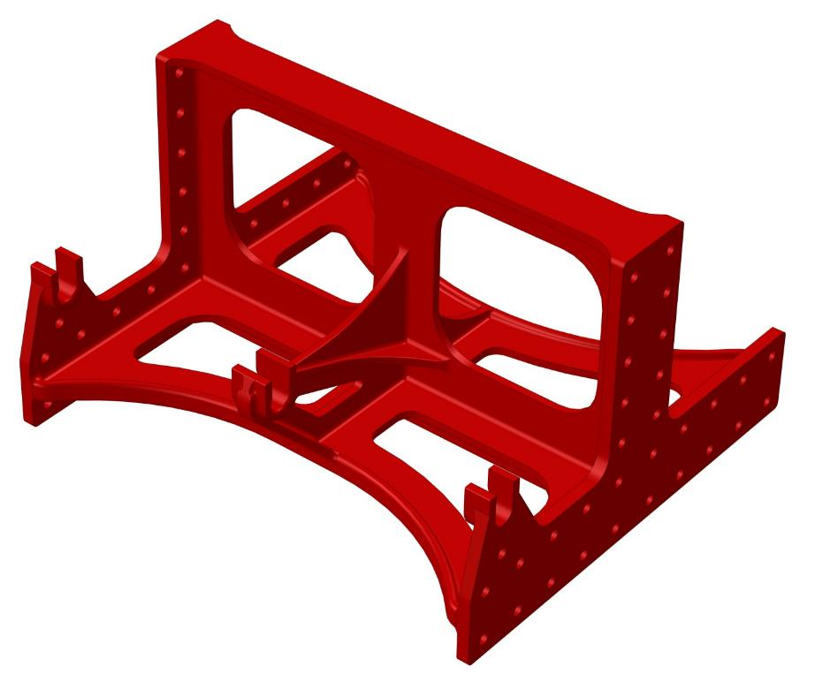
Design
P2 design example – intermediate frame stay original casting
37

Slide 38
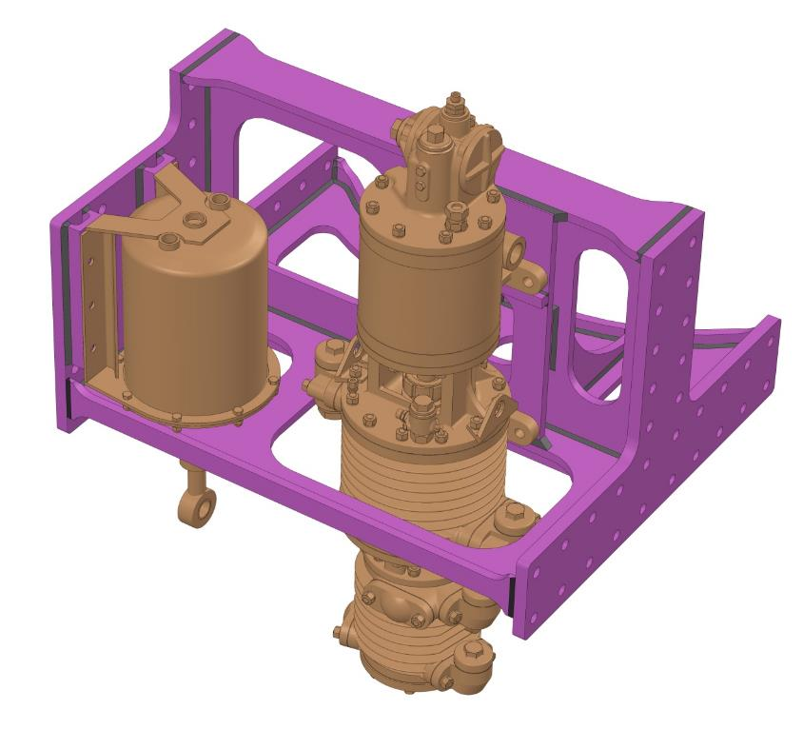
Design
P2 design example – intermediate frame stay as fabrication
38

Slide 39
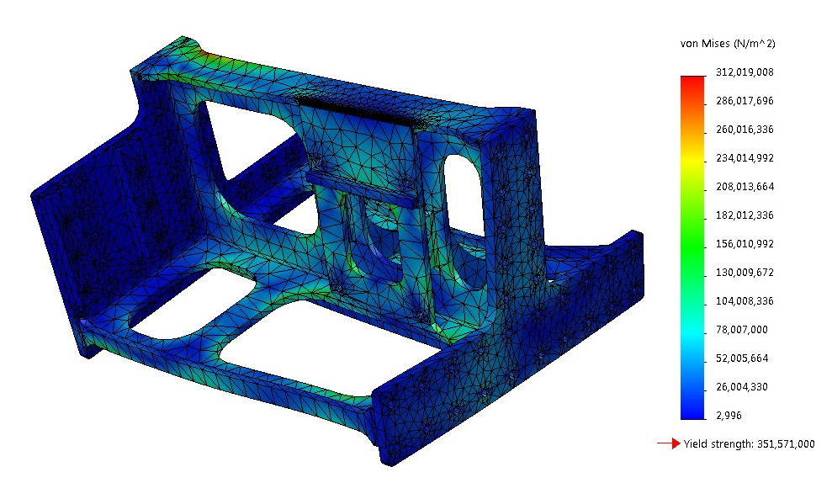
Design
P2 design example – intermediate frame FEA simulation
39

Slide 40
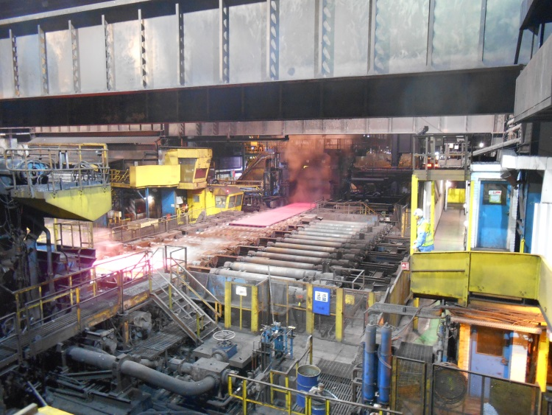
The frame plate material is rolled 23rd April 2014 at TATA Scunthorpe
Frames

Slide 41
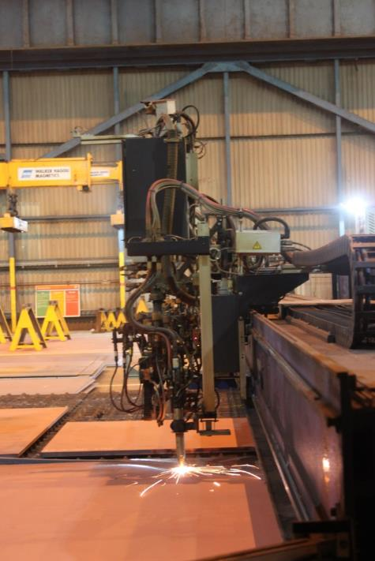
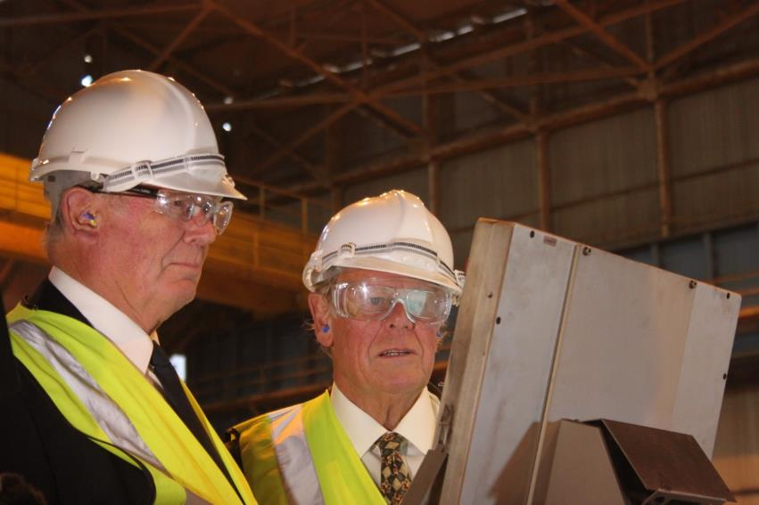
Sir Nigel Gresley’s grandsons start the profiling on 21st May 2014
Frames
Ben and Tim Godfrey start the profiler
Notes:
Feasibility study
Business plan
Organisational structure
Sponsor dialogue
Frame plates ordered
Establishing P2SLC
Launch of The Founders Club
Prince of Wales name announced
First component made

Slide 42
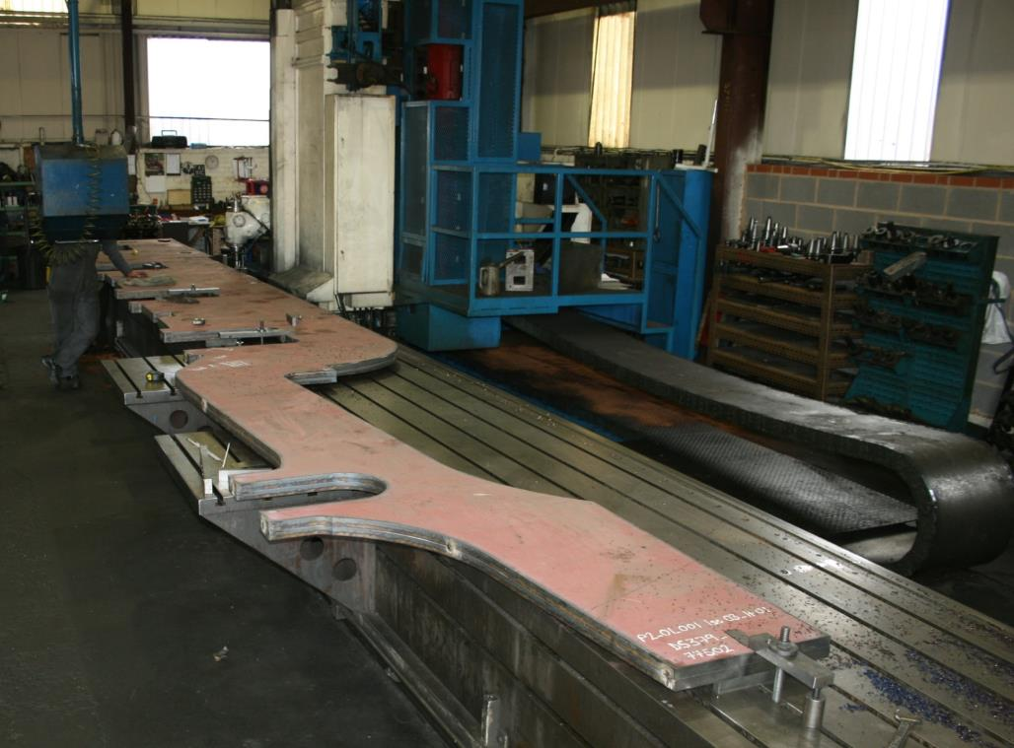
Machining frame plates at Boro’ Foundry
Frames

Slide 43
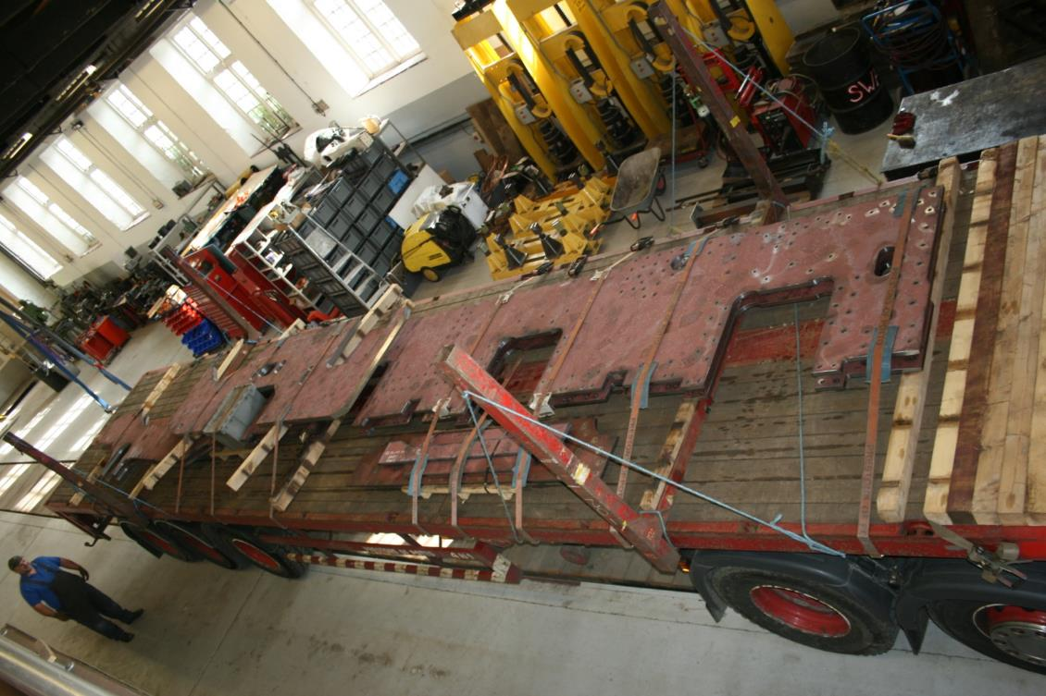
A flat pack kit arrives at Darlington...
Frames

Slide 44
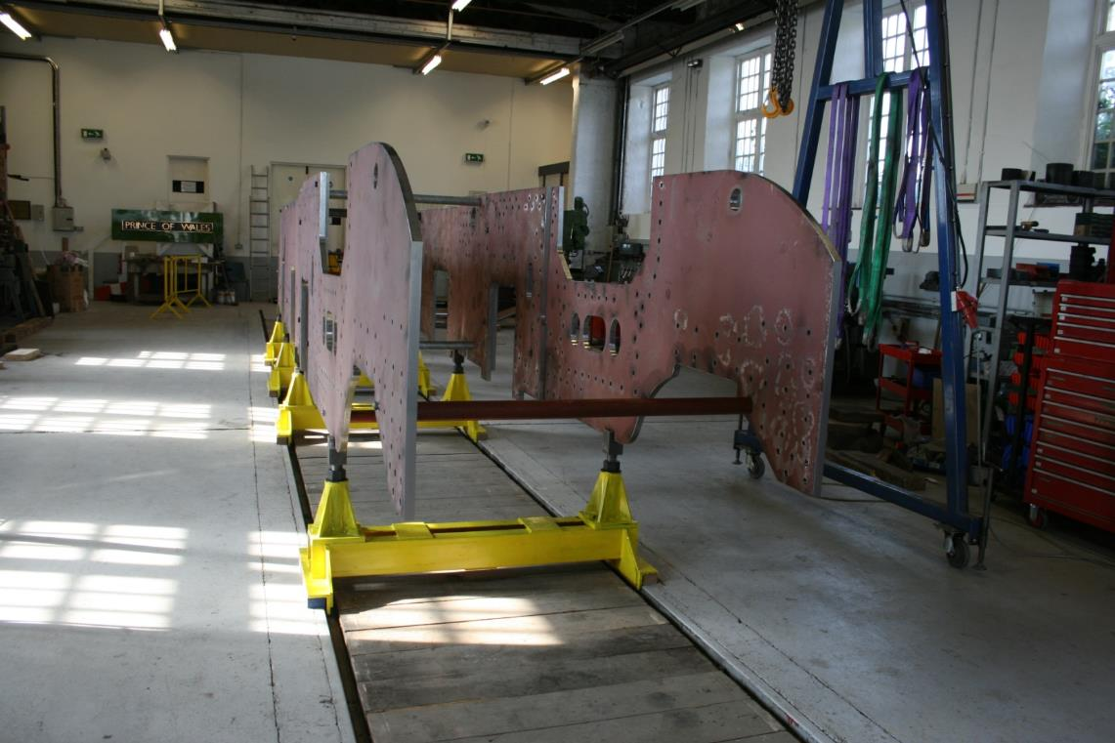
....and assembly starts
Frames

Slide 45
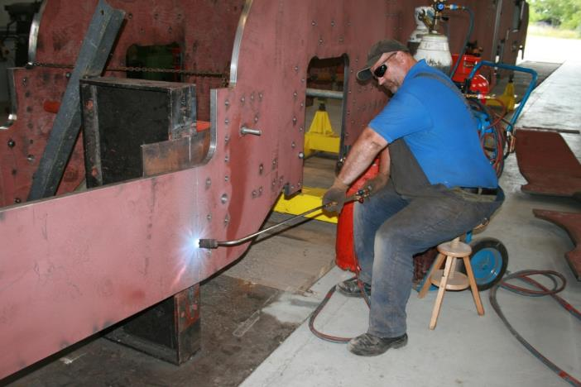
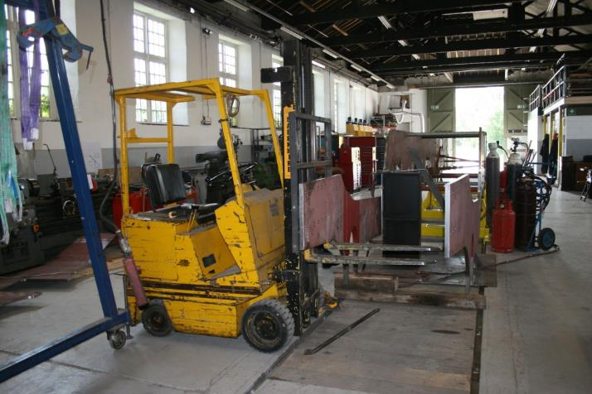
The rear frame is heated and bent
Frames

Slide 46
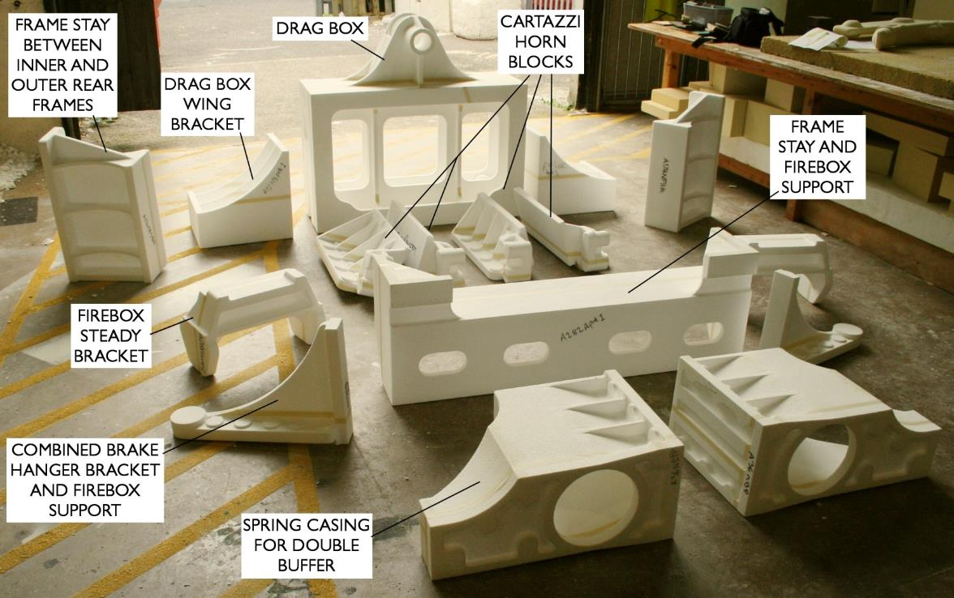
Polystyrene patterns for frame castings – castings completed
Frames
Notes:
Feasibility study
Business plan
Organisational structure
Sponsor dialogue
Frame plates ordered
Establishing P2SLC
Launch of The Founders Club
Prince of Wales name announced
First component made

Slide 47
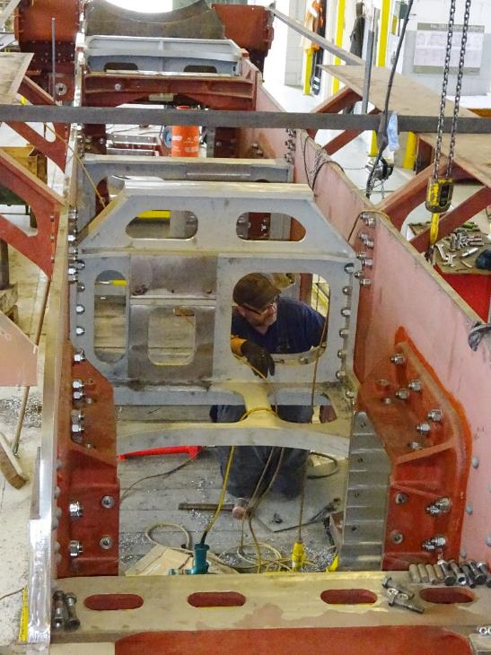
Frame progress
The most of the major frame stays and all the hornblocks are in

Slide 48
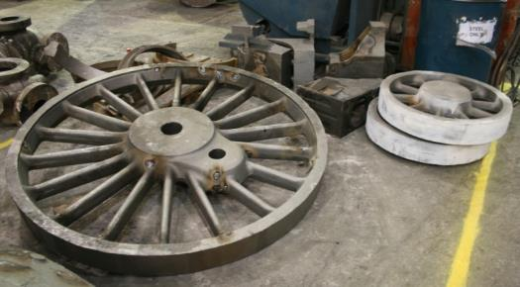
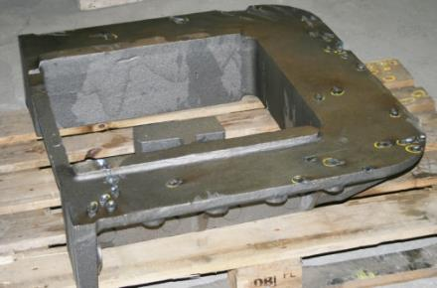
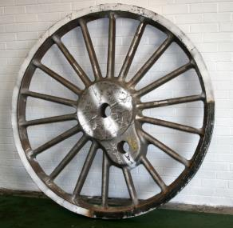




Some of the 66 steel castings made so far.....
Frames and wheels
Notes:
Feasibility study
Business plan
Organisational structure
Sponsor dialogue
Frame plates ordered
Establishing P2SLC
Launch of The Founders Club
Prince of Wales name announced
First component made

Slide 49
Cylinders
Cylinders & valves
P2 cylinders were 2in wider overall than A1 cylinders
Modern track has reduced clearance between rails and platforms
No. 2007 must be no wider than Tornado to retain route clearance
250psi boiler permits reduction in cylinder diameter to 19¾in to maintain tractive effort
Use of improved design will enable No. 2007 cylinders to be no wider than those on Tornado and have superior thermodynamic performance

Slide 50

Monobloc cylinders re-designed as welded fabrication
Cylinders & valves
Main structure from steel plate and machined steel profiles
Valve chests and exhaust passages as steel castings
Steam chests and cylinders from steel tube

Slide 51
Valve gear
Cylinders & valves
No. 2001 was equipped with Lentz rotary cam poppet valve gear
Originally with continuously variable cut-off
Modified to stepped cams providing limited cut off settings following excessive wear on original cams
Resulted in reduction in economy due to wide steps in cut-off and continued problems with high wear rate
Investigations pointing to improved version of Lentz gear using the 1940s developments by Franklin in the USA
Lentz/Franklin gear to be basis for 2007

Slide 52

Shortage of original P2 Lentz valve gear drawings
Cylinders and valves
South African 15E class similar in size and built in 1934/5 with Lentz valves

Slide 53
Copies obtained of 15E valve gear
Cylinders and valves

Slide 54

Franklin development of Lentz gear with infinitely variable cams
Cylinders and valves

Slide 55

Franklin drawings lent by Charles Smith
Cylinders and valves

Slide 56
Wheels, axles and bearings
Wheelsets
All wheel castings completed for engine and tender
Roller bearings for engine and tender delivered (mostly!)
Tyres delivered
Axles due for delivery imminently
Axle and cannon boxes in process of machining

Slide 57



From 3D model to casting
Wheels
Notes:
Feasibility study
Business plan
Organisational structure
Sponsor dialogue
Frame plates ordered
Establishing P2SLC
Launch of The Founders Club
Prince of Wales name announced
First component made

Slide 58

Axle and cannon box castings
Wheels

Slide 59


Axles
Wheels
Pony truck and cartazzi axles
Crank axle web

Slide 60
Boiler design
Boiler
Use of diagram 118A Tornado boiler with detailed modifications to improve overhaul life
Interchangeable with Tornado boiler
Tornado boiler is 17in shorter than P2 boiler – smoke box will be extended within cladding
250psi retained to improve economy and increase maximum power

Slide 61


Boiler life improvement - forged foundation ring corners
Boiler
Original design machined from solid plate
New design as forging with extended ends and height to facilitate replacement on existing boiler

Slide 62

Smokebox sponsored by the Gresley Society
Smokebox

Slide 63


Smokebox door
Smokebox

Slide 64



Smokebox door pressed from CorTen steel
Smokebox

Slide 65


Smokebox door frame machined from slab
Smokebox

Slide 66


Chimney pattern and casting delivered
Smokebox

Slide 67


Cab 3D model
Cab

Slide 68

Cab kit laser profiled and CNC rolled
Smokebox

Slide 69

Cab
The roof is trial assembled on a specially made cradle.

Slide 70

Cab
Then the sides and spectacle plates are trial fitted.

Slide 71

Cab
…. and the cab trial fitted to the frames.

Slide 72

Cab
The cab is dismantled, all parts grit blasted and primed, and permanent riveting of the roof is underway using our specially made rivet squeezer.

Slide 73


Cab
The beading on the back edges of the cab is made from 2” x 1” rectangular bar turned to round to make 2” half round beading.

Slide 74


Cab
Beads are fitted to cab sides using recessed bolts which are welded over afterwards.
Beading is formed by blacksmithing and a large amount of propane gas!

Slide 75

Cab
The cab is refitted to the frames to check that it is in gauge – it is!

Slide 76

Cab
The air brake equipment cubicle is fitted to the lower sides of the cab.

Slide 77

Smokebox
Thanks to generous sponsorship from The Gresley Society Trust the smokebox has taken form starting with the a kit of parts which are profiled and rolled from CorTen steel to improve corrosion resistance.

Slide 78


Smokebox
Mick Robinson cuts, prepares and tacks together the smokebox barrel and door frame, then a coded welder welds the seams.

Slide 79


Smokebox
The anti-vacuum valve and superheater covers are made and fitted, door hinges and fittings are mounted enabling a trial fit of the smokebox on a temporary frame stay.

Slide 80


Smokebox
Beading for the smoke lifting plates is formed and the lifting plate joint strip made and fitted.

Slide 81

Smokebox
The smoke lifting plates are trial fitted to the smokebox.

Slide 82

Where we are now

Slide 83
Finding £5m - fundraising initiatives
Raising the money
The Founders Club
Regular donations by Covenant
Sponsoring a component by Dedicated Donation
Commercial sponsorship
The Boiler Club
The Mikado Club
Loan finance
Legacies
Grants
£1m spent to date
Over £2.2m committed by supporters

Slide 84
And finally…
Questions and answers
For more information on 2007 Prince of Wales please visit
www.p2steam.com
Thank you !

