Slide 1
AST CONFERENCE 9th Oct 2016
JOY’S MOTION
FOR
NEW BUILD LNWR ‘GEORGE V’
Terry McMenamin
George the Fifth Steam Locomotive Trust

Slide 2
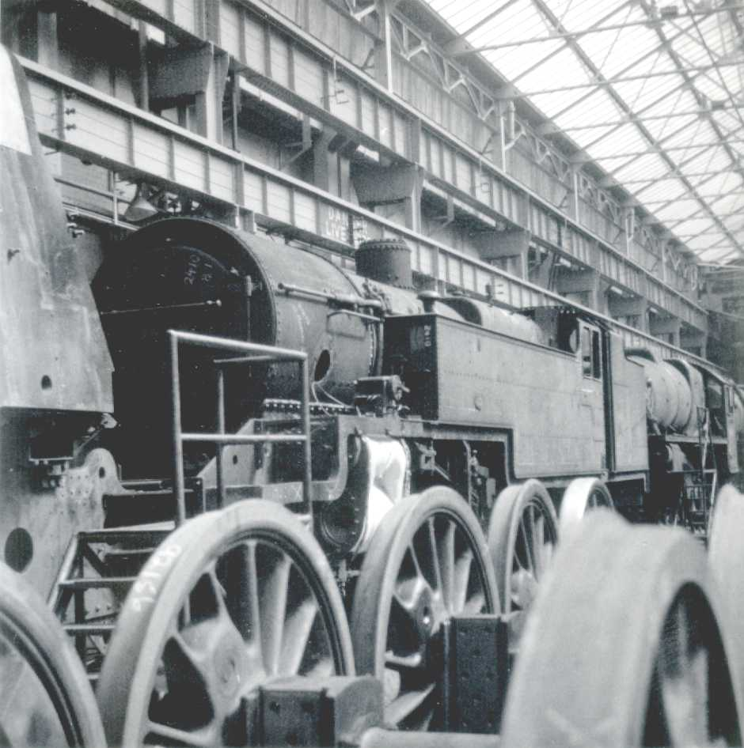
WHEN I WAS A LAD

Slide 3
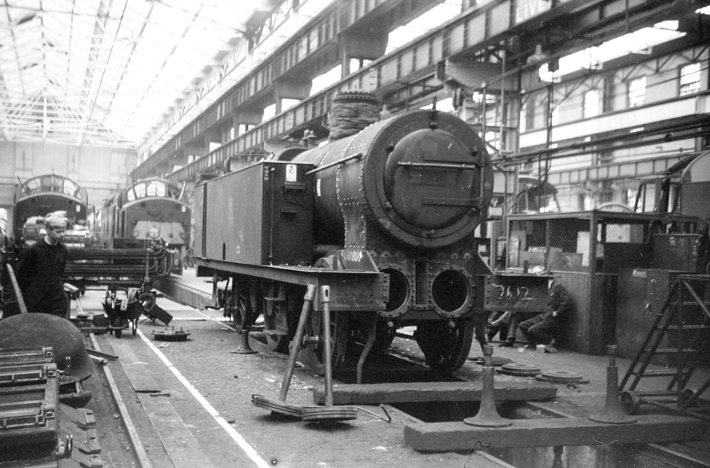
WHEN I WAS A LAD

Slide 4
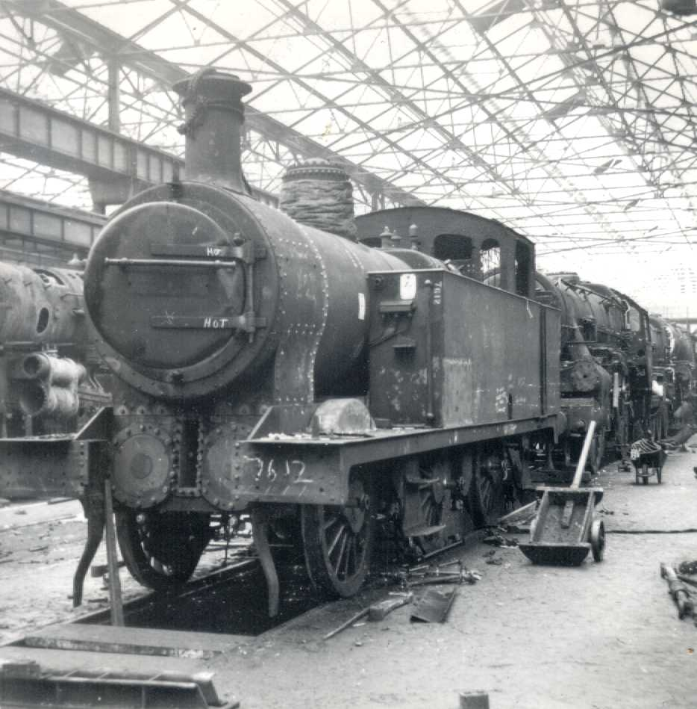
WHEN I WAS A LAD

Slide 5
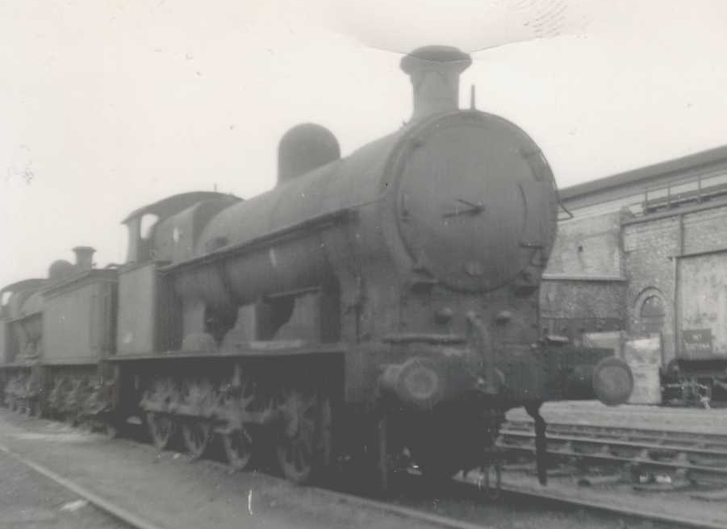
WHEN I WAS A LAD

Slide 6
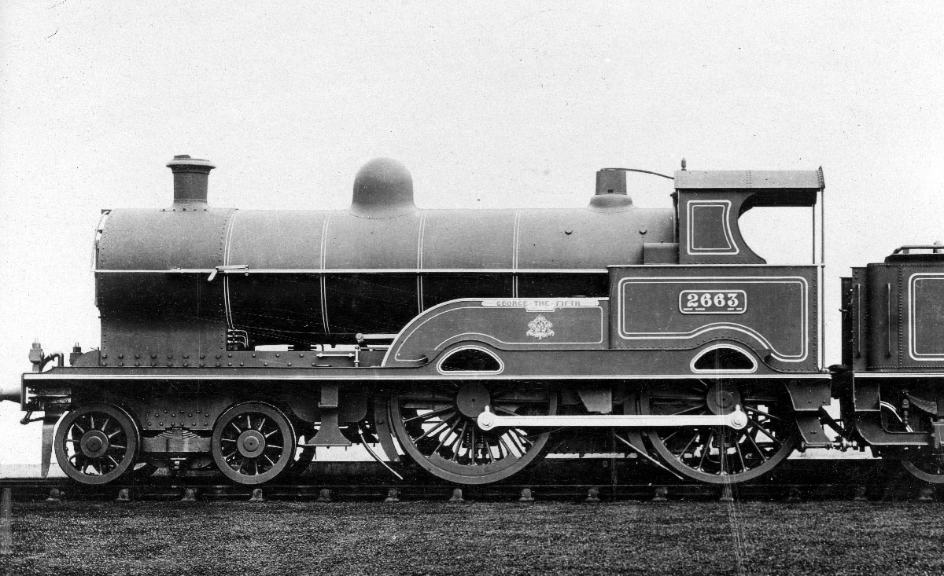
WHY BUILD A NEW LNWR GEORGE V?
A 60 ton 4-4-0, so a reasonable project
Performance, 400 tons to Liverpool in 3½ hours
A big omission from the heritage scene
Great appearance!

Slide 7
LNWR GEORGE V
The Downside
  Design standards
  Ergonomic cab (NOT!)
  Adhesion & consequent limited earning power
  Joy’s Motion & fractured con rods
Beating the Downside
  Design to modern standards for NR operation
  Increase Pressure, Improve steam circuit
  Increase axleload on driving axles
  Modern sanders
  Joy’s Motion redesign from scratch

Slide 8
DAVID JOY
b1825, his father Oil Seed Mill Manager
Joy more interested in the New Railways:-
  Possibly responsible for Jenny Lind?
  Railways Nott’m & Grantham, OWW
  Marine Engines, Bridge Building
  Prolific inventor
Valve Gear
  Patent 1879
  Paper at Barrow 1880
  Included in Webb’s Cauliflower of 1880
  Widely used by LNWR & LYR, less elsewhere
Joy’s Diaries on the web, very enlightening!

Slide 9
JOY’S MOTION
Earliest description found: D K Clark’s 1890
Steam Engines: a Treatise Vol 4 (Google Books)
  Quotes Joy’s detailed directions
  Very exact but vague
  Valve rod level, well, maybe up to 1 in 13 slope
  Don’t worry if the angle is more!
Maybe not so useful!

Slide 10
JOY’S MOTION
Simulation (limited)
http://www.billp.org/Dockstader/ValveGear.html
File 10H – Inside Admission (direct motion)
File 10M for outside admission

Slide 11
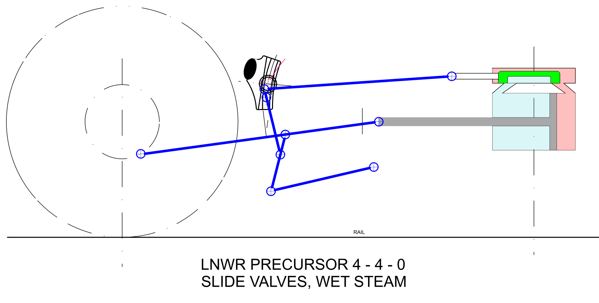
TRADITIONAL CREWE LAYOUT

Slide 12
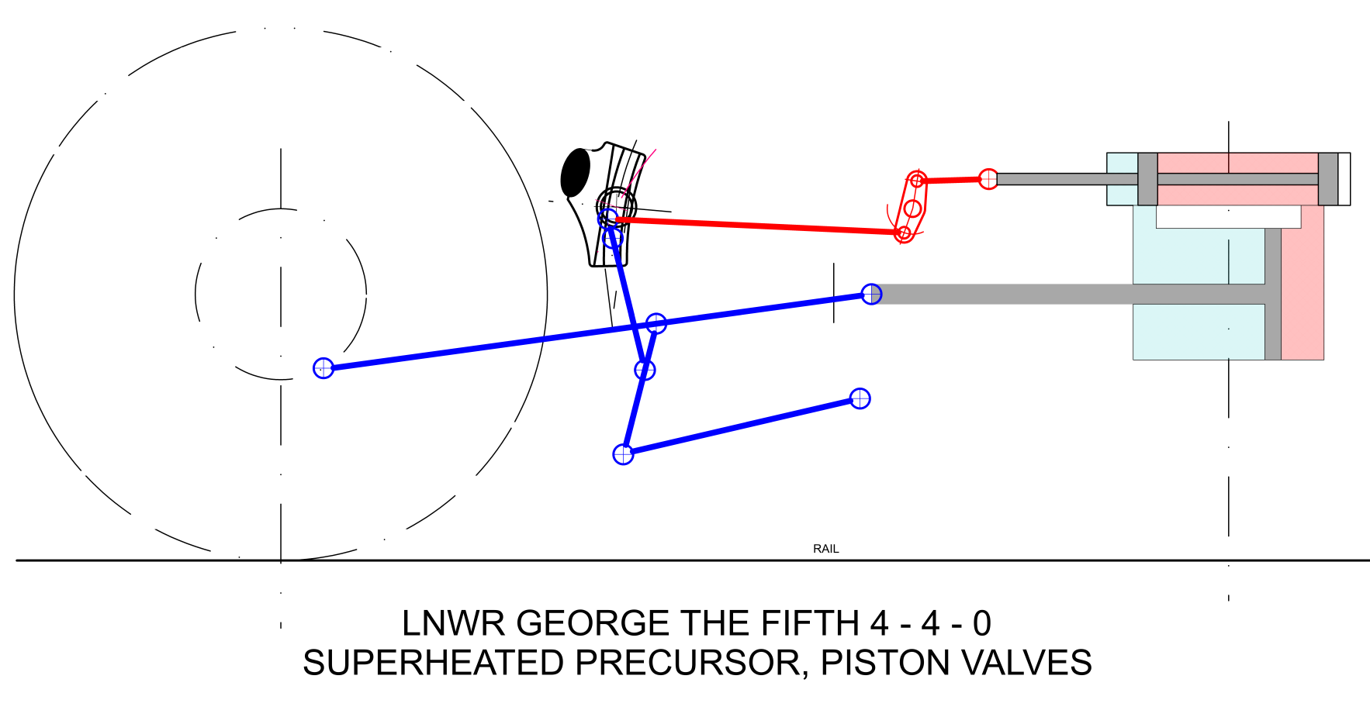
CREWE QUICK FIX FOR PISTON VALVES

Slide 13
CREWE’S SQUASHED VERSION FOR THE 4-6-0 PRINCE OF WALES

Slide 14
CREWE’S LATER DIRECT MOTION FOR THE 4-6-0 PRINCE OF WALES

Slide 15
OBVIOUS SNAGS
Maybe 40-50 kg on con rod middle pivot
Weigh shaft fixed, crank axle moves in horns
Design for new condition, not for worn tyres
lifting link reaches ~45° to weigh shaft guides
Two-part links:
  Jack link fits outside con rod
  Lifting link fits outside jack link
  Die blocks fit outside lifting link
  Guides need to be well separated

Slide 16
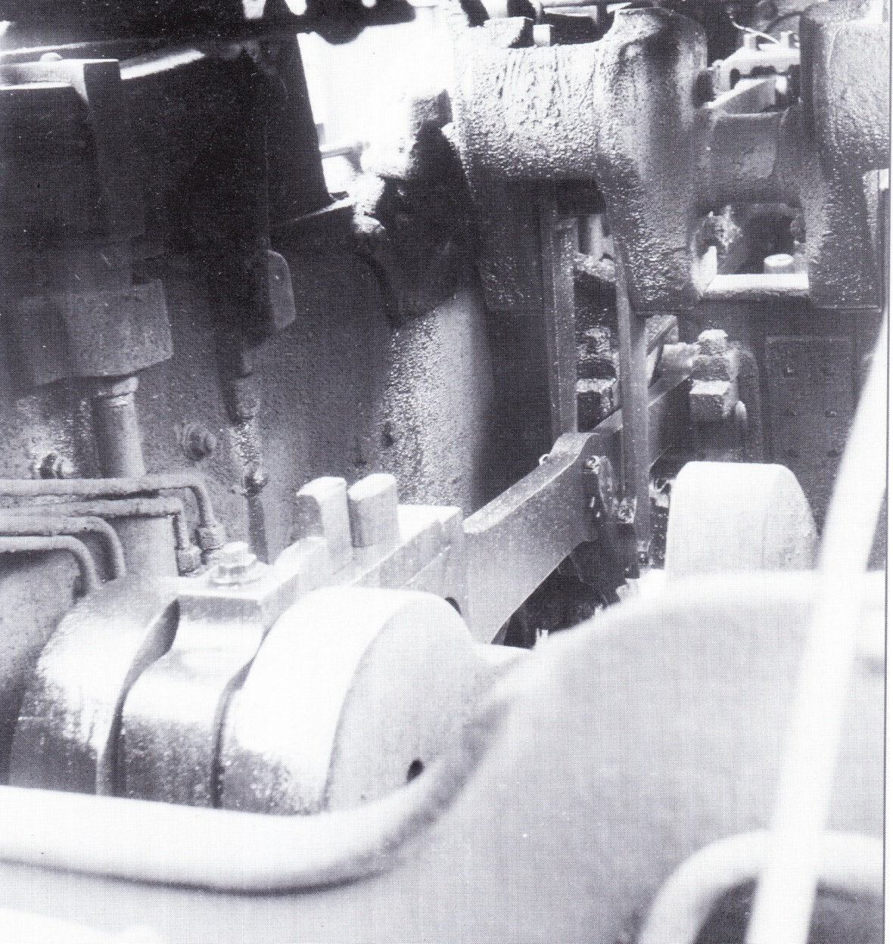
OBVIOUS SNAGS
Talbot: LNWR 8-Coupled Goods Engines

Slide 17
HOW DID IT GO?
Very Well – for a few years
  Inevitable wear on heavy duties
  As with the Precursor turn it into a 4 -6- 0
  Prince layout rather poor, never such good locos
Post war con rod failures
Two Accident Reports affecting the Princes:
  Cheadle Hulme 1922
  Betley Road 1923
  Failures:
    7/year 1907-13, incl 4 boiler penetrations
    19 con rod fractures/year 1920 & 21 (all LNW?)
    14 fractures first half 1923 incl. 4 boiler penetrations
    May 1922-May 23: 80 flawed con rods at Crewe

Slide 18
ROOT CAUSES OF FAILURES
Lack of design calculation capacity:
  Drawing Office model of motion for valve events
  No idea of forces
  Couldn’t measure service accelerations & stresses
Lubrication
  Oil injection to steam
  Lubricant formulation poorly developed
Steel:
  LNWR Class C: UTS ≥34ton/in² yield ≥17ton/in²
  Process: ~6 reheats, no temperature instruments

Slide 19
ROOT CAUSES OF FAILURES
Maintenance & Overhaul:
  Repeated smithing of rods – increased C & S
  Frequent annealing - temperature control?
  Inspection with a rape oil lamp (still about in 1962!)
  Horn distances long on LHS, short on RHS
  Apparent dismantling for misdiagnosed knocking
Driving – Coasting in full gear & steam shut off:
  Valve and cylinder lubrication stops
  Admits air to oxidise oil & chill valves & cylinders
  Dynamic forces maximised (Experiment @93.5 mph!)

Slide 20
1920’s CORRECTIVE ACTIONS
Con rod inspection on bench at 10,000 miles
New design con rods
Datum system to control horn distances
Above applied to Princes, probably Georges too
But:
  Hughes orders removal of centre bearing & frame
  Cox quotes for 1930, for 246 Princes in service:
    117 driving axle hot boxes (1920: 1/162k loco miles)
    34 intermediate and trailing axle hot boxes
    50% have frames welded
Did Hughes get it wrong?
It was all over for the Precursor family

Slide 21
JOY’S MOTION FOR NEW ‘GEORGE’
Design Calculations MS Excel:
  Parameter search @ 10° crank angle increments
  Direct motion weigh shaft angle limits valve travel
  Greenly straight slides unbalanced front to back
  Keep valve rod as near level as possible
  Other factors not so significant
  The George as-built is quite good for Joy’s motion
  Valve travel was 5½”; 6¼” OK with rocking link multiplier
  Force calculations – internal plus track impact
Options: inclined cylinders, direct/indirect motion included
Developing still

Slide 22
JOY’S MOTION FOR NEW ‘GEORGE’
Lightweight Piston Valve - Porta/Wardale
Steel En16: Yield ≥44ton/in²: (Cl C UTS 34ton/in²)
Minimise mass of each item
Low friction low mass bearings
Roller slides for weigh shaft and PV spindle
Preserve worn condition performance

Slide 23
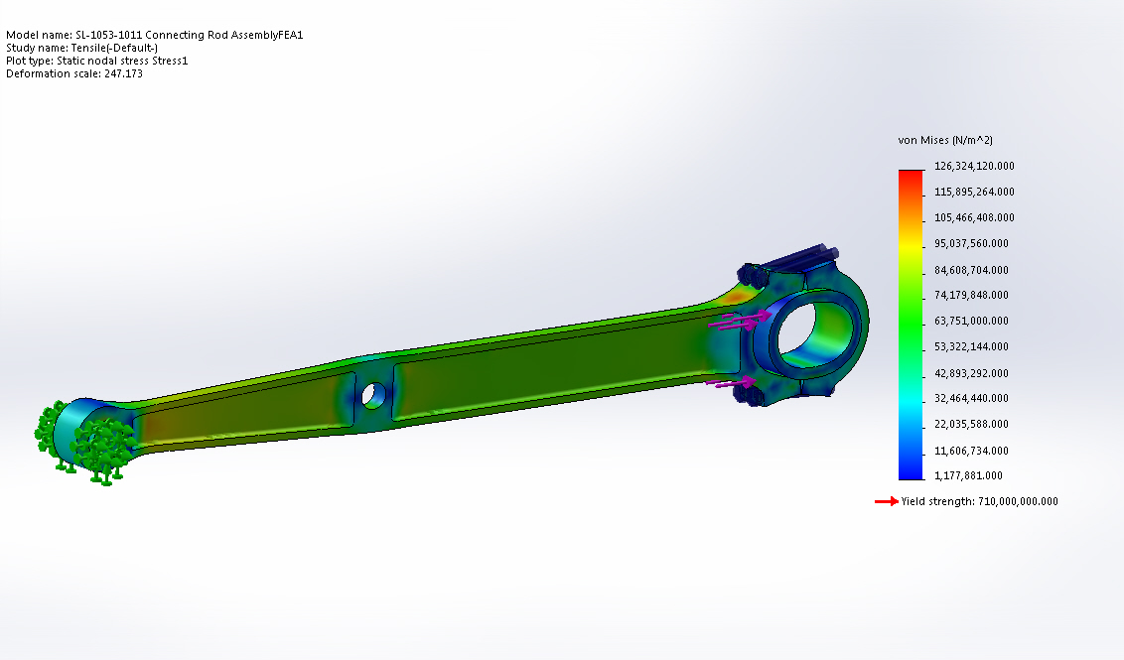
JOY’S MOTION FOR NEW ‘GEORGE’
Possible con rod option (Jamie Keyte)

Slide 24
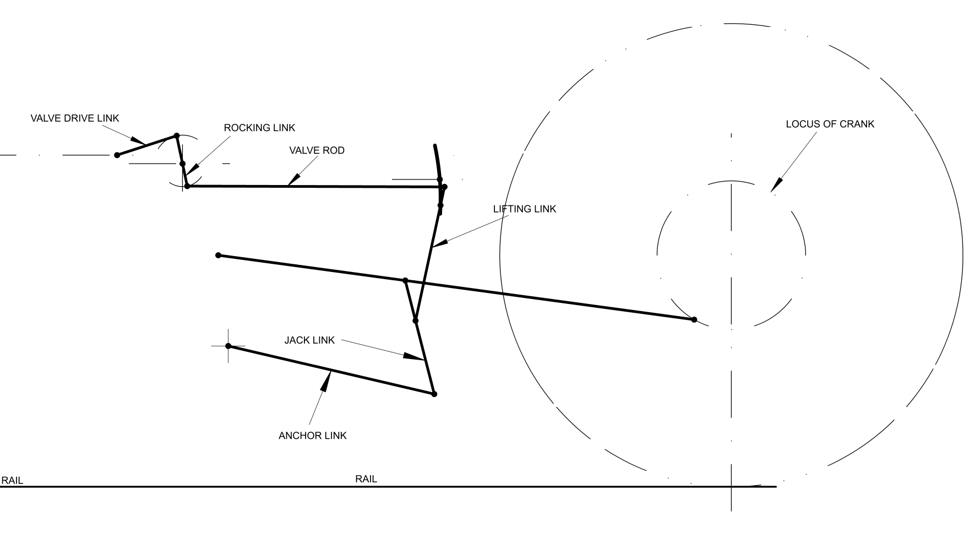
PROPOSED LAYOUT FOR NEW ‘GEORGE’

Slide 25
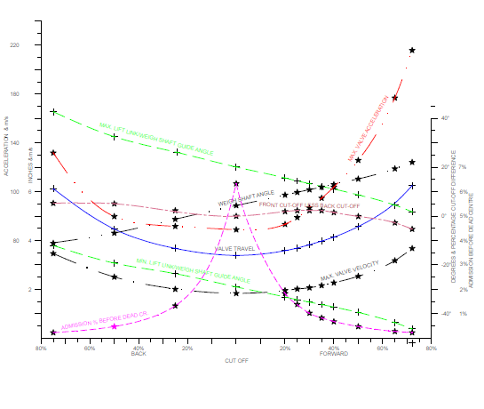
GRAPH OF EVENTS ‘GEORGE’

Slide 26
THE FUTURE
Need to proceed with the rest of the loco
May require changes
Detail Design will be challenging

Slide 27
JOY’S MOTION
FOR
NEW BUILD LNWR ‘GEORGE V’
ROLL ON THE NEXT INSTALMENT!
THANK YOU FOR LISTENING

